Slide 1

Long-Range Transportation Plan
PARA Grant Application
Cochise County Board of Supervisors
July 10, 2010

Slide 2
PARA GRANTS
Planning Assistance for Rural Areas
2012-2013 Federal Fiscal Year
Grant Applications Due on July 23rd
Letters of Support provided by Safford District and SEAGO

Slide 3
Cochise County 2040 Long-Range Transportation Infrastructure Plan
TABLE OF CONTENTS
Acronyms
Introduction & Location
Long-Range Strategic Planning
Transportation Infrastructure Plan Development
Demographic Profile and Projected Growth
Completed 2005-2010 Projects
Transportation Needs & Challenges
Transportation Finance
2040 LRTP Recommendations
  Roadway System
  Transit System
  Bikeway System
  Pedestrian System
  Aviation & Railroad Systems
Performance Assessment
Next Steps and Future Trends
Sources for Additional Information
Acknowledgements
Appendices I - Right of Way Needs Report
Appendices II - 2040 Proposed Project List
Appendices III – 2040 Reserve Project List
Notes:
This is not really a presentation on the long-range plan but this is the outline for the preliminary draft we have put together in-house. We have this to about a 85 percent completion stage and both Benny Young and Carlos de la Torre provided input into its development. It is now at a stage where there are just a few areas where technical assistance to complete this plan would be very helpful.

Slide 4
QRS II Model Projections
Population Employment
2007 Base Year ~ 137,200 / 40,902
Census 2010 ~ 131,346 /
2020 Projection ~ 169,717 / 57,023
2040 Projection ~ 231,851 / 83,600
Notes:
2007 was used to calibrate to real data: we will weave the Census 2010 data into the dataset as well as updated traffic counts that we will be receiving this year as part of a SEAGO project. One of the technical elements we are asking for assistance with in this grant is re-calibration of our model with those two new inputs.
__________
Growth in our County is inevitable. Long-range projections smooth out the typically cyclical growth patterns; however, our County is beginning to see surges within it own internal natural growth cycle. Average around 8-10 babies a day in our County. By 2040…those children will be having families of their own and it doesn’t take too many babies and we have our 231,000 residents all wanting to go somewhere on our county roadway system.
2020- 2.3 pphh
2040- 2.4 pphh
2009 – 140,263

Slide 5
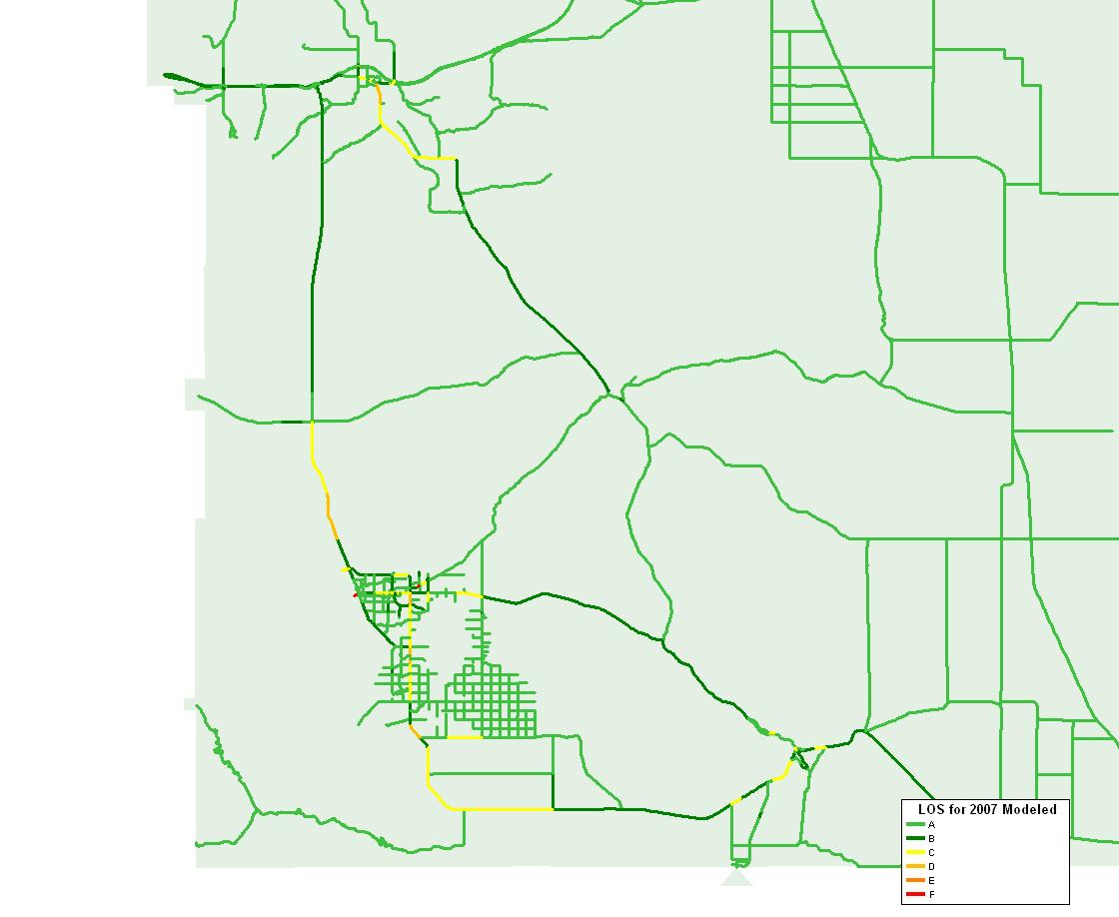
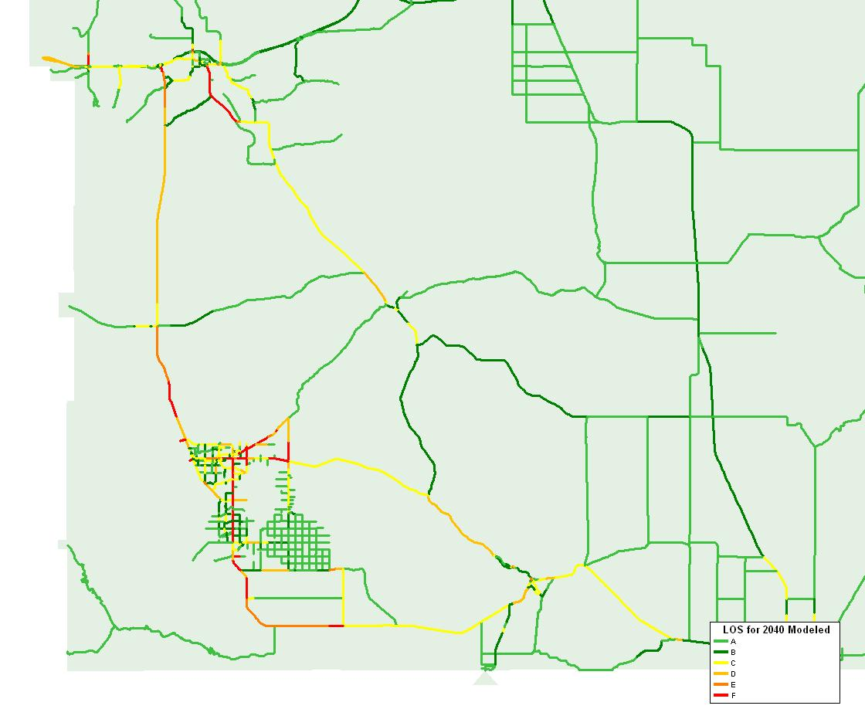
County-Wide LOS Model Run
Notes:
What this is showing us is the No-Build Level of Service Model Run for 2007/Base Year and 2040 County-Wide. As you might guess…orange and red indicate areas of concern based on projected traffic.
Now this is a great map for me to work but not as good of a map to take out to the public to describe what we think will happen over time. Another technical element we will ask for assistance with is mapping the existing conditions and future scenarios.
______
4 step model: Basically tracking how people are moving: where are they going and where are they coming from. Also, what route are they likely to take, what mode will they use and how will they respond to changing conditions, like congestion on any given route. Minimum path is not distance – it is time.

Slide 6
Cost Estimate Assumptions
2009-2018 Needed Roadway Expenditures Arizona Association of County Engineers
Operations & Maintenance | $235,247,000
Existing Bridge Repairs/Maintenance | $7,919,000
New Bridges on Existing Roads | $5,238,000
Upgrade Existing Roads | $199,102,000
New Road Construction | $1,308,000
Safety Improvements | $35,199,000
TOTAL | $387,189,000
Notes:
In preparing a long-range plan you look at cost estimates for needed projects. We have tables like this, developed average costs for roadway improvements, made revenue assumptions and from there you can have an idea of what the funding gap is for meeting needs. Right now I have a sentence in the long-range plan that says: total system needs through the year 2040 have been estimated at….a zillion dollars.
The third major element we will be asking for in this grant is for technical assistance to verify our assumptions for costs, future revenues and what a future funding package might look like.

Slide 7
Technical Assistance Request
Re-Calibrate the Model
Provide Mapping Services
Verify Cost Estimates Assumptions
Conceptual Corridors
Alternative Mode Assessment
Public Outreach Services
Final Document Preparation
Presentation Graphics

Slide 8
Resolution of Support
Indicates support for the application; not the plan
No Match Required
Grants awarded Fall 2012
Notes:
The long-range plan will be completed with or without this grant; we are bringing this application forward because it is an opportunity to obtain, at no cost to the County beyond staff participation, specialized technical assistance to finish the plan. During the next year and half it is expected that the Board will have as many opportunities as you desire to look at the idea presented, to refine those ideas and before the plan is adopted to prioritize the project, polices and strategies.

