Slide 1

Docket CP-12-01/Z-12-05 (Martin)
Board of Supervisors
August 28, 2012

Slide 2
Docket CP-12-01/Z-12-05
A request for a Comprehensive Plan amendment from NC to DEV to facilitate rezoning the 6.3 acre subject parcel from TR-36 to GB. The Applicant is Bill Martin of Madera Realty.
Unspecified commercial use.
The property is located approximately .7-mile north of Mustang Corners in Whetstone, at the corner of SR90 and E. Hamel Rd.
Notes:
Mr. Chairman, Commissioners, this is a request to amend our Comprehensive Plan and rezone a 6-acre property to GB for undetermined commercial use. The property is located ~ 7-tenths of a mile north of Mustang Corners in the Whetstone area.

Slide 3
Growth Category B
Comprehensive
Plan
Growth Category A
Growth Category C
Growth Category D
Plan Designations
Neighborhood
Conservation
Enterprise
Developing
Neighborhood
Rehab
Enterprise
Redevelopment
Rural
Residential
Rural
Zoning Districts

Slide 4
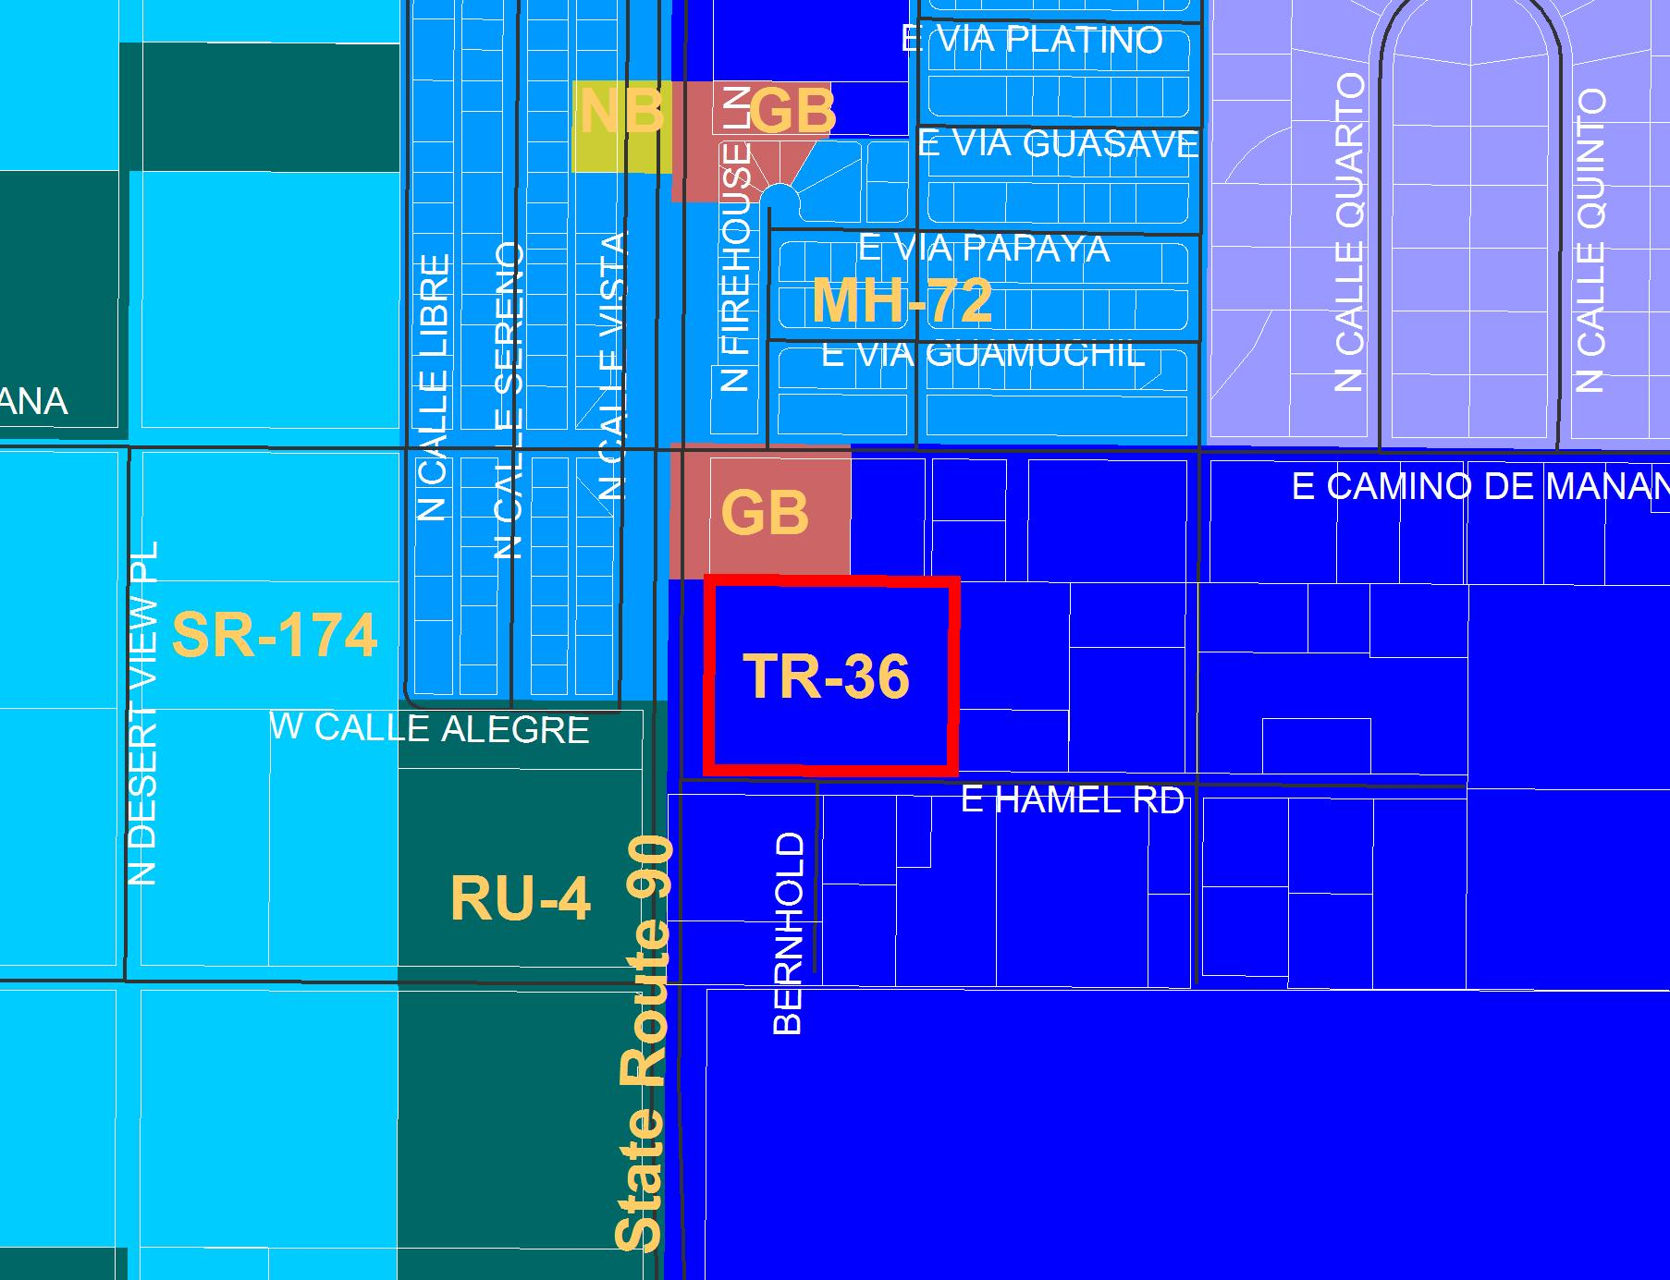
Notes:
This graphic shows the subject parcel outlined in red and the various zoning districts in the area. Much of this area carries residential zoning, but note that there are two properties zoned GB just and one property zoned NB to the north.

Slide 5
Comprehensive Plan Plan Designations
The Comp Plan’s Growth Area Categories and Designations are designed to provide a measure of protection to existing land use character.
Cat B Growth Areas are described as having a moderate level of residential and/or commercial growth.
Serve as a transition between urban and rural areas.
Have adequate water, access, drainage and sewage.
Have Improved streets may support commercial development.
Have substantial potential for further development.
Notes:
The entire area of Cochise County, with the exception of incorporated cities, shall be divided into four (4) categories, based on each area’s existing or foreseeable infrastructure, character and capacity for growth: A,B, C & D
1. Category A -Urban Growth Areas - This category includes those areas adjacent to or surrounded by incorporated cities, and having the necessary facilities and services to support it. These areas are largely built out or established but may have pockets of vacant land.
2. Category B Community Growth Areas - This category includes those areas adjacent to Category A Urban Growth Areas as well as the larger unincorporated communities of the County, which are experiencing growth. These are areas in transition from a traditional rural environment to something more urbanized. Category B Community Growth Areas include the areas presently identified as “Category B” and any additional areas that have been determined to meet the following criteria:
3. Category C -Rural Community Areas – This category includes less populated rural communities that are characterized by a slow rate of growth and the desire to maintain the existing neighborhood or rural atmosphere. These areas are generally found as small clusters of residential and non-residential development adjacent to agricultural production areas.
4. Category D Rural Areas - This category includes the outlying rural areas between cities and unincorporated communities and characterized by a low rate of growth; unimproved roads; low density, large lot rural residential development; agricultural production; and large tracts of undeveloped private and public lands. Non-residential development is geared toward providing local services, tourism or intensive uses that are not appropriate in more the densely populated parts of the County,

Slide 6
Comprehensive Plan
To obtain GB rezoning, a Comp Plan Amendment must first be approved to change the NC (Neighborhood Conservation) designation to DEV (Developing).
The area’s NC designation is a reflection of general residential character; amendments must be justified by specific examples of existing or future growth patterns.
Areas to the west and south are designated DEV.
Precedent for commercial zoning and activity in the general area.
Notes:
PLAN DESIGNATIONS
Within the four Growth Categories, there are seven potential plan designations. These designations more specifically identify the existing character of smaller areas within each Growth Area. Plan Designations represent the broad parameters for delineated land use in the Comprehensive Plan.
This request constitutes a minor Comprehensive Plan Amendment.
The Comp Plan indicates that the creation of new zoning districts must be consistent with the character and intent of the Plan Designation or Growth Area in which the site is located.
Neighborhood Conservation (NC) - A "Neighborhood Conservation" (NC) plan designation identifies an area as having an established character which is primarily residential, and which needs special rezoning protections to maintain the character of land use that occurs, in general, on lot sizes of one acre or less. The NC plan designation may occur within a Growth Category A, B or C Area, and shall be established according to the following criteria:
Developing (DEV) - The “Developing” (DEV) plan designation is used to describe areas experiencing non-rural growth rates that are developed with scattered, mixed residential, business or industrial and agriculture-related uses and that ultimately will accommodate future growth as the more populated areas reach build-out. Since these areas are assumed to be in transition, the Planning Department will periodically re-evaluate these areas to determine if the rate of new development warrants a new designation or growth area that is either more or less intense. The Developing designation may occur in Growth Category A, B, and C Areas that do not meet the criteria of the other designations.

Slide 7
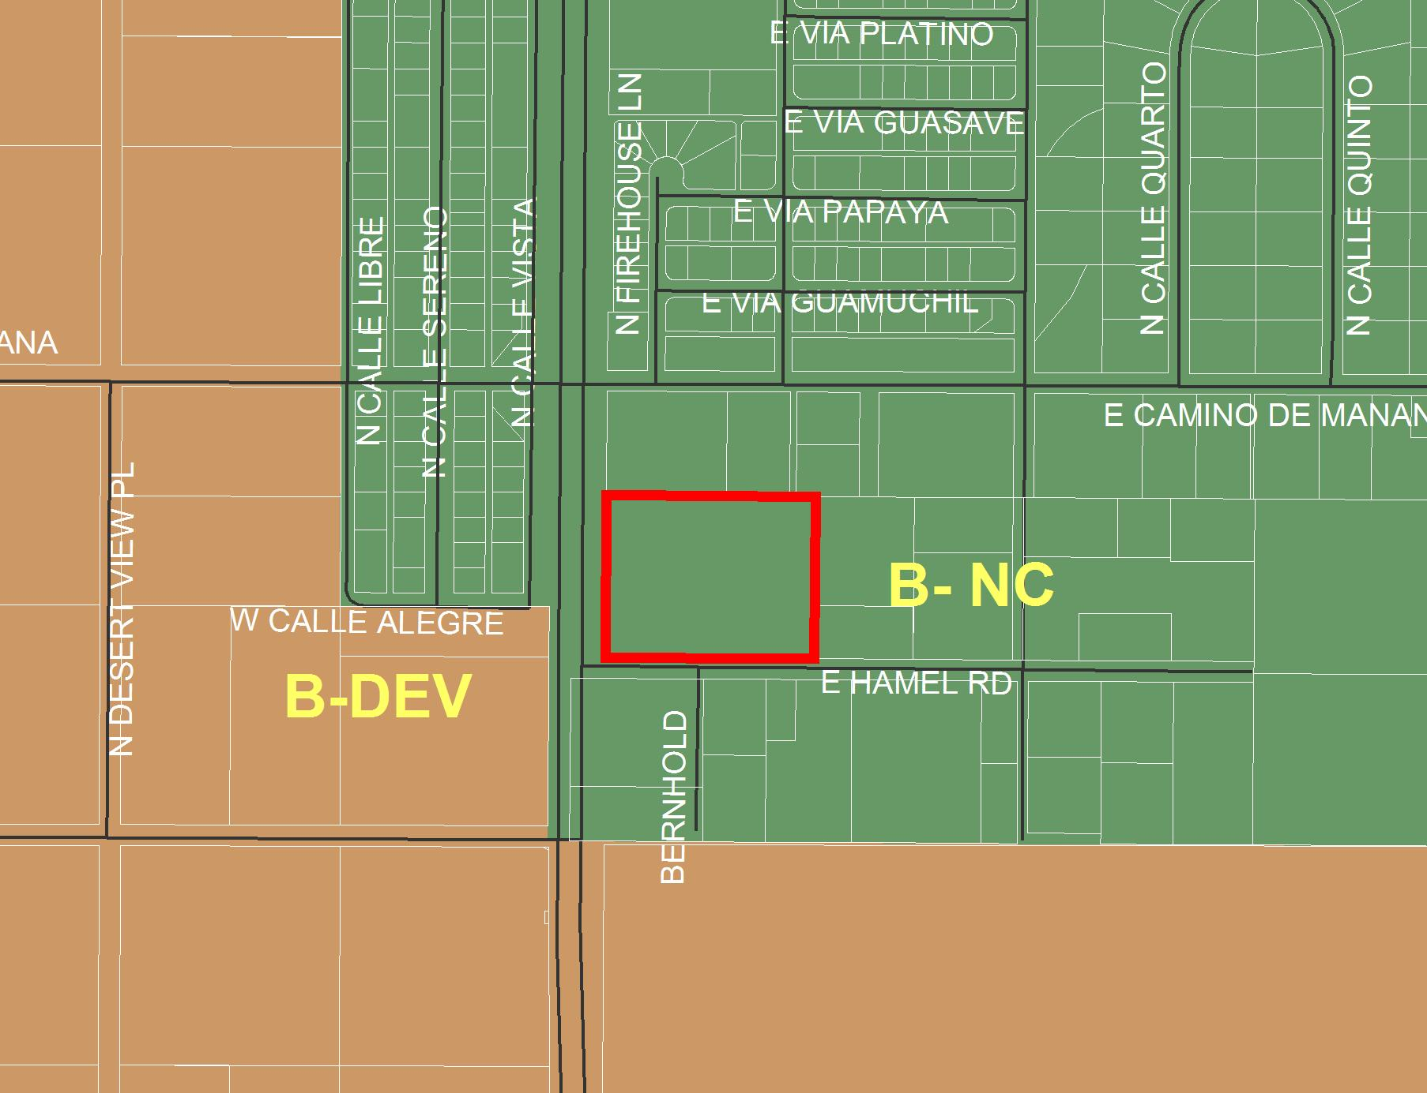
Subject
Parcel

Slide 8
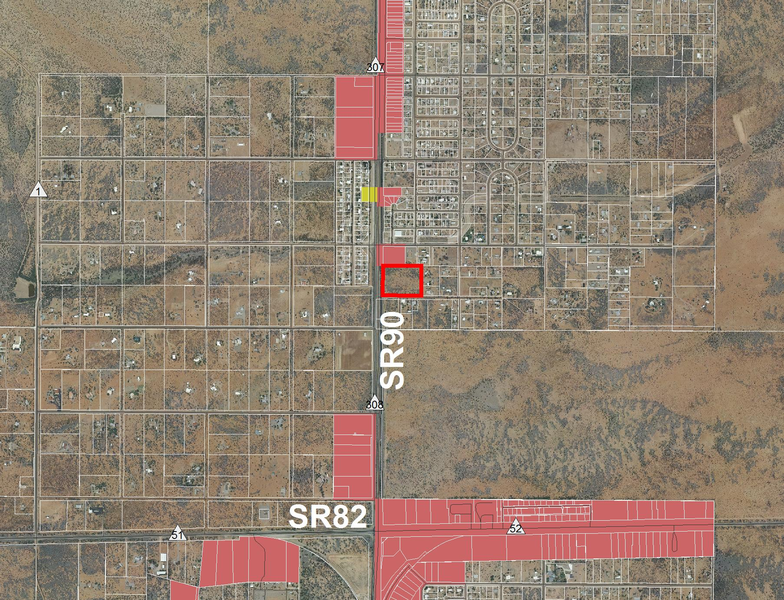
GB
NB
Subject
Parcel
GB
GB
GB

Slide 9
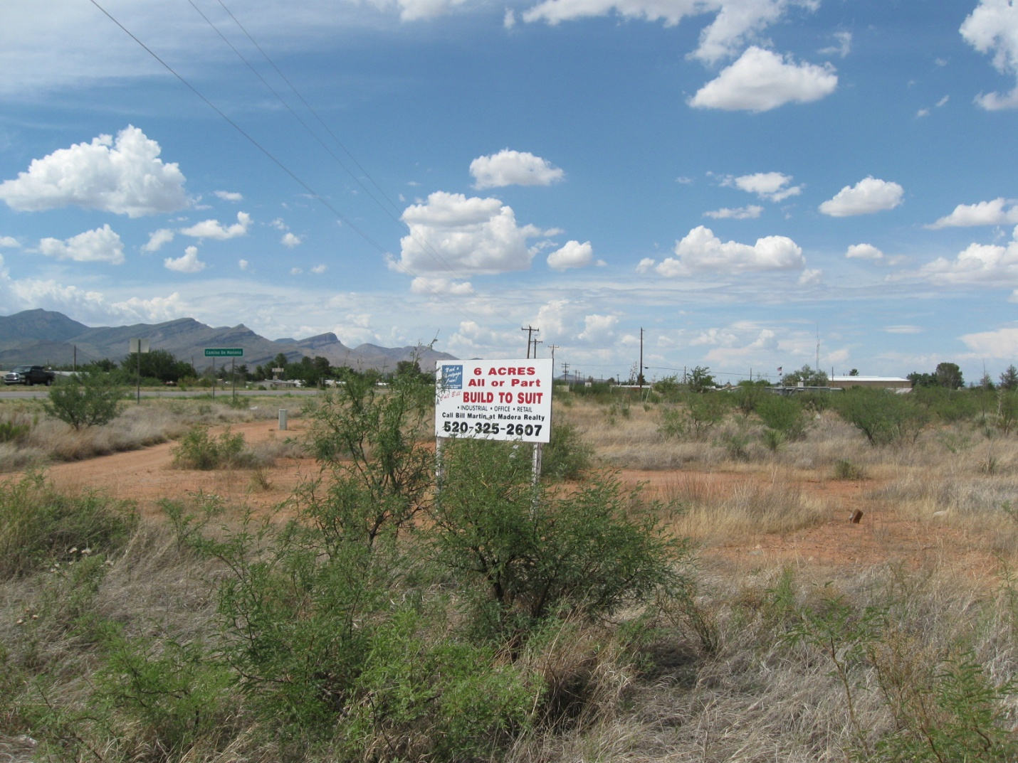
Northward from property

Slide 10
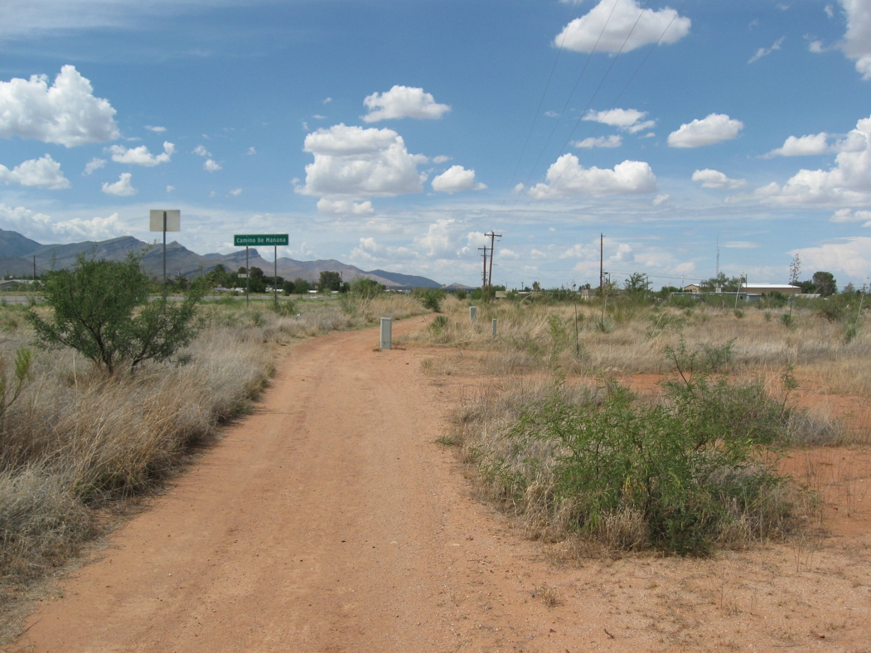

Slide 11
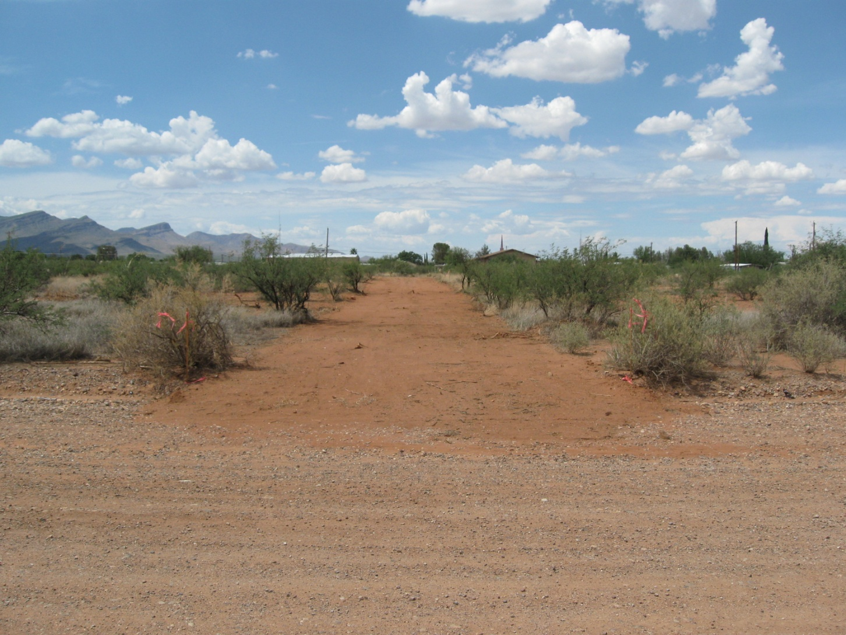
Photos

Slide 12
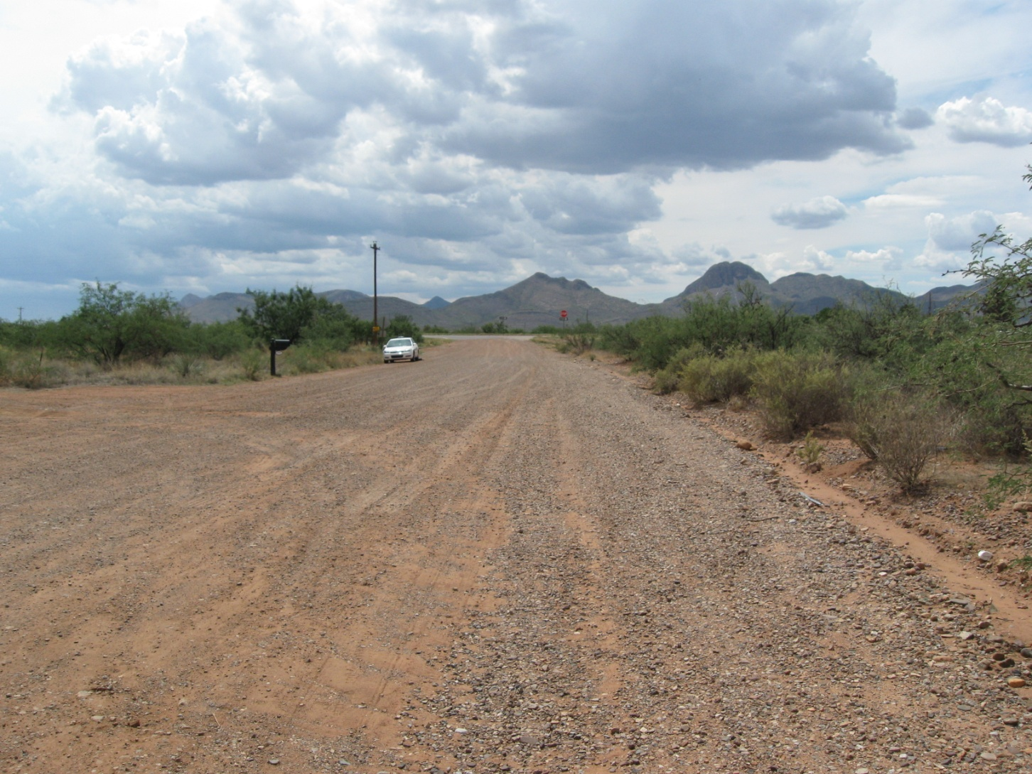
Westward
SR90
Subject Property
E. Hamel

Slide 13
Rezoning Factors
Land Use/Concept Plan – Does not comply
Compliance w/ Site Development Standards - Would likely comply
Adjacent Districts Capable of Development – Complies
Limitation on Non-conforming Uses - Complies
Compatibility with Existing Development – Somewhat complies
Rezoning to More Intense Districts – Somewhat complies
Adequate Services and Infrastructure - Complies
Traffic Circulation/Development Along Major Streets - Complies
Infill – Not applicable
Water Conservation – Not applicable at this time
Public Input - Complies
Hazardous Materials – Not applicable at this time

Slide 14
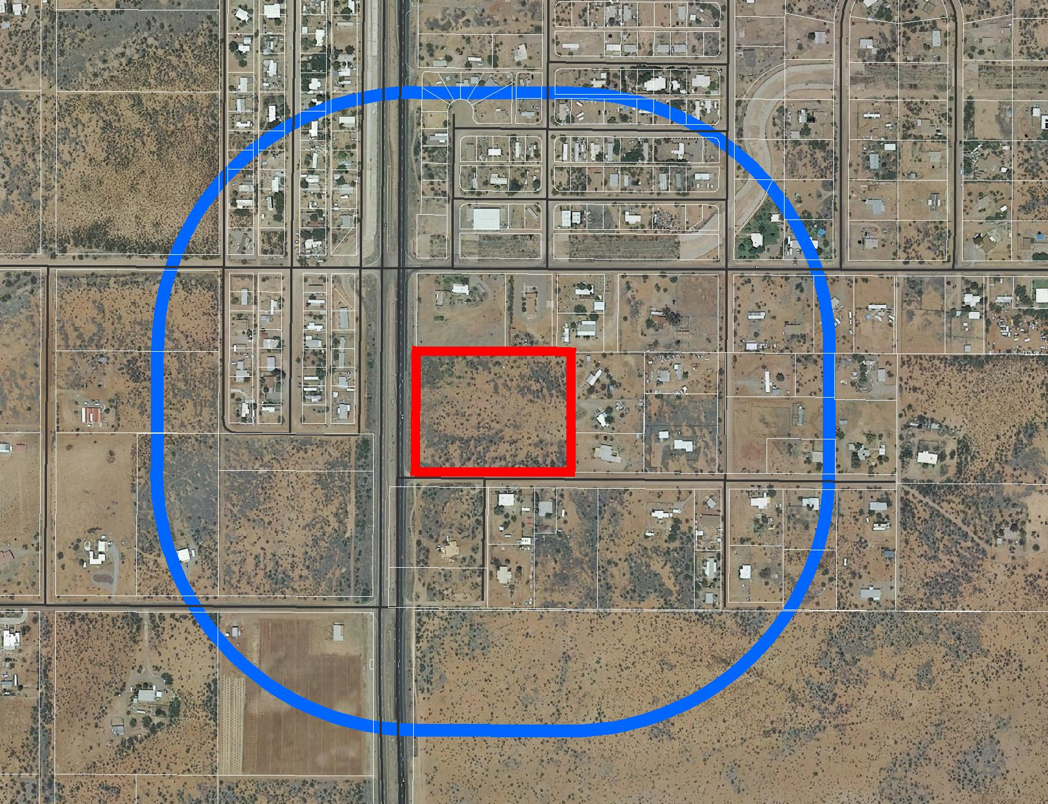
To date the Dept. has received 2 letters of support
and 2 letters of protest within 1,000-ft
Subject
Parcel
Support
Protest

Slide 15
Planning & Zoning Commission Recommendation
The Commission voted unanimously to forward a recommendation of approval to the Board for the requested Comprehensive Plan Amendment change.
However, because of their concern about the uncertainty of future commercial uses, the Commission voted unanimously to forward a recommendation of denial for the rezoning request.

Slide 16
Factors in Favor
Developing (DEV) Plan Designations are located nearby and precedent exists for commercial zoning and activities in the area;
The property lies along a major State Highway, a location appropriate for GB zoning;
There would be no immediate impacts to area residential and rural-residential properties; and
Three letters of support were received.
Notes:
Although a Plan amendment to Developing would not entirely be in keeping with the established, largely residential and rural-residential character of the area, because of the property’s proximity to another GB district and SR 90, and large areas designated Developing to the south and west across SR90, a change to Developing would not be inappropriate.

Slide 17
Factors Against
The subject parcel is in an area designated by the Comprehensive Plan as NC. This designation is intended to protect residential neighborhoods from a proliferation of non-residential uses;
The type of commercial activities which would occur is uncertain, making analysis of potential impacts difficult;
Two letters in opposition were received; and
The Planning and Zoning Commission voted unanimously to approve the requested Comprehensive Plan Amendment, but voted unanimously to deny the rezoning request.

Slide 18
Recommendation
Based on the Factors Favoring Approval, the Department recommends conditional approval. The following condition is recommended:
The Applicant shall provide the County with a signed Acceptance of Conditions and a Waiver of Claims form arising from ARS Section 12-1134 signed by the property owner of the subject property within thirty (30) days of Board of Supervisors’ approval of the Comprehensive Plan Amendment and Rezoning or the approval of the Amendment and Rezoning may be deemed void.
Notes:
Two motions required.

Slide 19
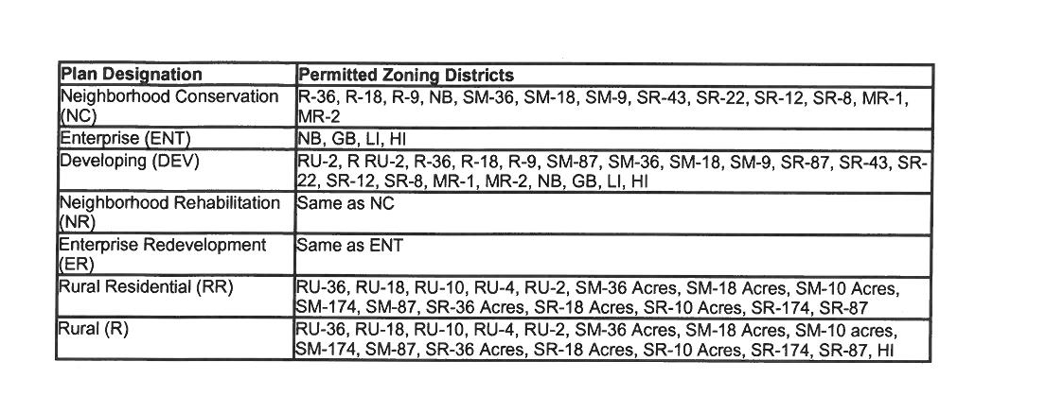
Per Article 4…
Neighborhood
Conservation
Notes:
B. PLAN DESIGNATIONS
Within the four Growth Categories, there are seven potential plan designations. These designations more specifically identify the existing character of smaller areas within each Growth Area. Plan Page 24 of 33
Designations may be established, in addition to those that presently exist, based upon the following criteria: 1. Neighborhood Conservation (NC) - A "Neighborhood Conservation" (NC) plan designation identifies an area as having an established character which is primarily residential, and which needs special rezoning protections to maintain the character of land use that occurs, in general, on lot sizes of one acre or less. The NC plan designation may occur within a Growth Category A, B or C Area, and shall be established according to the following criteria: (a) The area to be designated is a developed residential neighborhood that warrants protection from non-residential uses; or (b) The area is an approved subdivision for which all the improvements are in place and constructed to minimum County standards.
3. Developing (DEV) - The “Developing” (DEV) plan designation is used to describe areas experiencing non-rural growth rates that are developed with scattered, mixed residential, business or industrial and agriculture-related uses and that ultimately will accommodate future growth as the more populated areas reach build-out. Since these areas are assumed to be in transition, the Planning Department will periodically re-evaluate these areas to determine if the rate of new development warrants a new designation or growth area that is either more or less intense. The Developing designation may occur in Growth Category A, B, and C Areas that do not meet the criteria of the other designations.

