Slide 1
Docket Z-12-06 Seitz/Hutson
Request for a Rezoning from RU-4 to Light Industry
Board of Supervisors
September 25, 2012
Notes:
Good afternoo

Slide 2
Docket Z-12-06
Three contiguous parcels (118-05-054; -055; and -056; totaling 12 acres) located at the southwest corner of State Highway 191 and Birch Rd. in the Sunsites area.
An existing 16,000 sq.-ft. metal building on Parcel 056 would be used for the storage and sale of agricultural products.

Slide 3
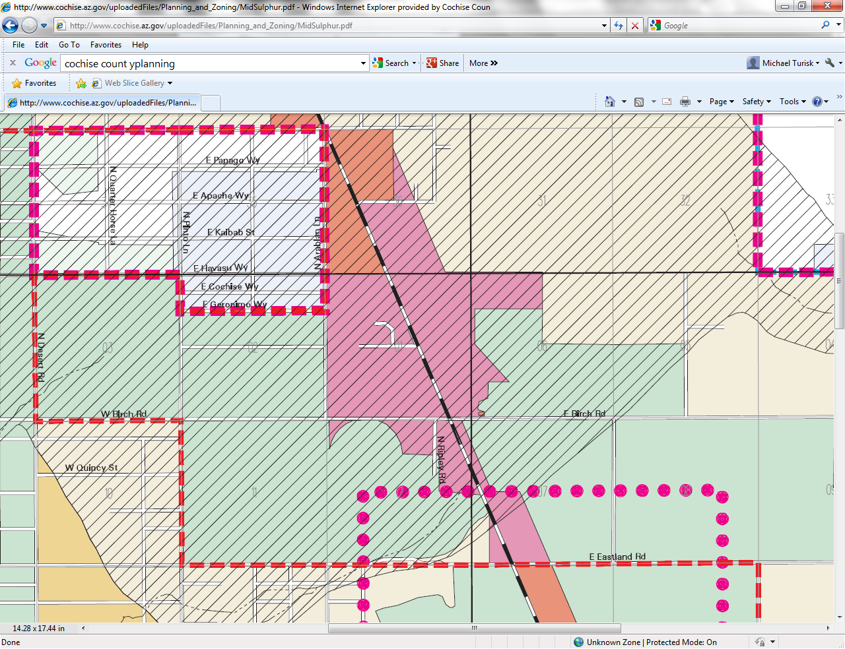
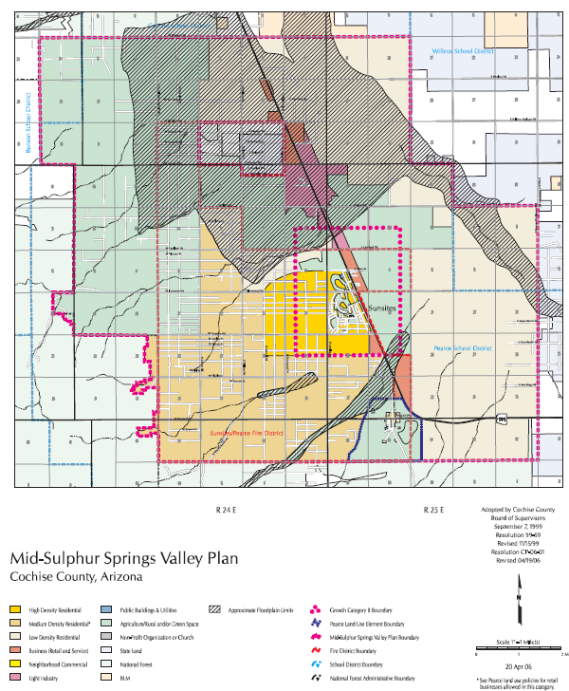
Mid-Sulphur Springs Valley Area Plan
Notes:
The property is within the bounds of the mid sulphur springs valley area plan and in an area designated by the plan as appropriate for LI uses

Slide 4
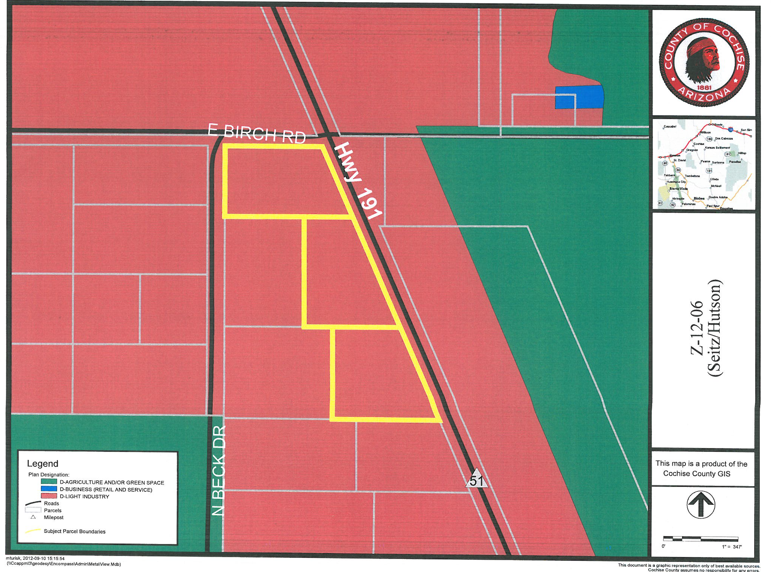
Notes:
The subject parcels are outlined in yellow and the areas shaded in reddish are designated by the Mid sulphur springs area plan as LI

Slide 5
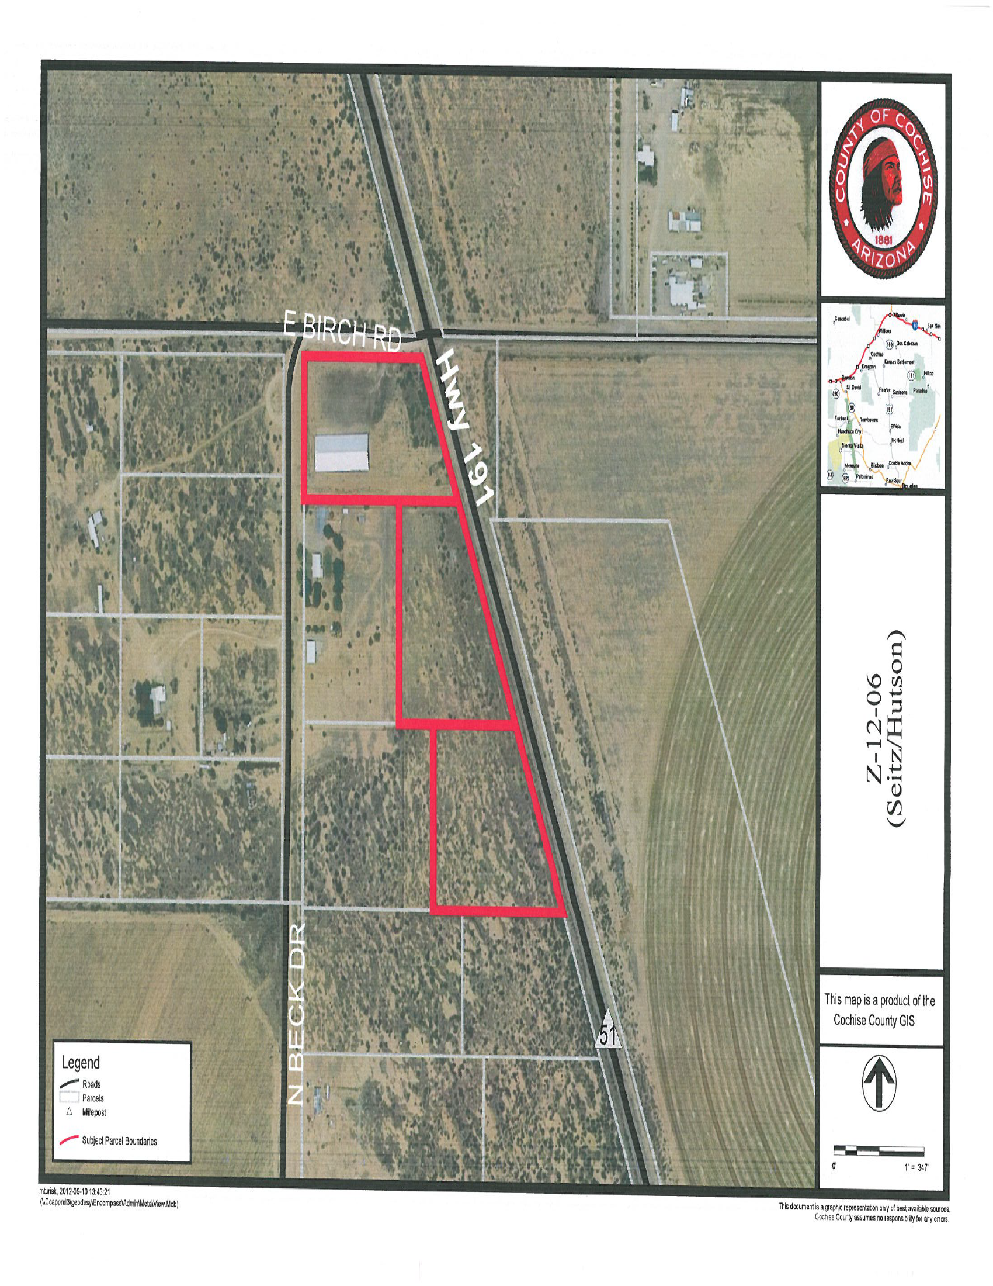
Notes:
The subject parcels are shown here outlined in red. You can see the 16K building that would be used for ag products storage and sale

Slide 6
Setback Modification
For those LI zoning districts which abut Rural zoning, the minimum setback shall be 80 feet.
If rezoned, a modification of this minimum required setback along the south and west property lines would be needed in order to maintain the location of the 16,000 sq.-ft. structure.

Slide 7
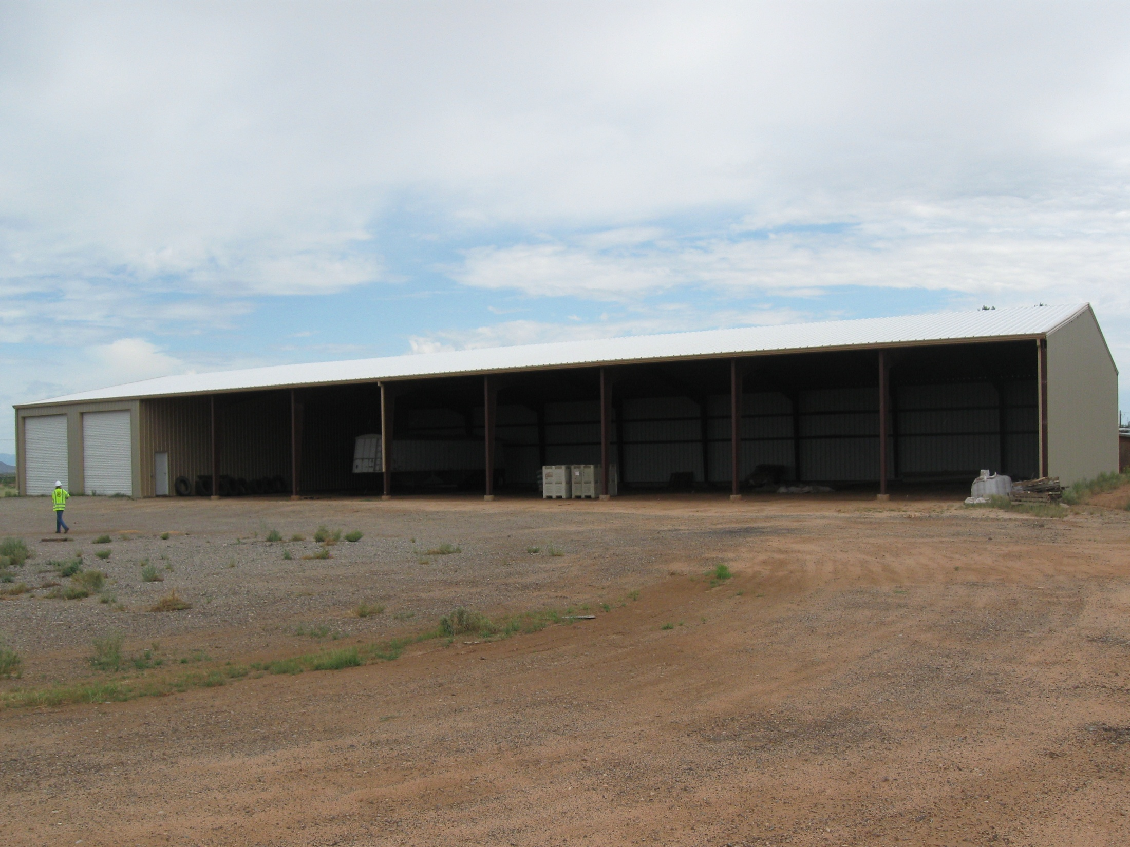
Photos

Slide 8
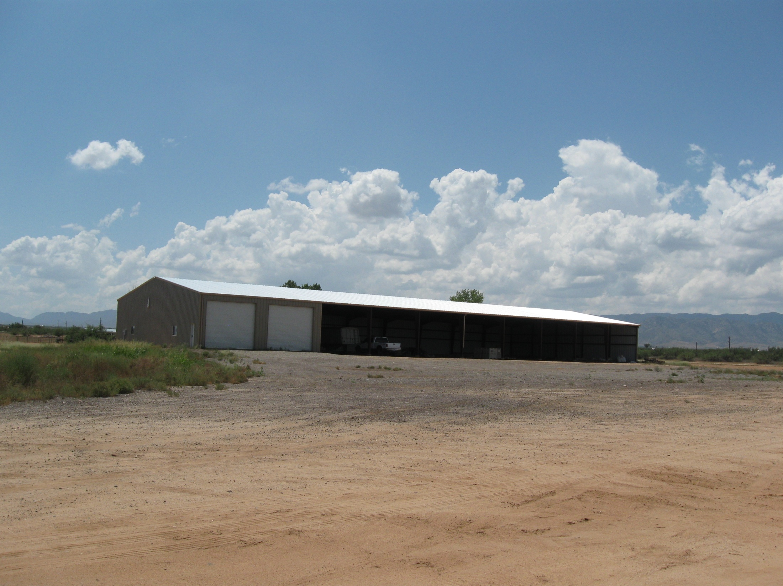

Slide 9
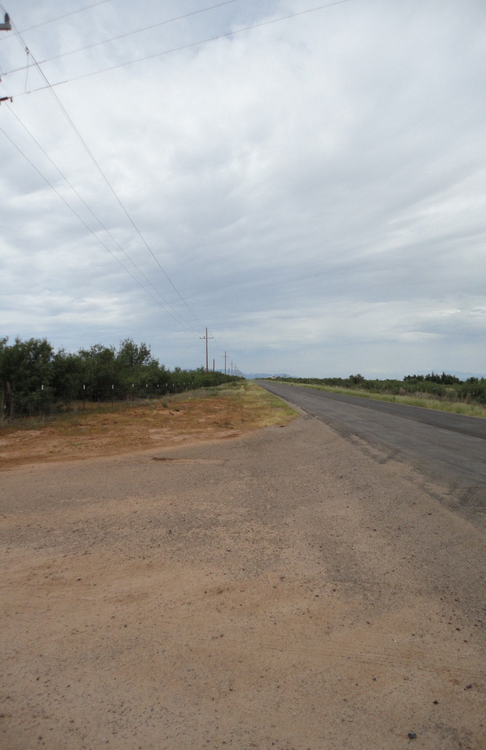
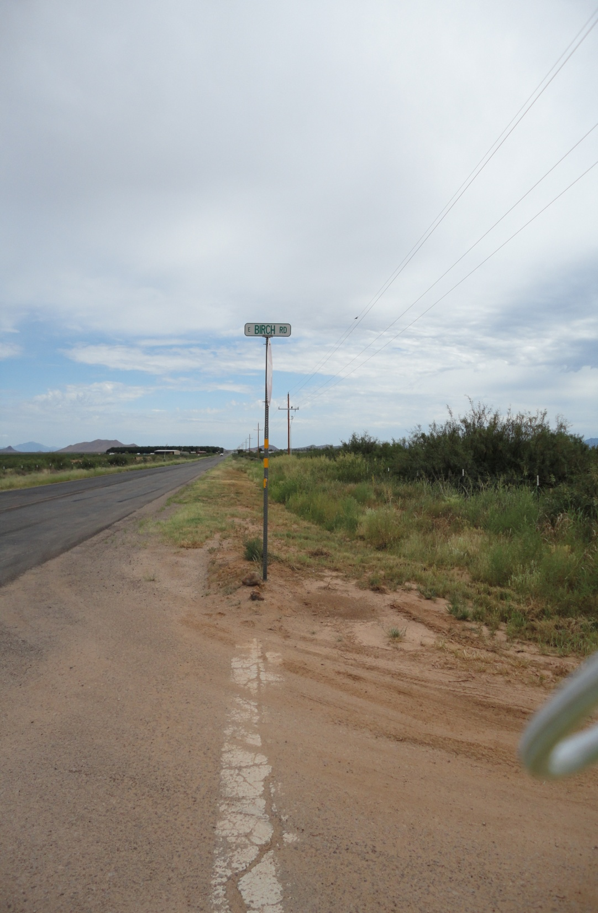
North
South
191
191
Birch Rd.
Birch Rd.

Slide 10
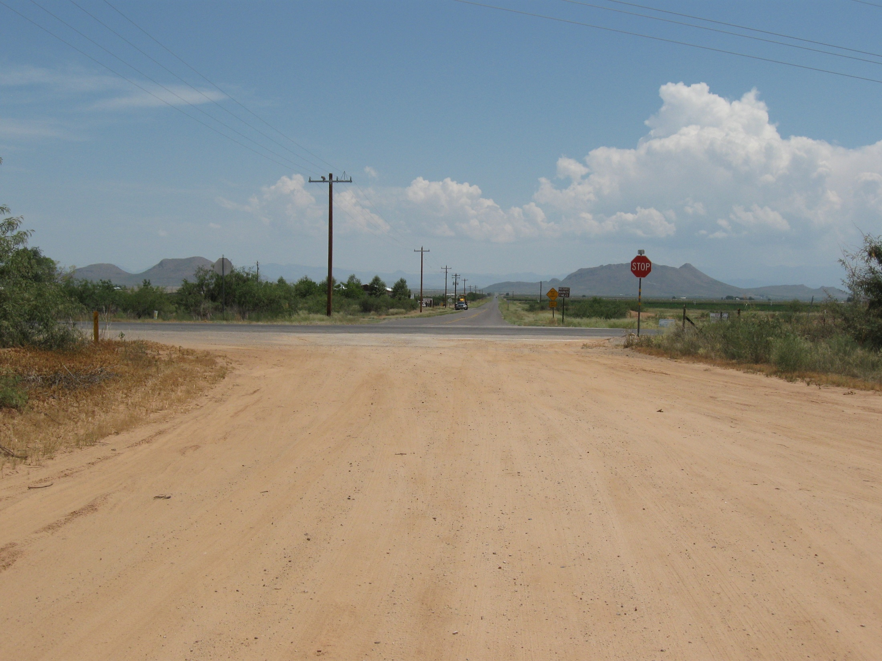
East
191
Birch Rd.

Slide 11
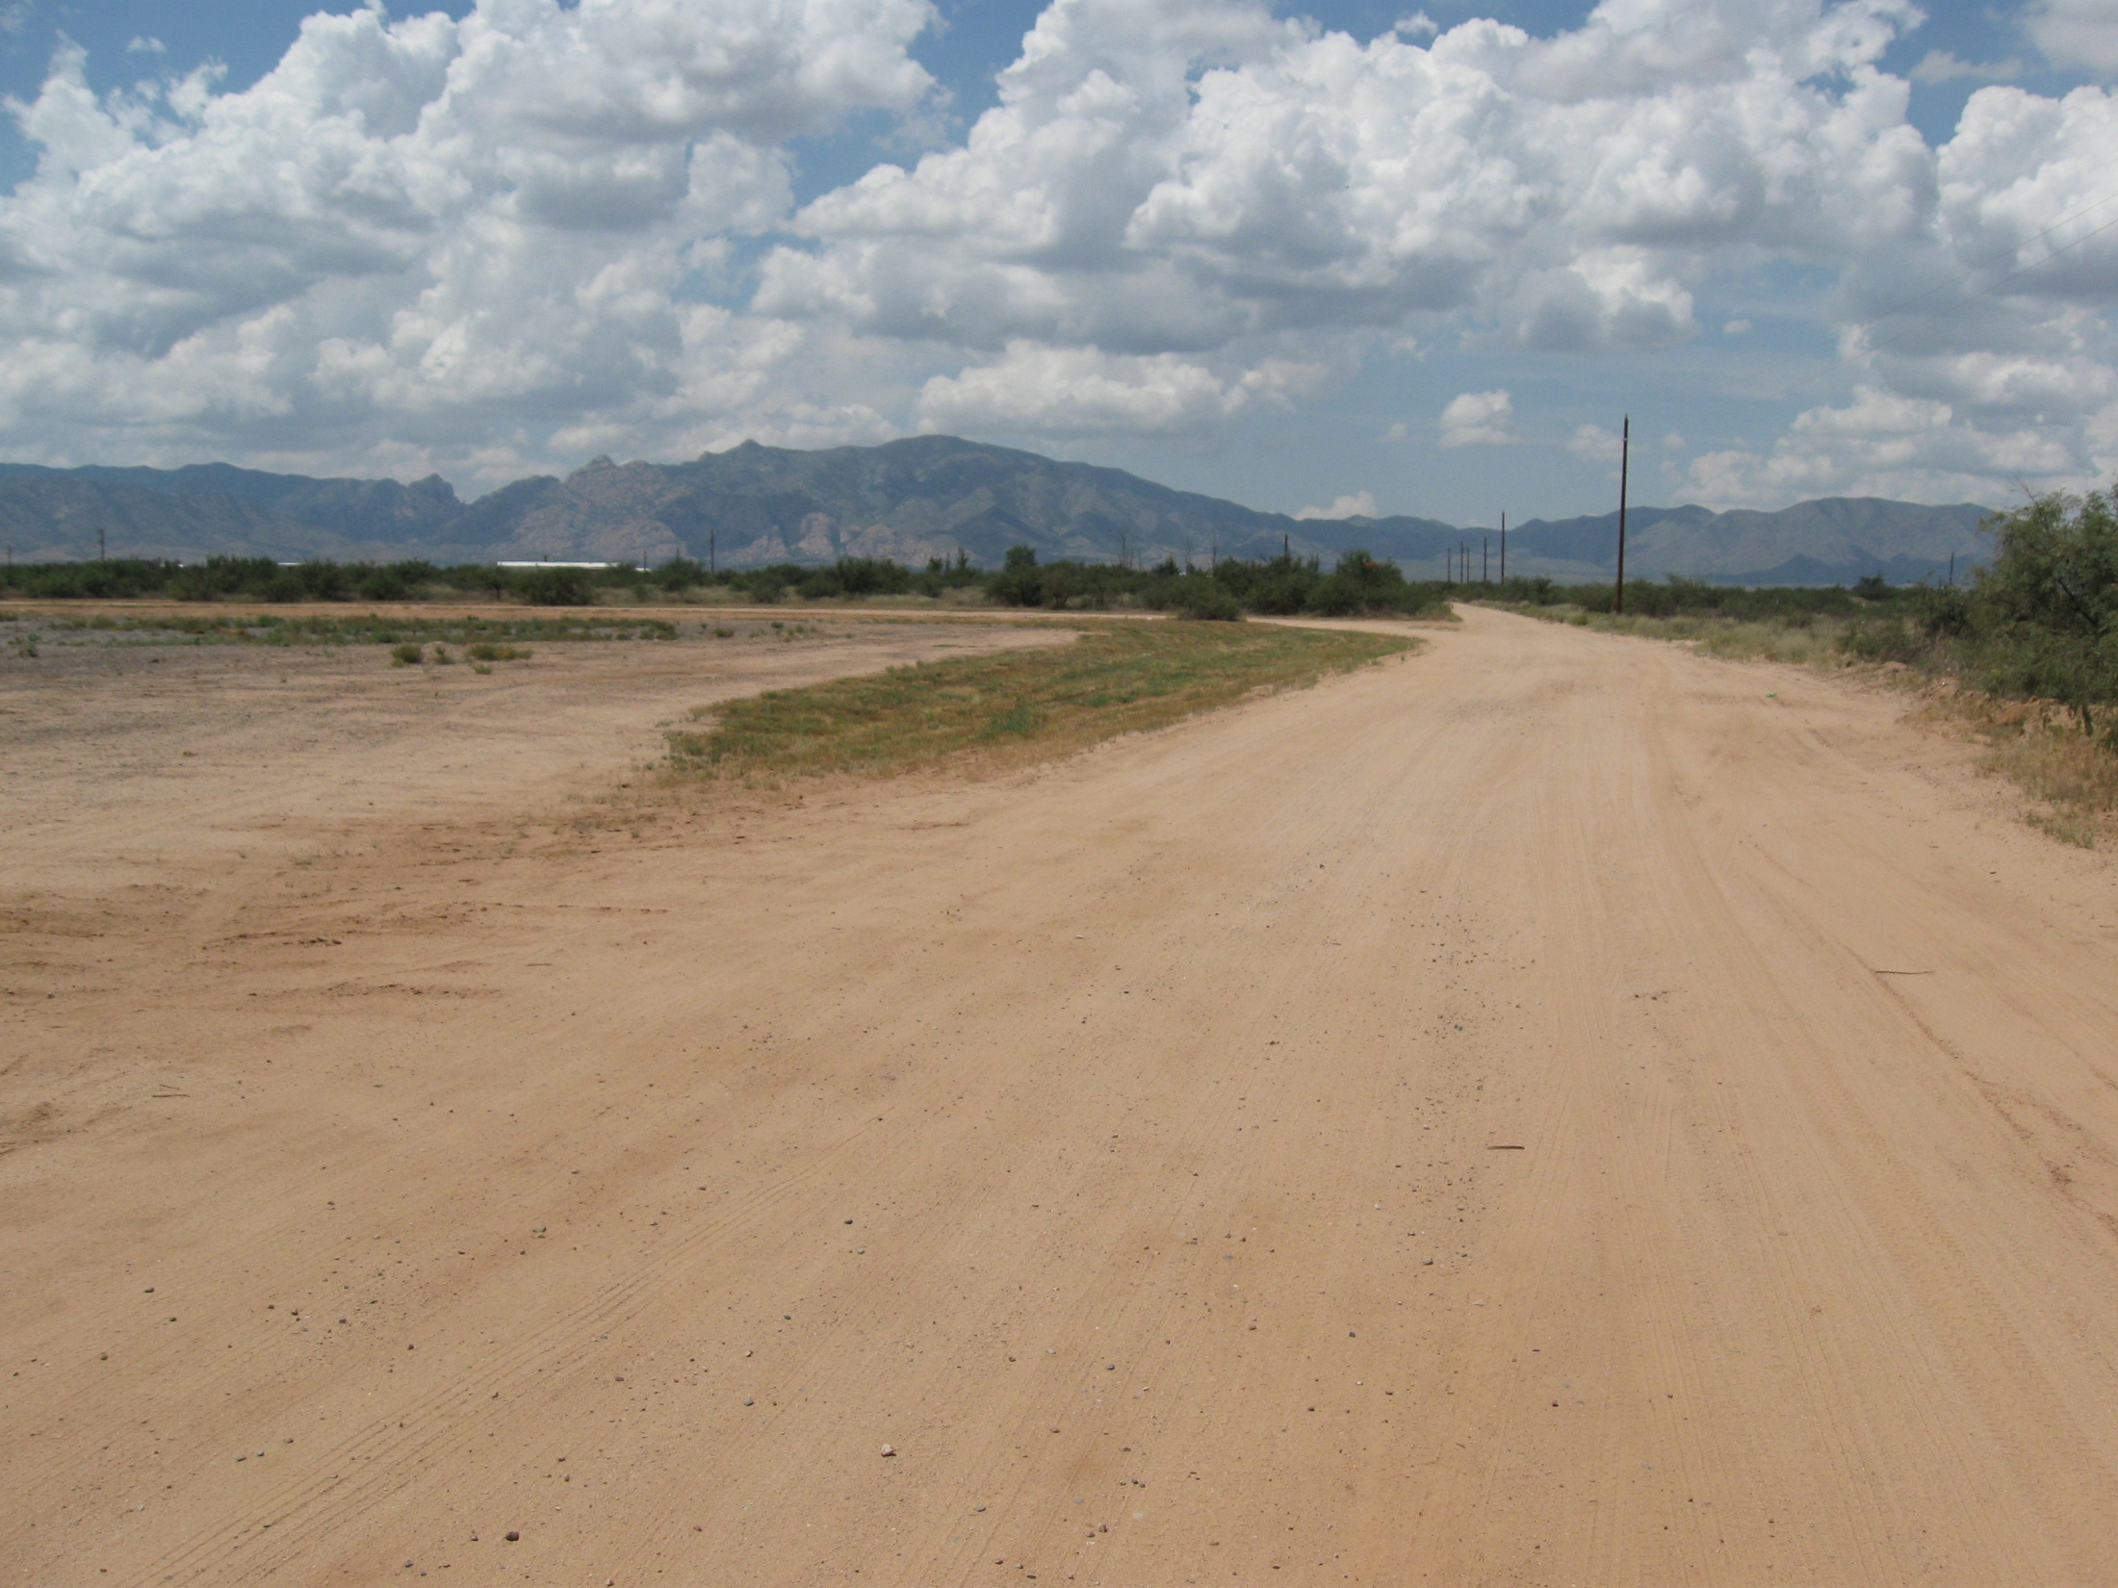
West
Birch Rd.

Slide 12
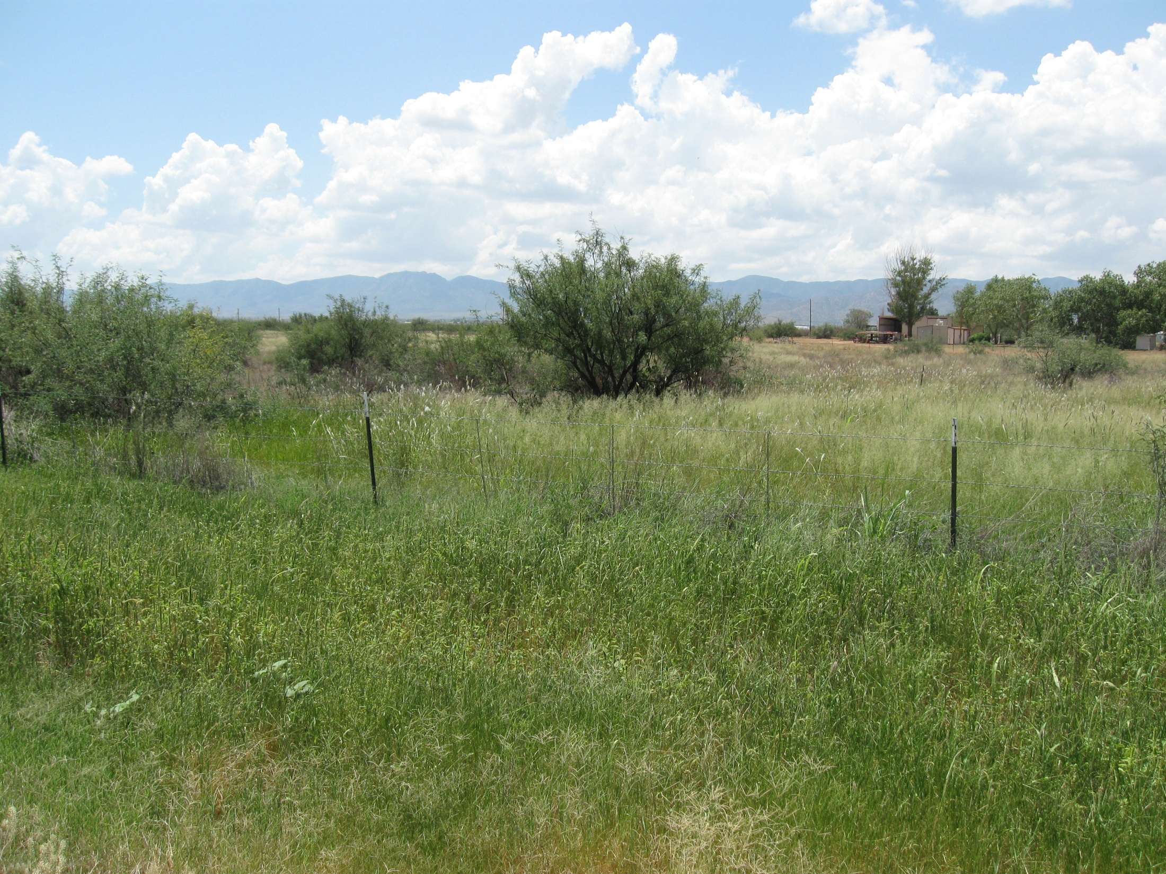
West

Slide 13
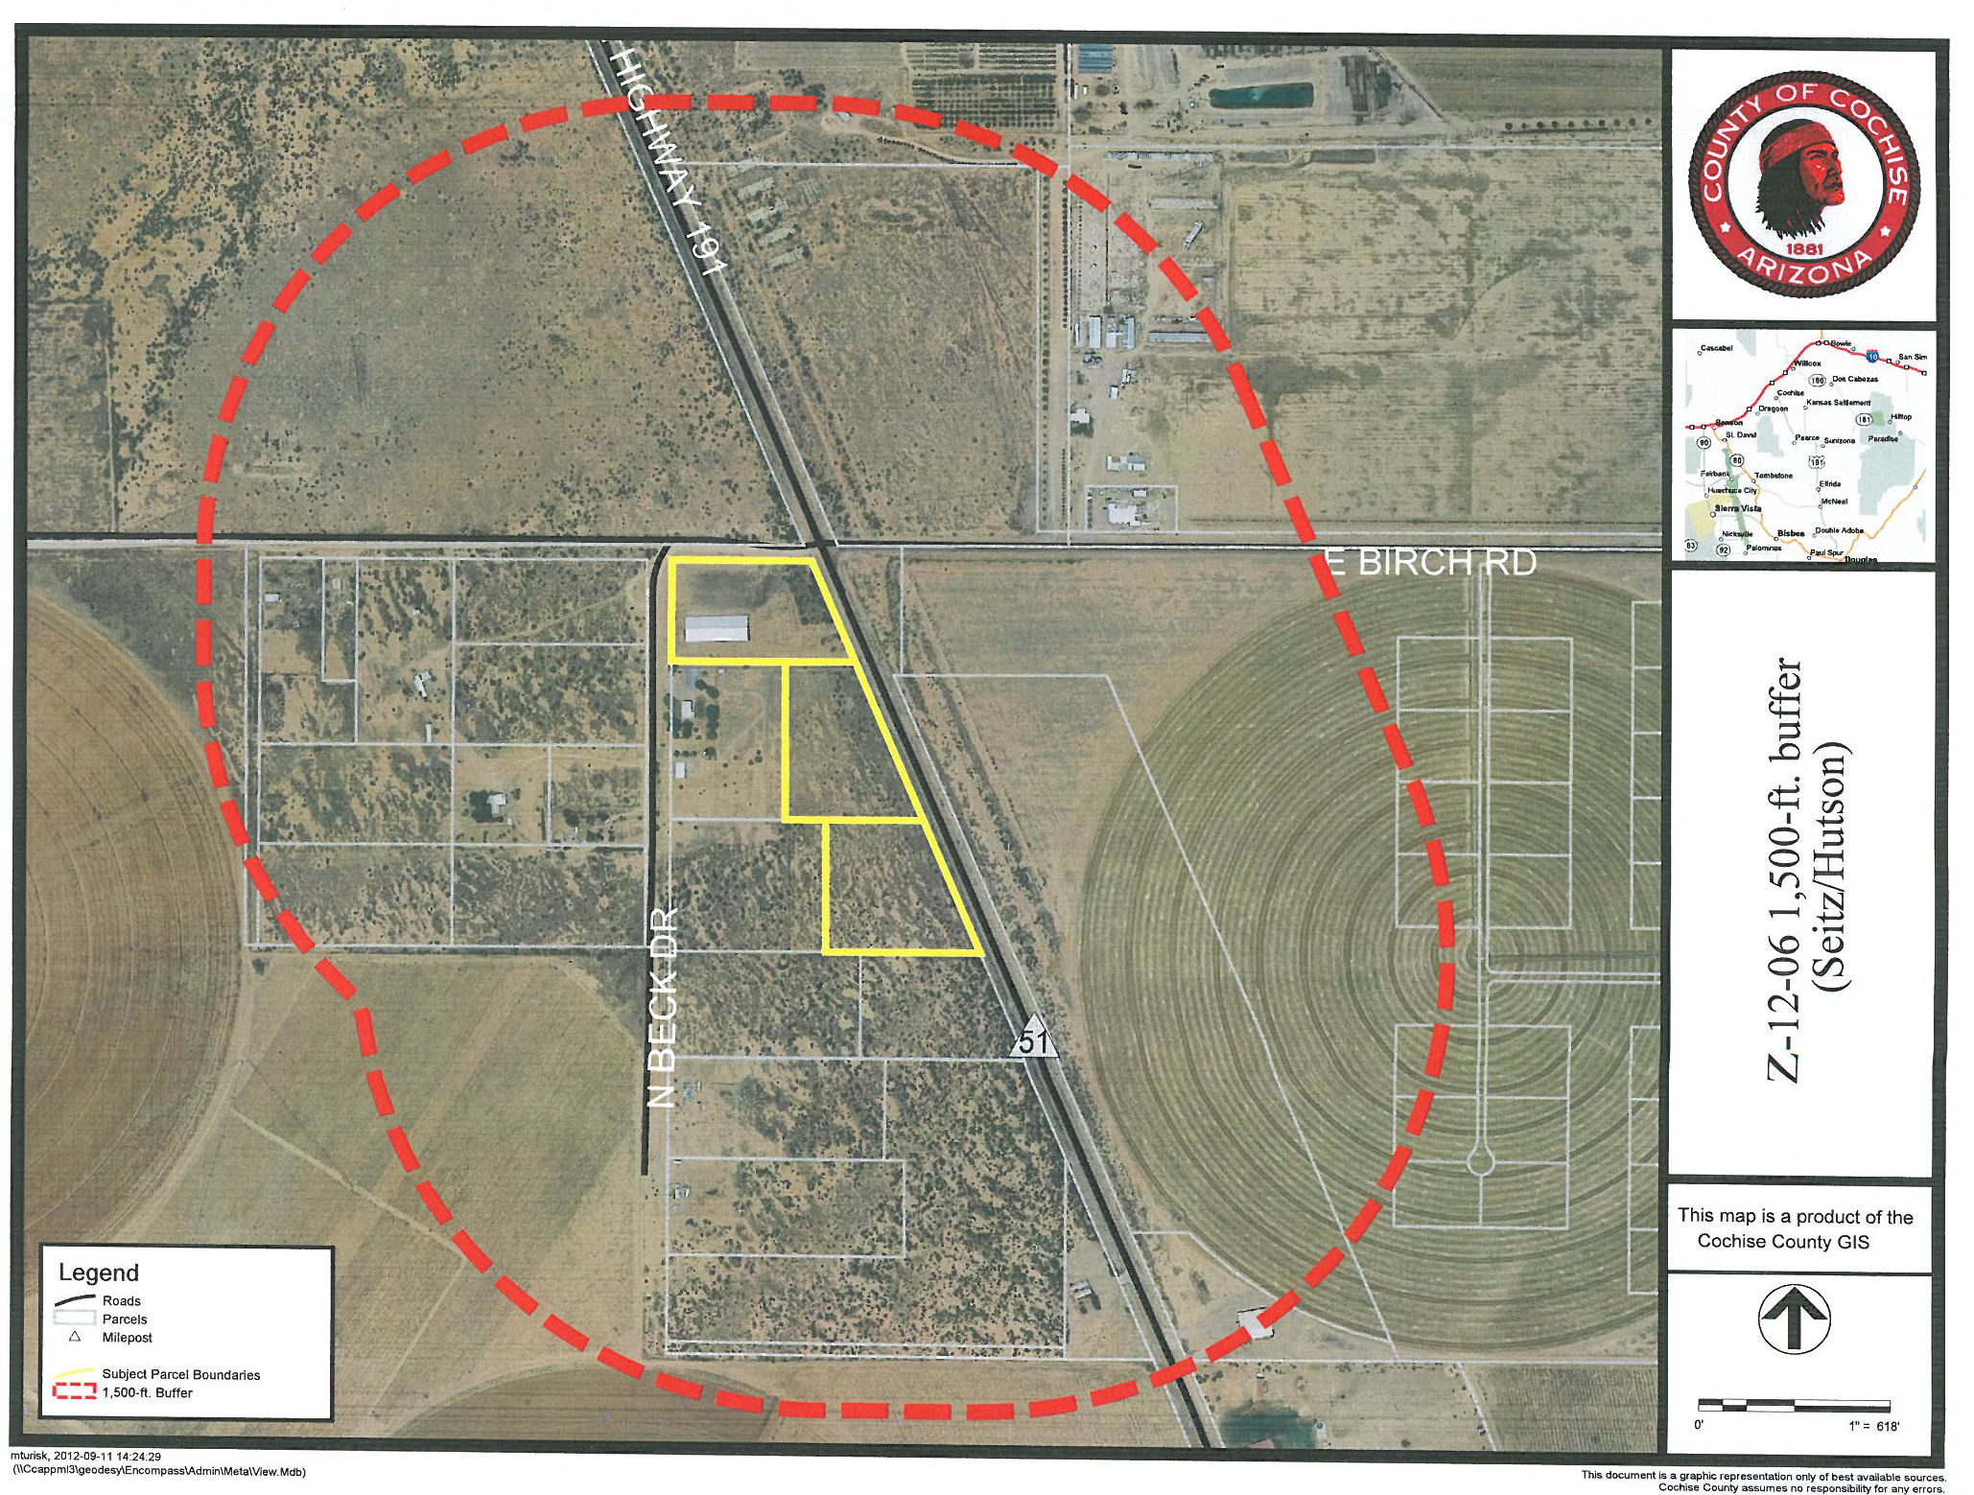
Public Input
One letter of support
and
one letter of protest
One letter of support
&
one letter of protest to date

Slide 14
Factors in Favor of Approval
1. The ag-related uses proposed would serve area farms and ranches;
2. Rezoning to LI will not result in the inability of neighboring parcels to develop;
3. The proposed ag-related commercial uses are in keeping with the agricultural and rural character of the area;
4. The site abuts heavily traveled State Highway 191, an area appropriate for commercial zoning, and limited access can be managed;
5. To date, the Department has received one letter in support of the rezoning request; and
6. The Mid-Sulphur Springs Valley Area Plan designates the subject area as appropriate for Light Industry.

Slide 15
Factors Against Approval
1. Rezoning to LI would not provide what would be considered a smooth transition from adjacent RU-4 properties;
2. The County's Highway Department has suggested that future commercial uses might require improvements to Birch Rd. and State Highway 191; and
3. To date, the Department has received one letter of opposition to the rezoning request.

Slide 16
Planning Commission’s Recommendation
On September 12, the Commission voted unanimously to forward a recommendation of conditional approval

Slide 17
Recommendation
Based on the Factors in Favor, staff recommends conditional approval (with the minimum setback Modification):

Slide 18
Recommended Condition of Approval
The Applicant shall provide the County with a signed Acceptance of Conditions and a Waiver of Claims form arising from ARS Section 12-1134 signed by the property owner of the subject property within thirty (30) days of Board of Supervisors’ approval of the Rezoning or the approval of the Rezoning may be deemed void.

