Slide 1
Request for Plat Abandonment
for the
Kayenta Estates Minor Subdivision
(S-06-02)
Board of Supervisors
December 4, 2012
Notes:
Good afternoon mr chairman, commissioners. Before you is a request for special use authorization for a small-scale metals recycling facility in the fry area of unincorporated sierra vista

Slide 2
S-06-02
Kayenta Estates Minor Subdivision
Request from Developer to abandon.
Final Plat was approved by the Board in 2008.
Assurance Agreement was extended in 2010 and is now expired.
No building permits have been issued and no evidence of lot lines, roadways or other infrastructure exists
Would remove lot lines, subdivision boundaries, and easements.

Slide 3
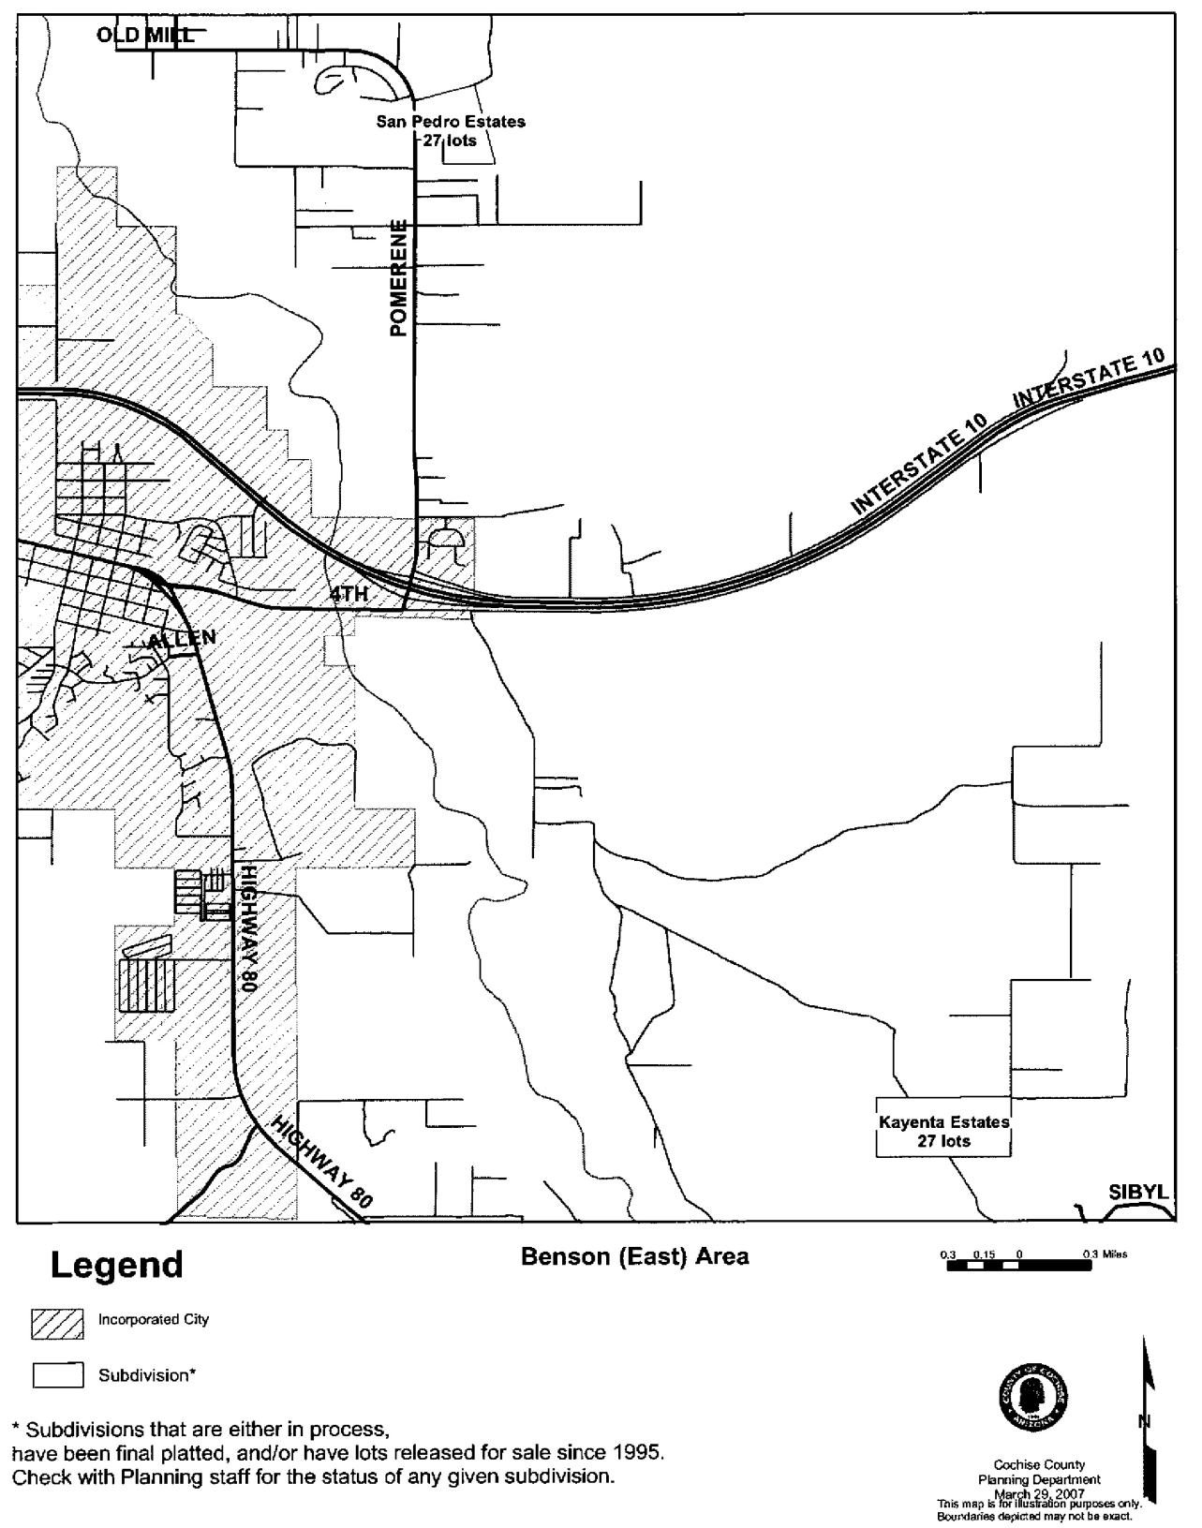
27-lots on 81-acres located
northeast of St. David.
Approved under existing
RU-4 zoning

Slide 4
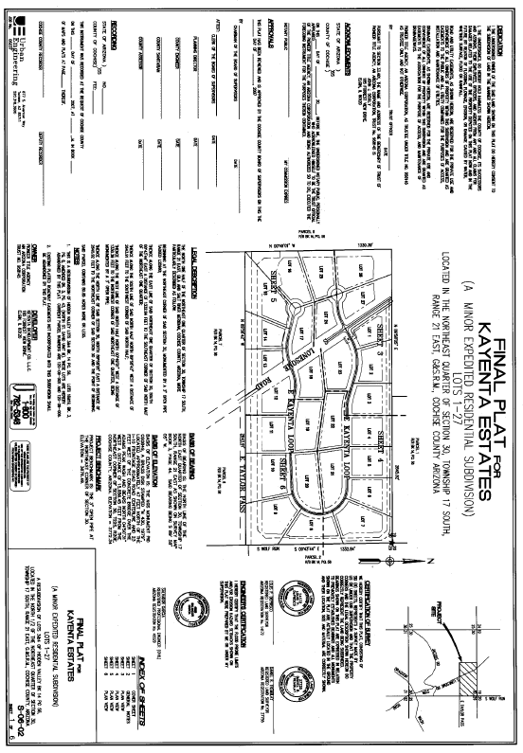

Slide 5
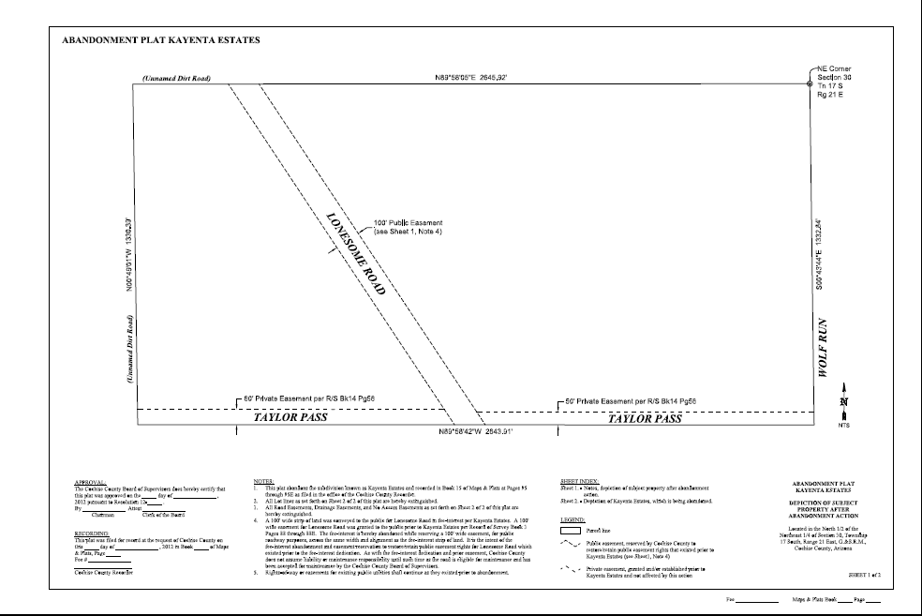

Slide 6
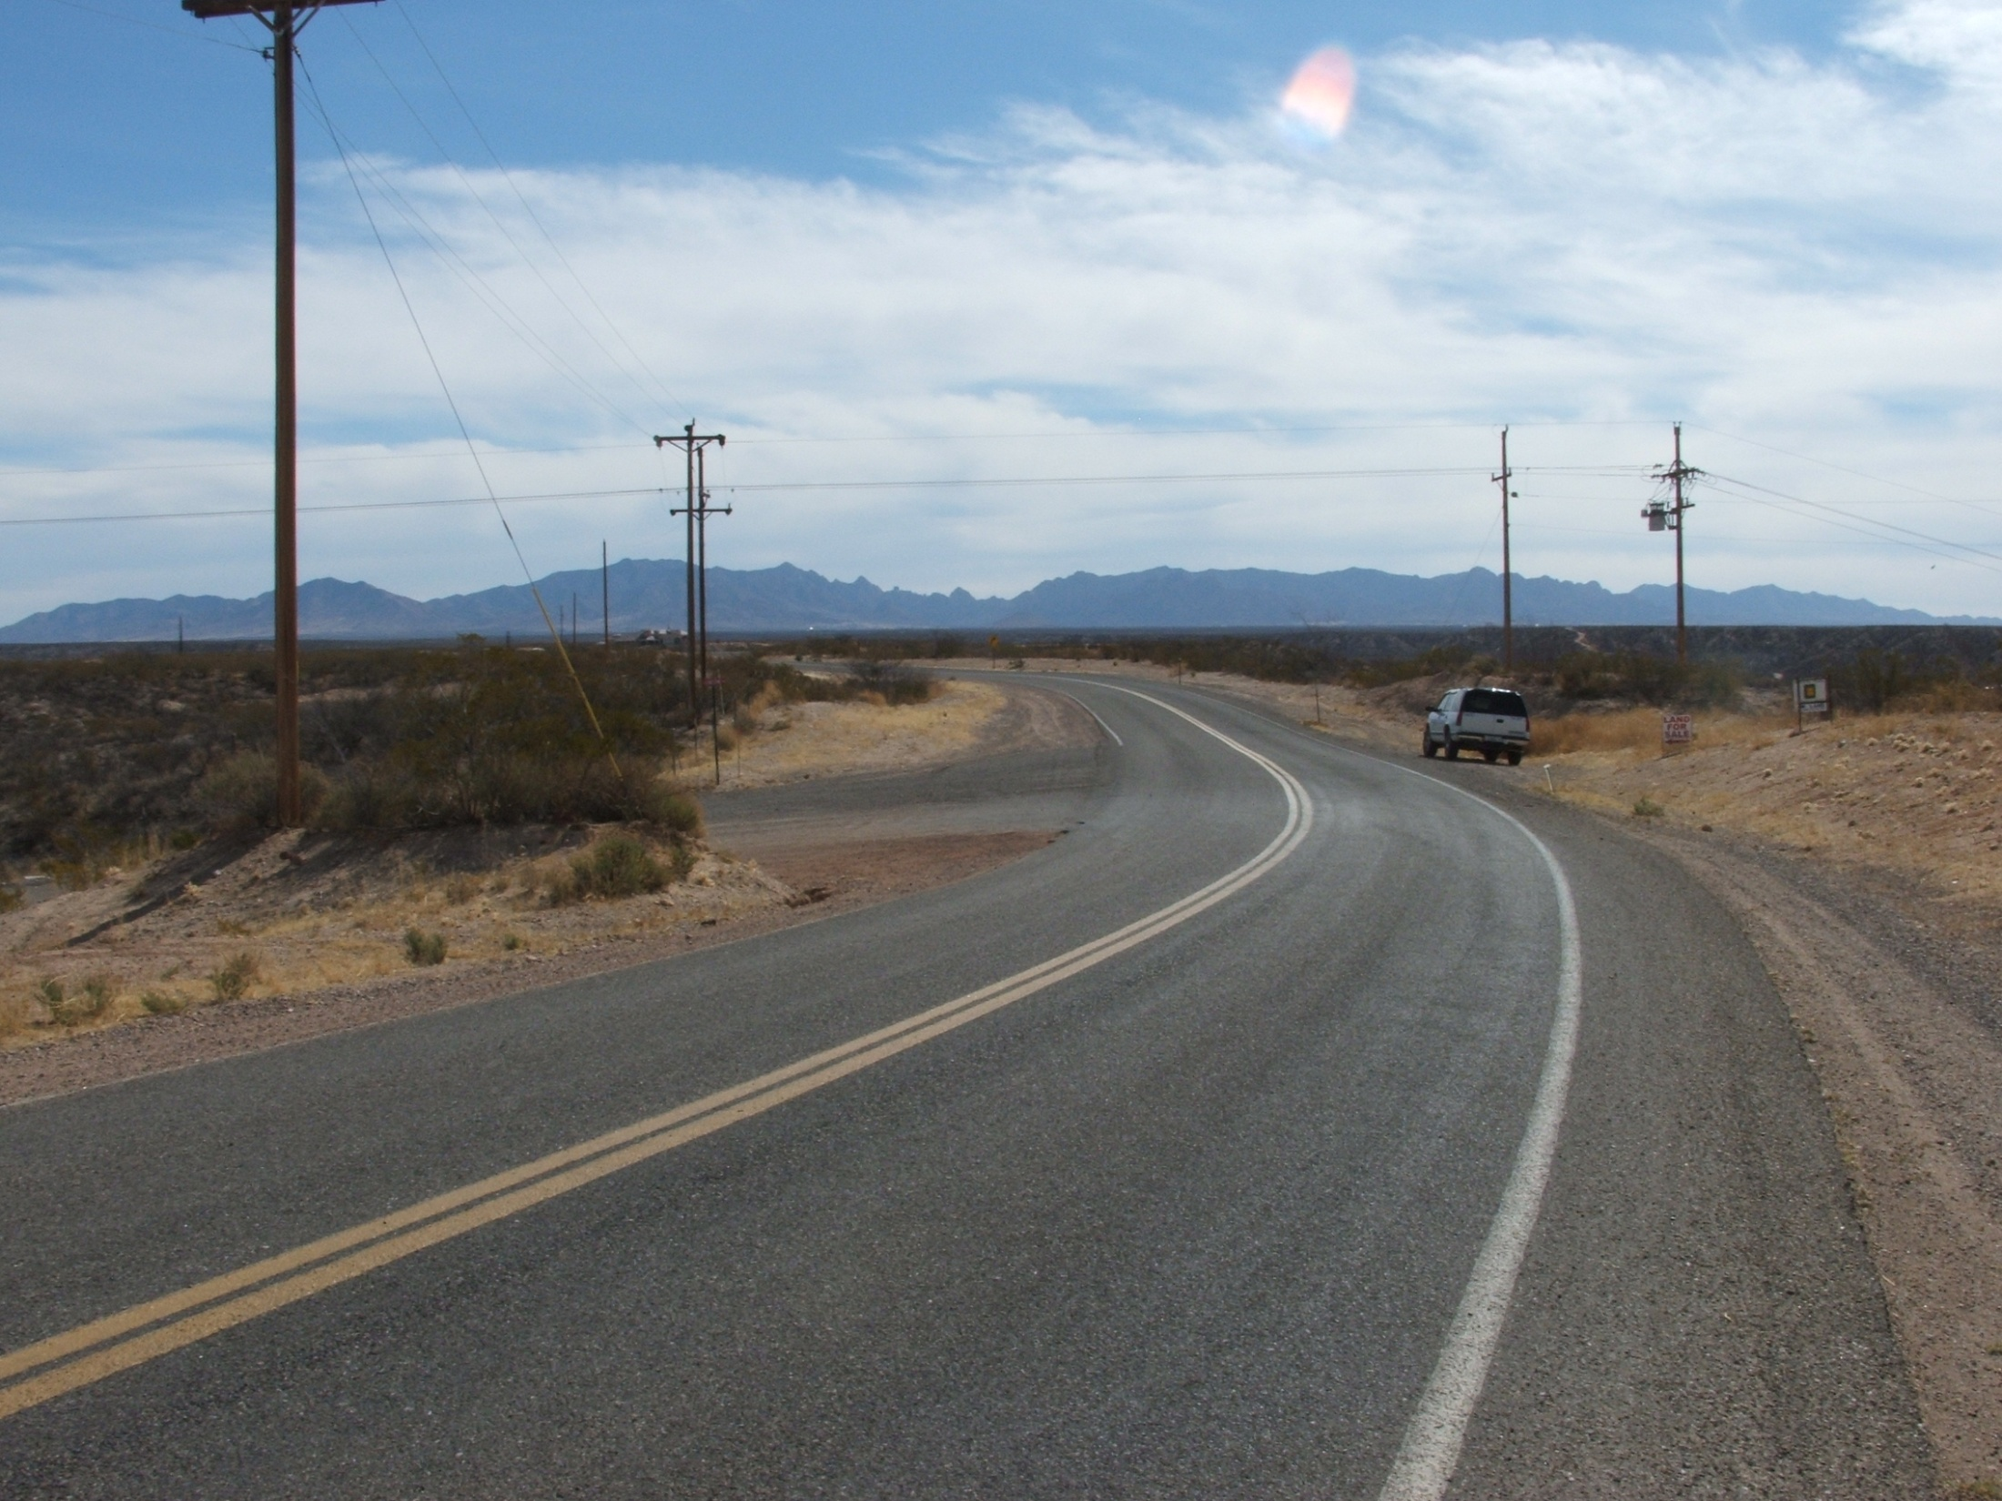

Slide 7
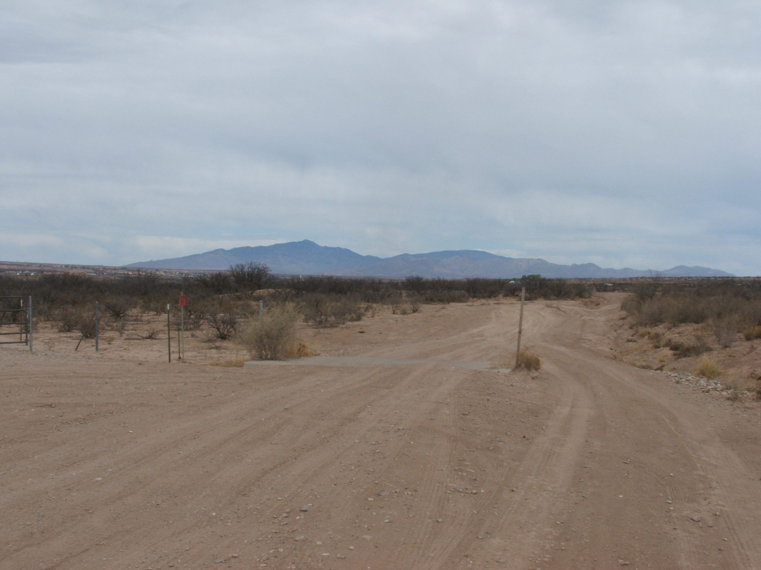

Slide 8
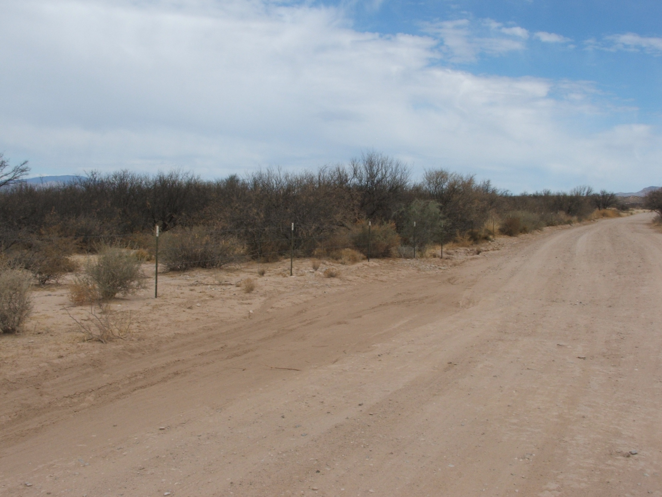

Slide 9
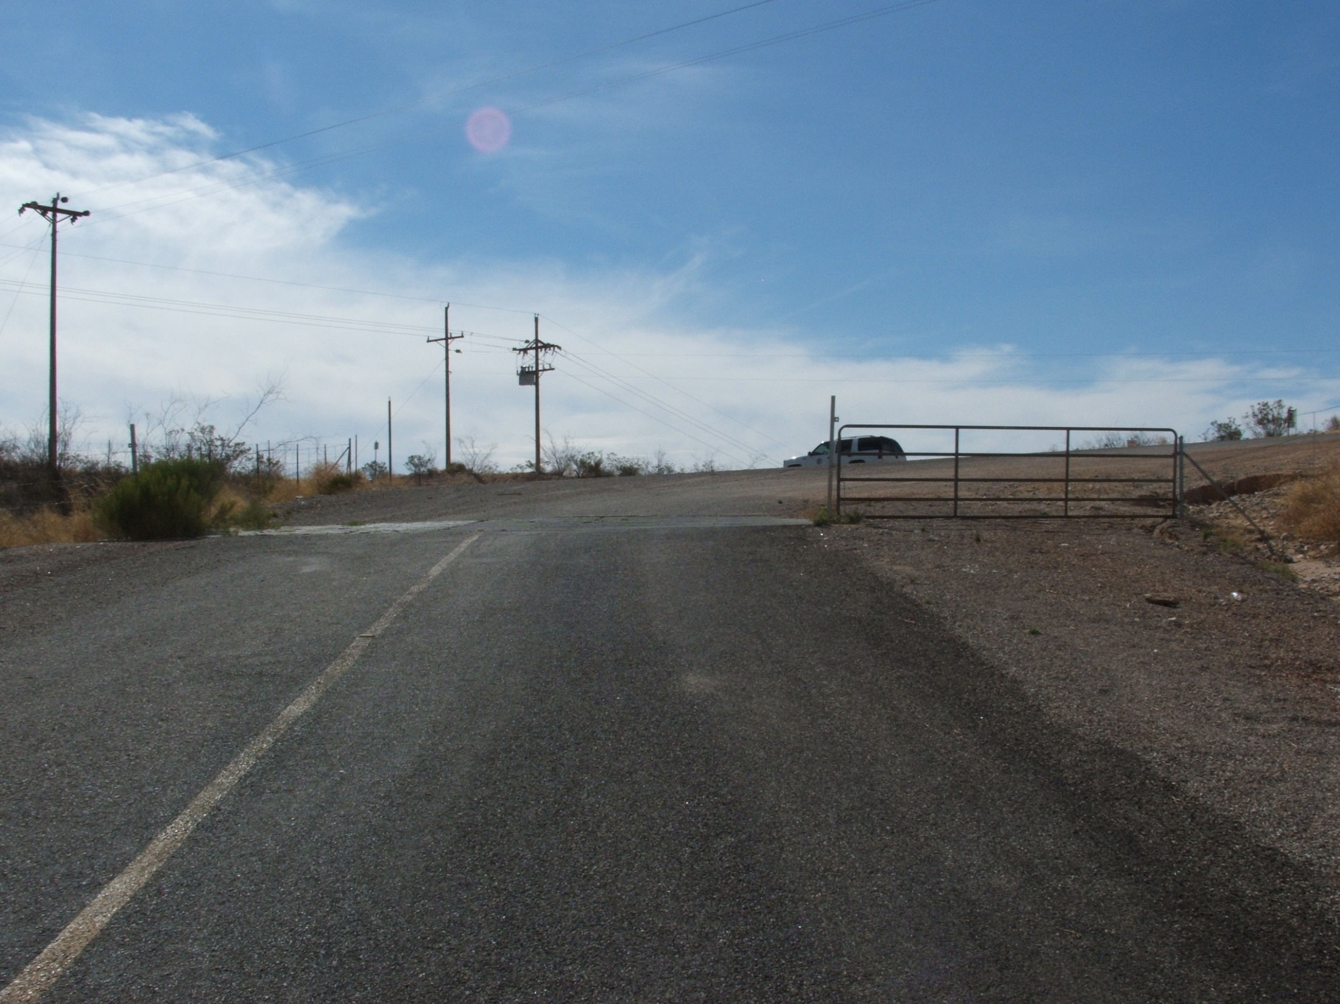

Slide 10
Recommendation
Approve the Resolution to abandon the Final Plat and Assurances.
Authorize the Chairman to sign the Resolution and the Record of Survey to return property to original parcel boundaries.

