Slide 1
Docket Z-12-07 (Jantz)
A Request to Rezone 9 Parcels from
SR-43 to RU-4.
Board of Supervisors, January 8, 2013

Slide 2
Docket Z-12-07 (Jantz)
Request to rezone nine one-acre parcels from SR-43 (Single Household Residential, 1 dwelling per acre) to RU-4 (Rural, 1 dwelling per 4 acres);
Applicant requests rezoning as part of an effort to convert 9.63 acres to full agricultural production;
Property was recently granted agricultural exemption;
The site (Parcels 119-05-244 through 252) is located at 730 N. Skyline Road in Cochise, AZ;
The Applicants are Michael and Cynthia Jantz of the same address.

Slide 3
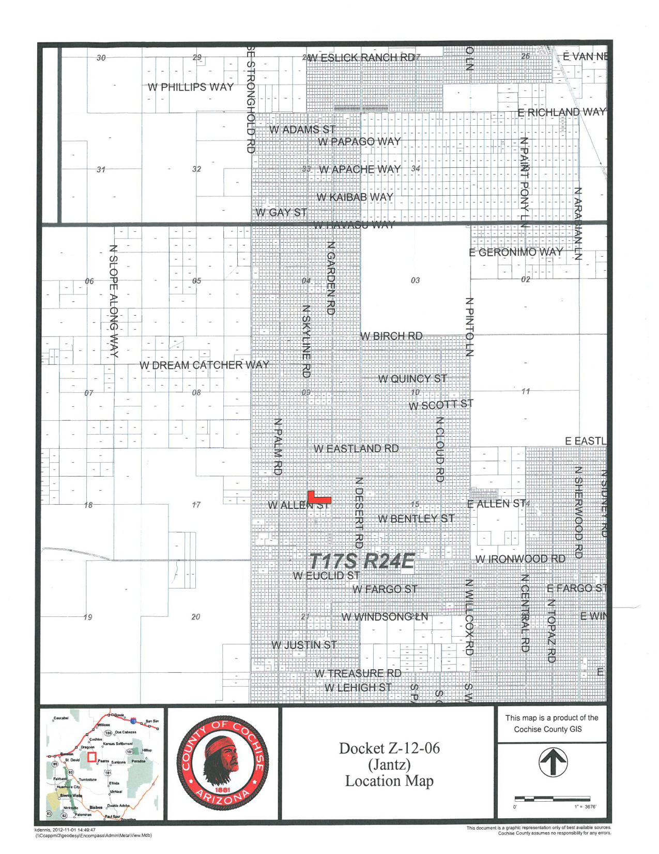
Location
The property is located along Skyline Rd., north of Ironwood Rd. in Cochise.

Slide 4
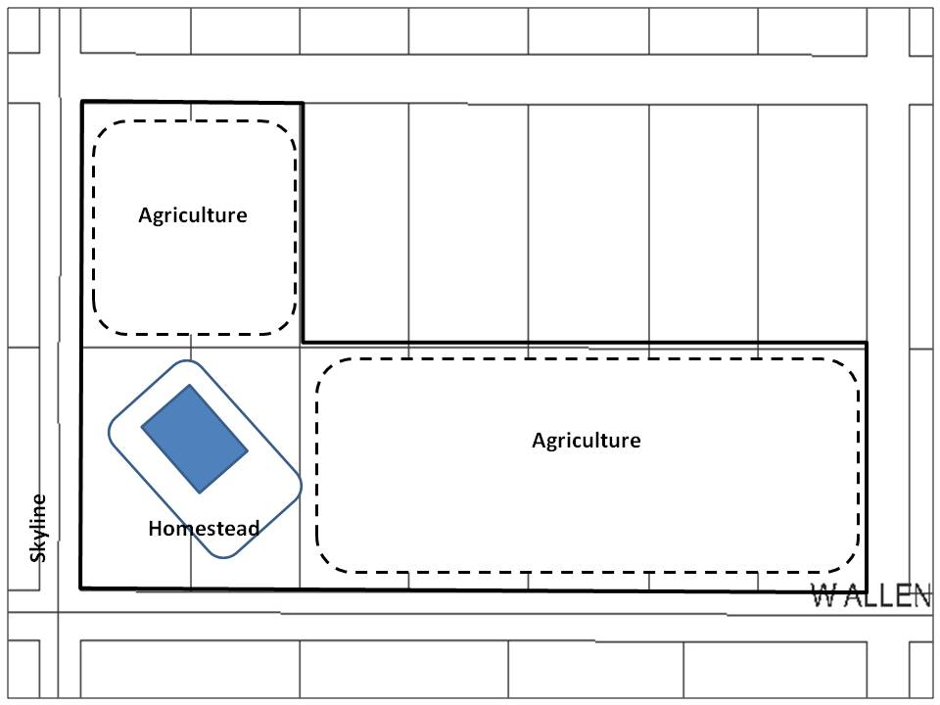
Concept Plan

Slide 5
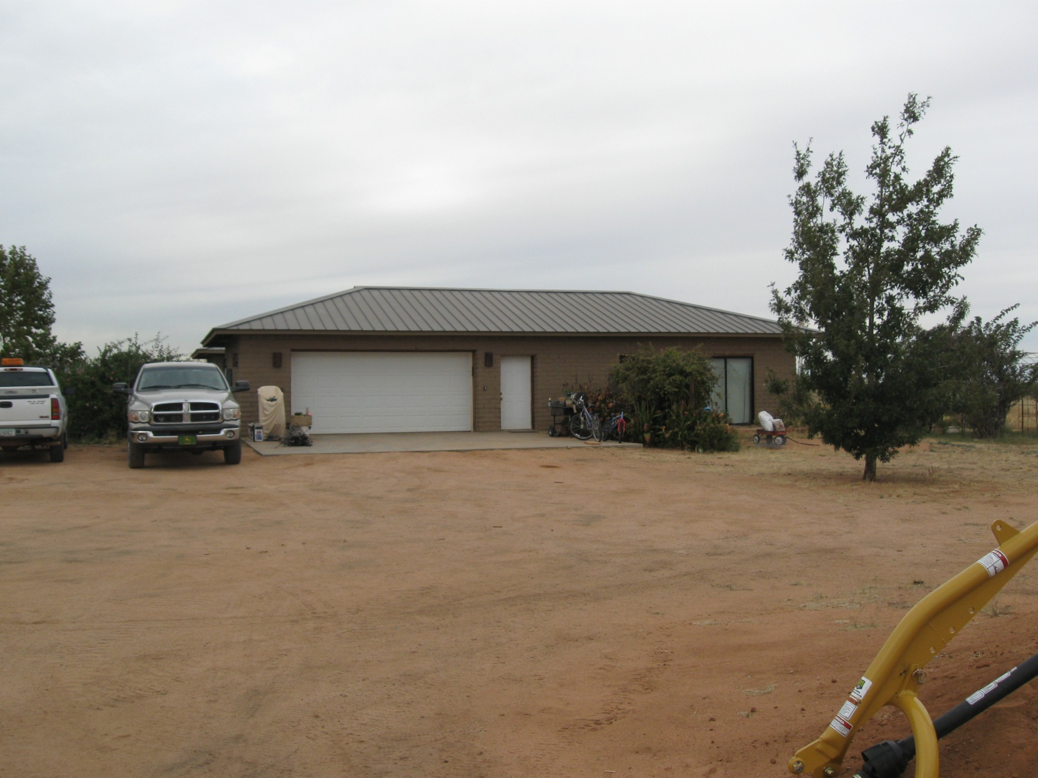
Site Photos
North view of the Jantz residence.

Slide 6
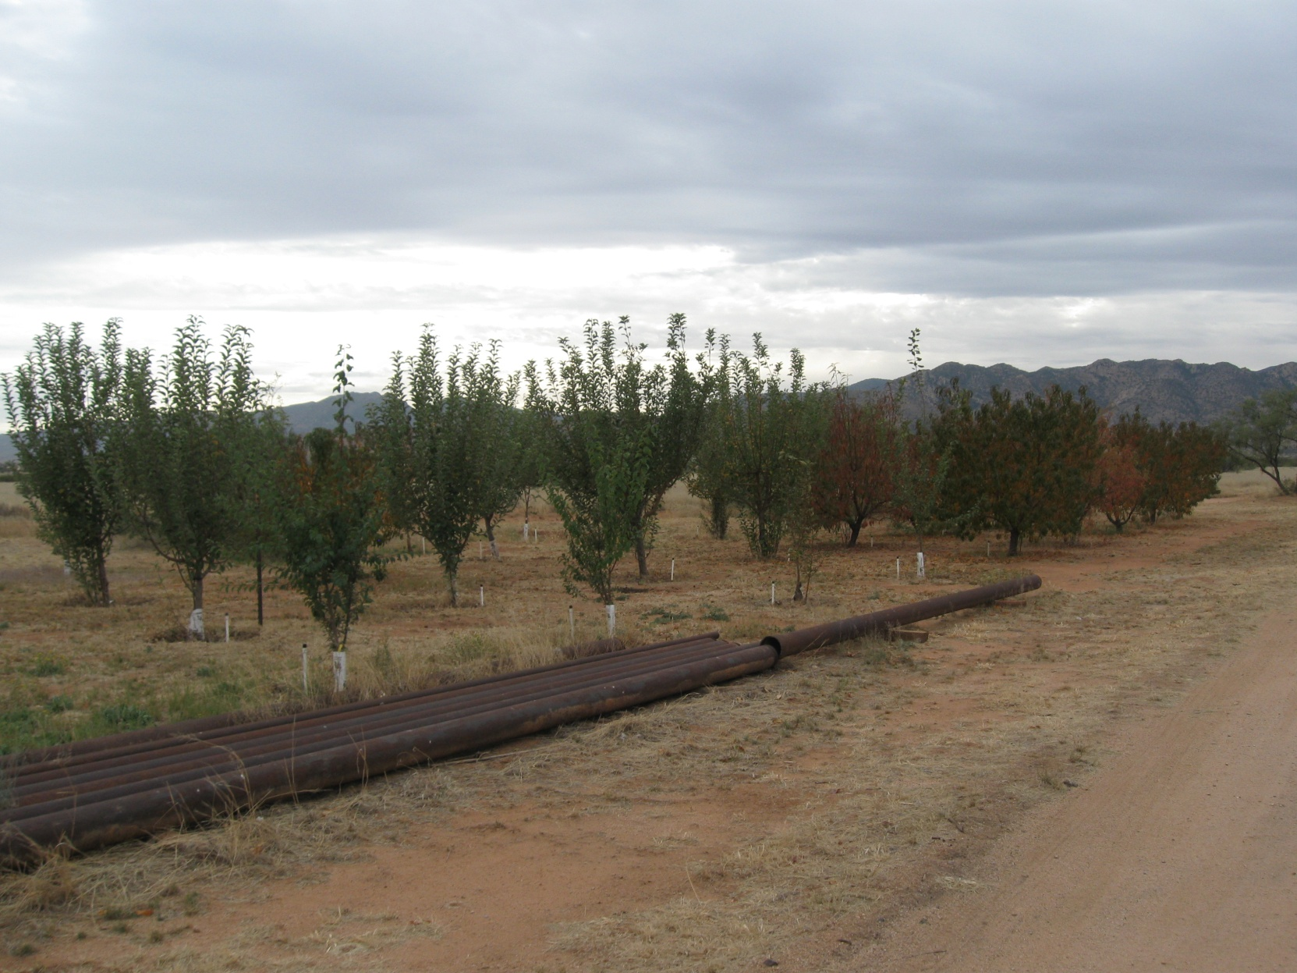
Site Photos
Fruit tree orchard adjacent to Allen Road.

Slide 7
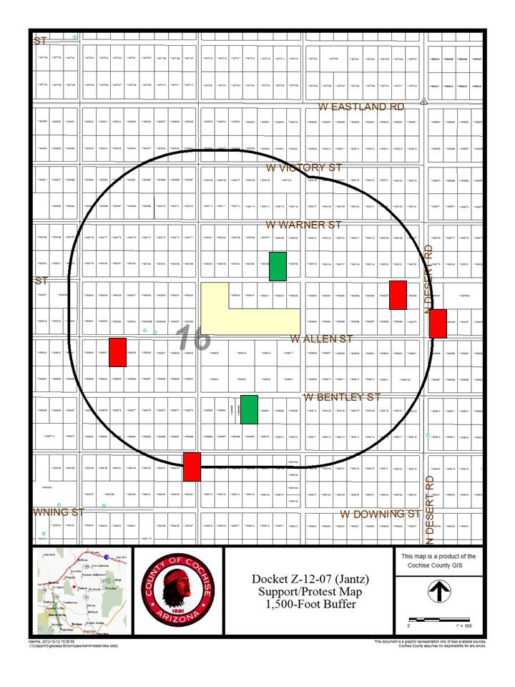
Support & Protest
Staff received letters of support from two neighboring property owners, and four letters opposing.

Slide 8
Factors in Favor of Approval
Allowing the request would be in keeping with the character of development in the area;
The request is in keeping with the Rural Growth Area policies of the Comprehensive Plan, and the density prescribed in the Mid Sulphur Springs Valley Area Plan;
Two neighboring property owners have expressed support for the proposal; and
On December 12, the Planning and Zoning Commission voted unanimously to forward a recommendation of conditional approval.

Slide 9
Factor Against Approval
Four neighboring property owners oppose the request, citing concerns about reduced property values.

Slide 10
Recommendation: Conditional Approval
The Applicant shall provide the County with a signed Acceptance of Conditions and a Waiver of Claims form arising from ARS Section 12-1134 signed by the property owner of the subject property within thirty (30) days of Board of Supervisors approval of the rezoning; and
It is the Applicants' responsibility to obtain any additional permits, or meet any additional conditions, that may be applicable to the proposed use pursuant to other federal, state, or local laws or regulations.

