Slide 1
H-13-01 (Hazard Abatement Lien)
Request to place a lien against Parcel 106-39-151 for $16,905.00; the cost of abatement of Hazard VH-06-0008).
Board of Supervisors, February 26, 2013

Slide 2
Docket H-13-01 (Hazard Abatement Lien)
Staff requests that the Board of Supervisors place a lien for the amount spent to abate the property.
Originated as outdoor storage complaint in 2006.
Found and removed an open accessible home that presented a hazard to the public.

Slide 3
Docket H-13-01 (Hazard Abatement Lien)
This is the first of nine Hazards to be brought for Board consideration per the earlier Hazard Abatement Ordinance, adopted September 8,1987.
The 1987 Ordinance requires the Board of Supervisors to approve all liens for Hazard Abatement.
The 2011 Ordinance allows staff to assess liens with Chairman of the Board’s signature only.

Slide 4
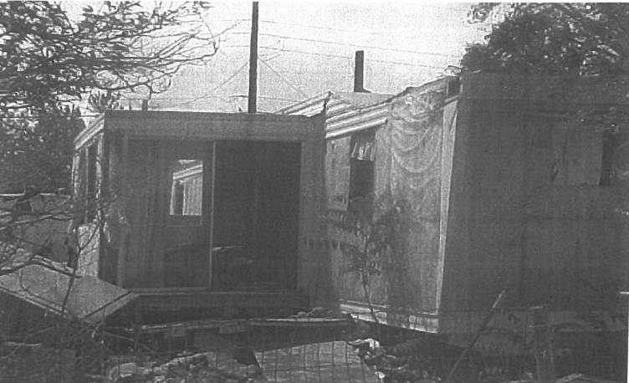
Site Photos

Slide 5
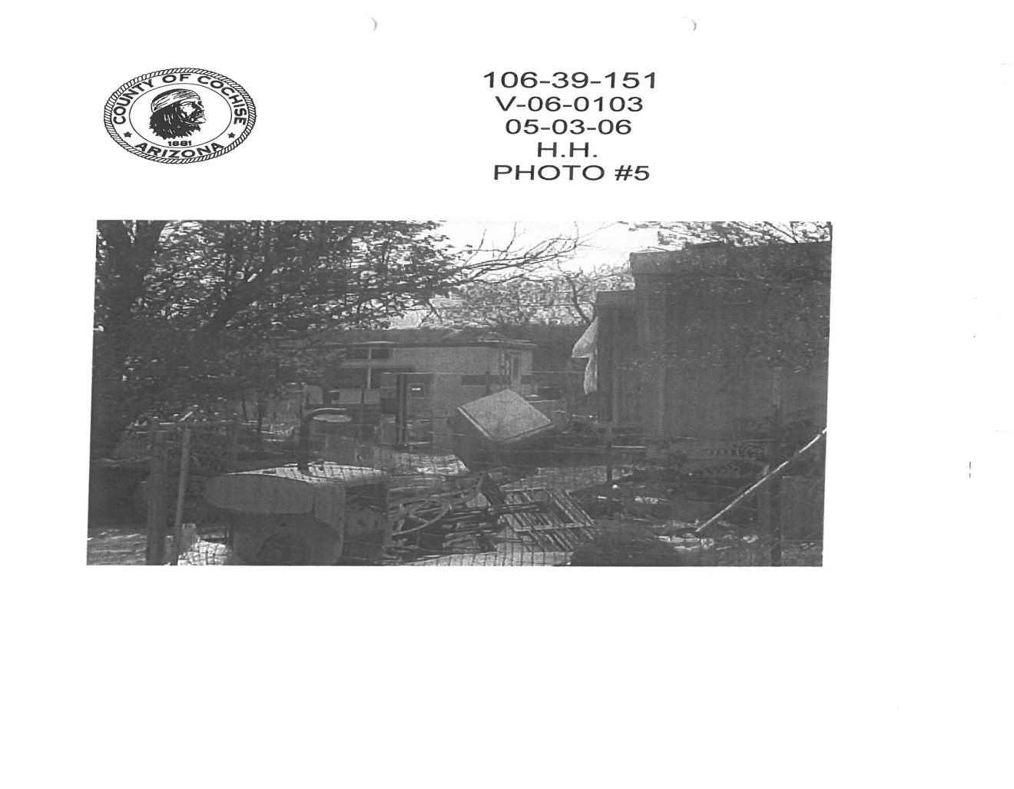
Site Photos

Slide 6
Staff Recommendation
Staff recommends the Board approve the lien to be placed against Parcel 106-39-151, in the amount of $16,905.00.

