Slide 1
Abandonment of rights-of-way for Bowie School
March 26, 2013

Slide 2
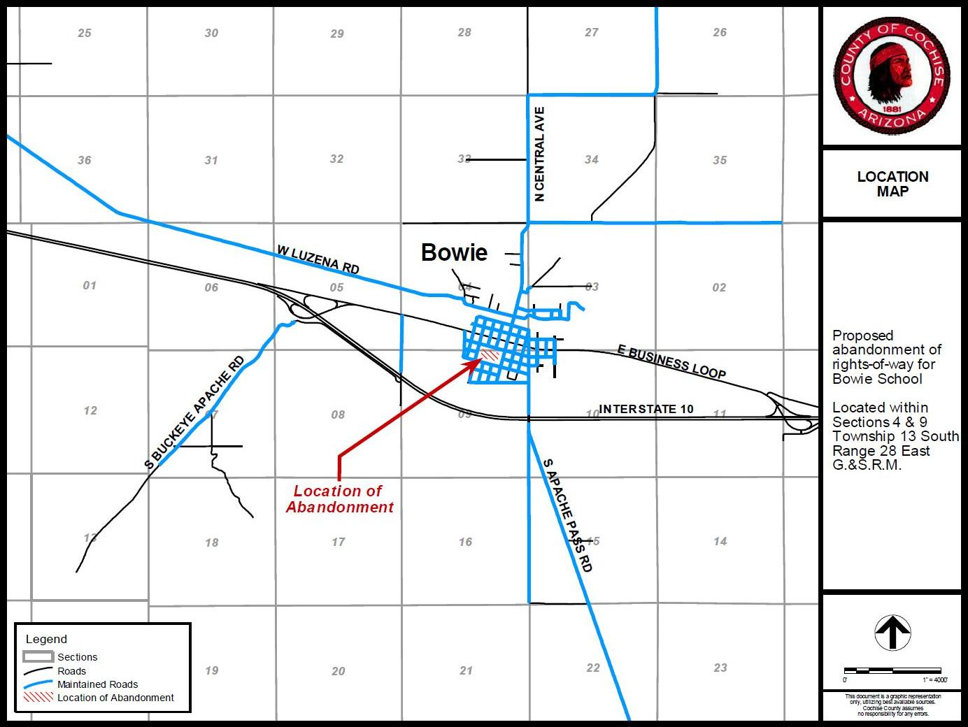

Slide 3
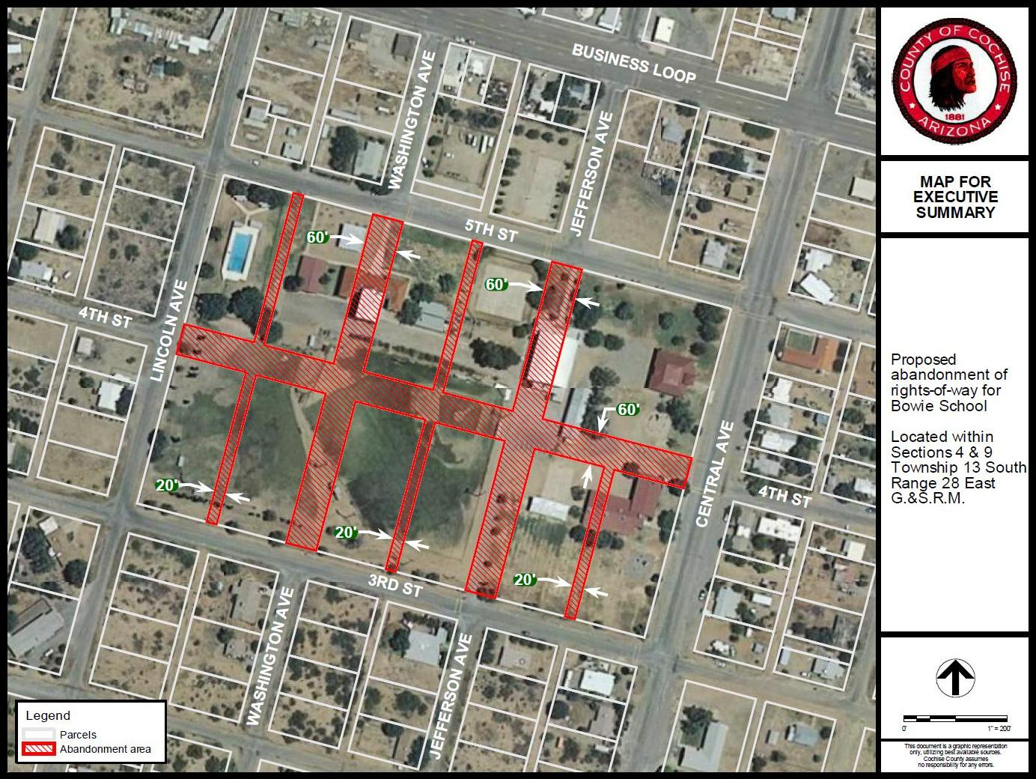

Slide 4
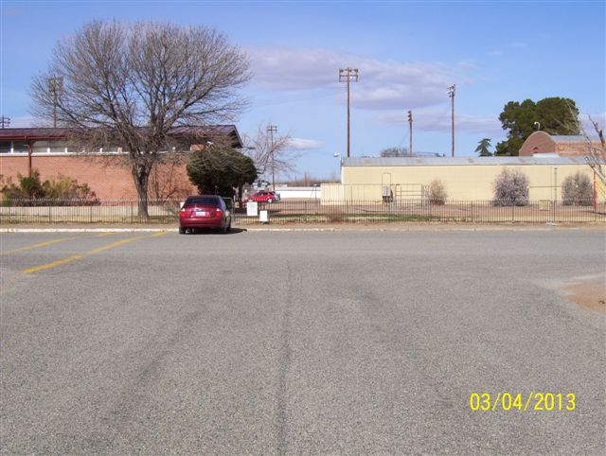
Intersection of Central Avenue and Fourth Street looking westerly along Fourth Street
Approx Abandonment Area
(abandonment area beyond buildings not shown)

Slide 5
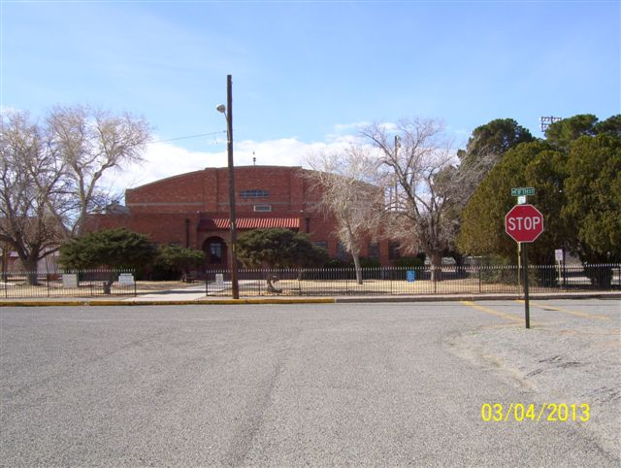
Intersection of Jefferson Avenue and Fifth Street looking southerly along Jefferson Avenue
Approx Abandonment Area
(abandonment area beyond buildings not shown)

Slide 6
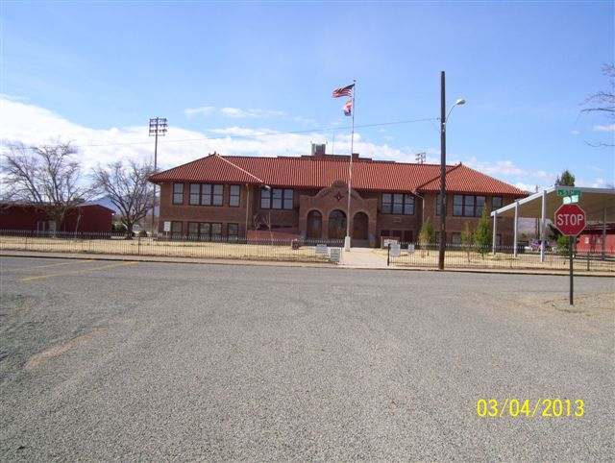
Intersection of Washington Avenue and Fifth Street looking southerly along Washington Avenue
Approx Abandonment Area
(abandonment area beyond buildings not shown)

