Slide 1
Docket Z-13-01
(Yesca)
A Request to Rezone a Parcel from
TR-9 to MR-1
Board of Supervisors, 3/26/2013

Slide 2
Docket Z-13-01 (Yesca)
Request to rezone a 12,915 sq-ft parcel from TR-9 (Residential, one dwelling per 9,000 sq-ft) to MR-1 (Multiple household, one dwelling per 3,600 sq-ft) for the purpose of completing the conversion of an existing garage into a single-family home.
Current TR-9 Zoning designation does not permit two dwellings on this parcel.
The property is located at 3790 S. Geisler Ave in Naco. Applicant is Maria Yesca, represented by Ernest Rogers.
On March 13, the Planning & Zoning Commission voted to forward a recommendation of conditional approval (7-1).

Slide 3
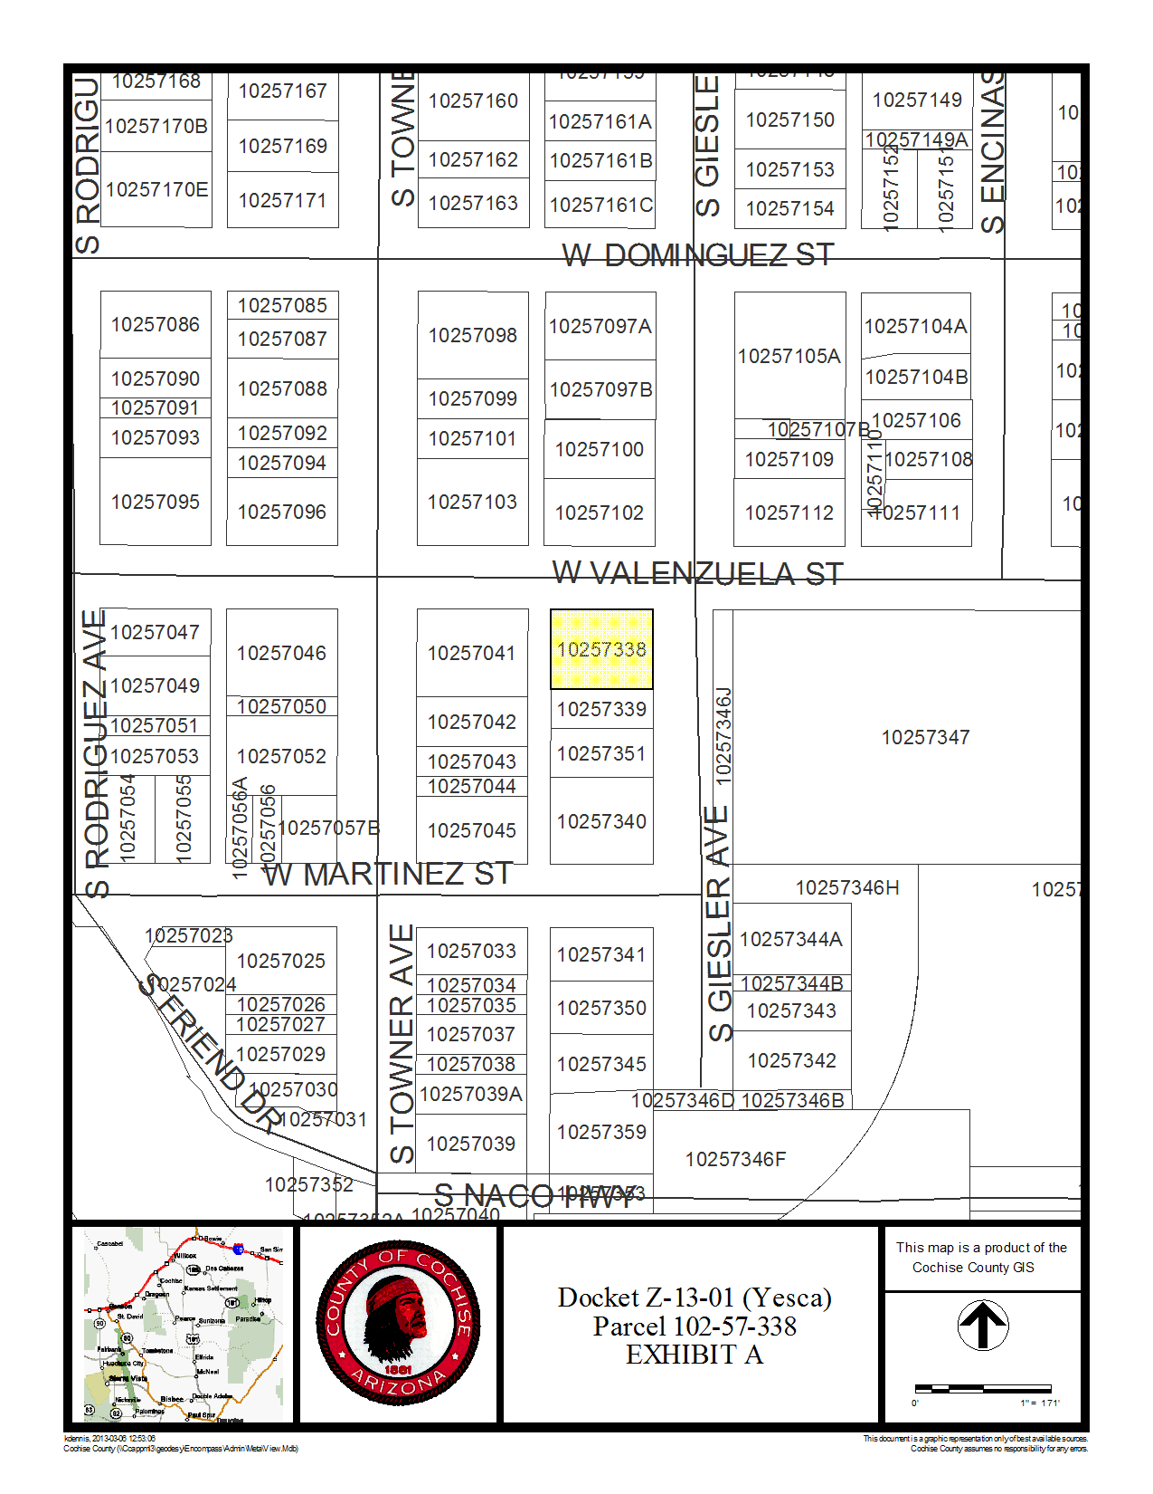
Location
The property is located at the corner of Valenzuela St and Giesler Ave, adjacent to the Naco School

Slide 4
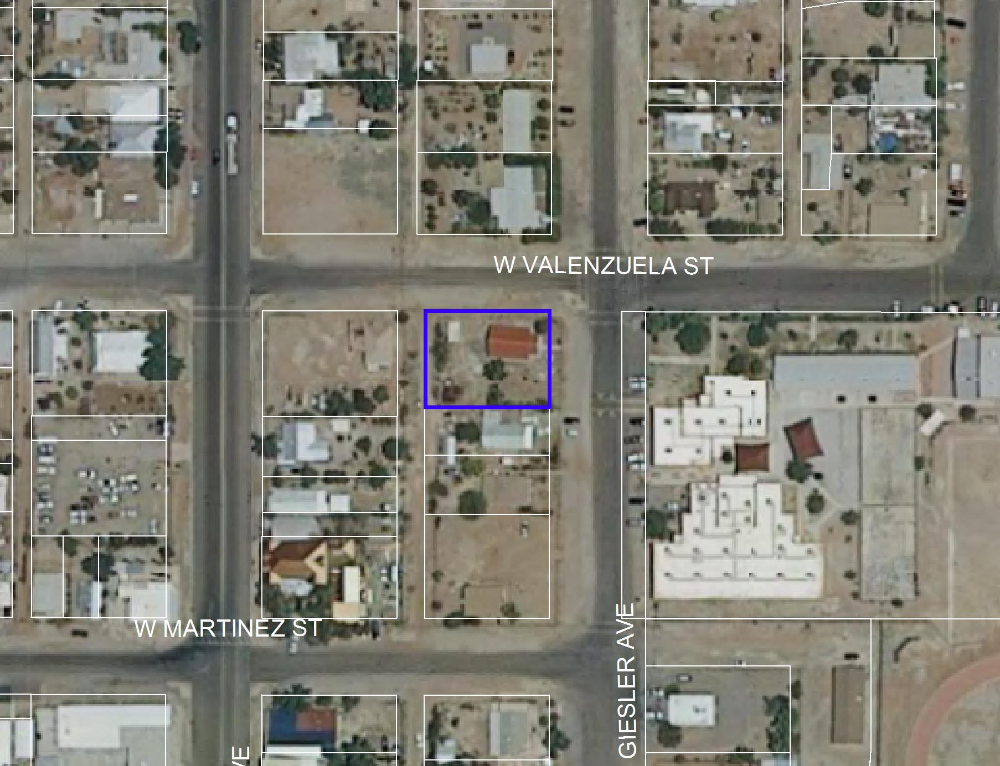
N

Slide 5
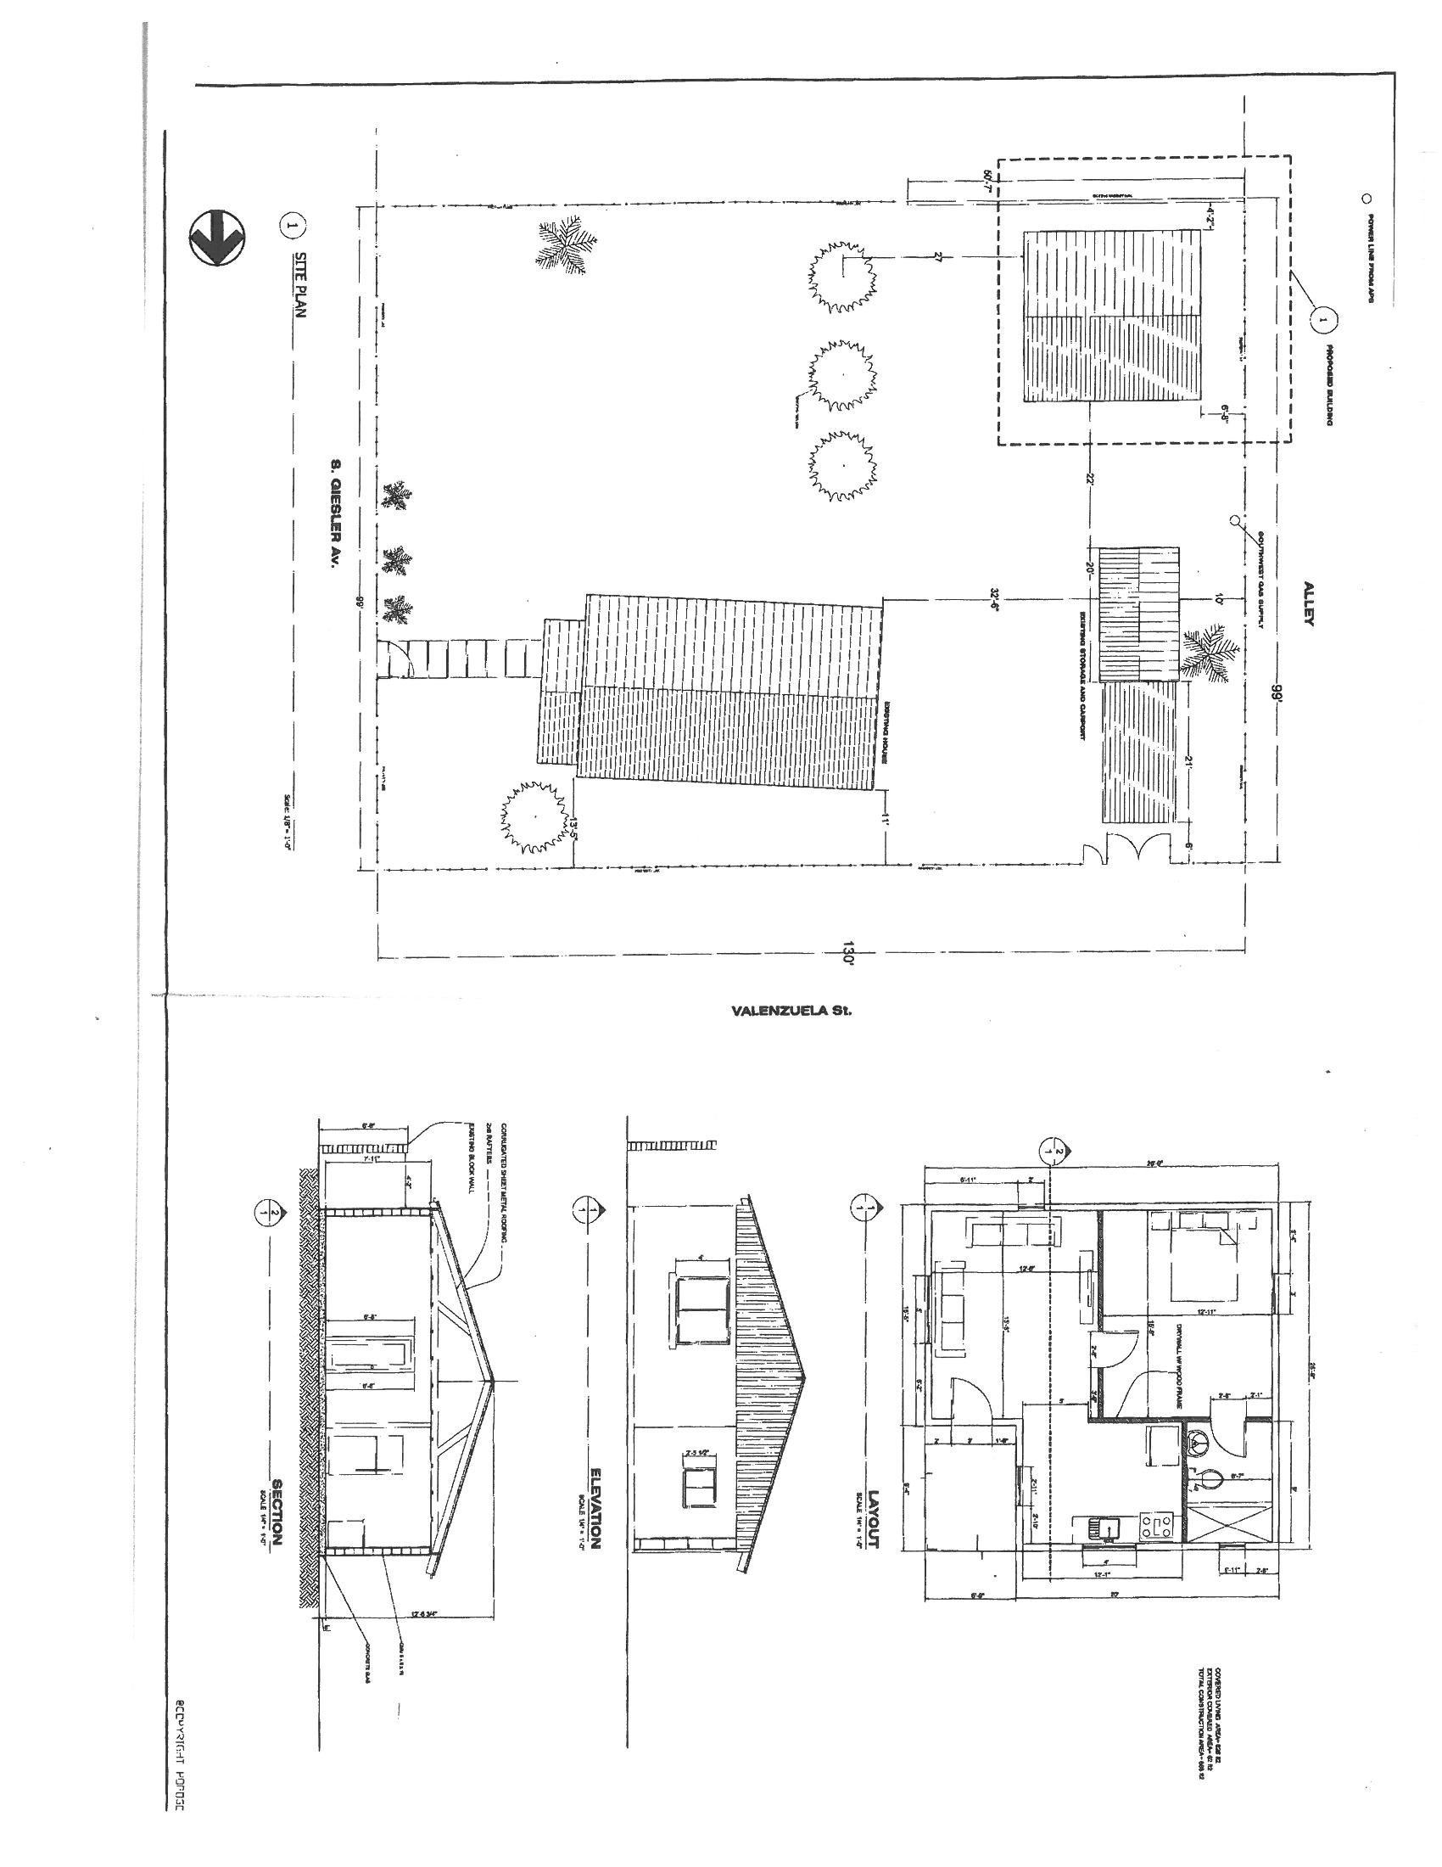
Concept Plan
Proposed Second Dwelling

Slide 6
Concept Plan
North view of the Jantz residence.

Slide 7
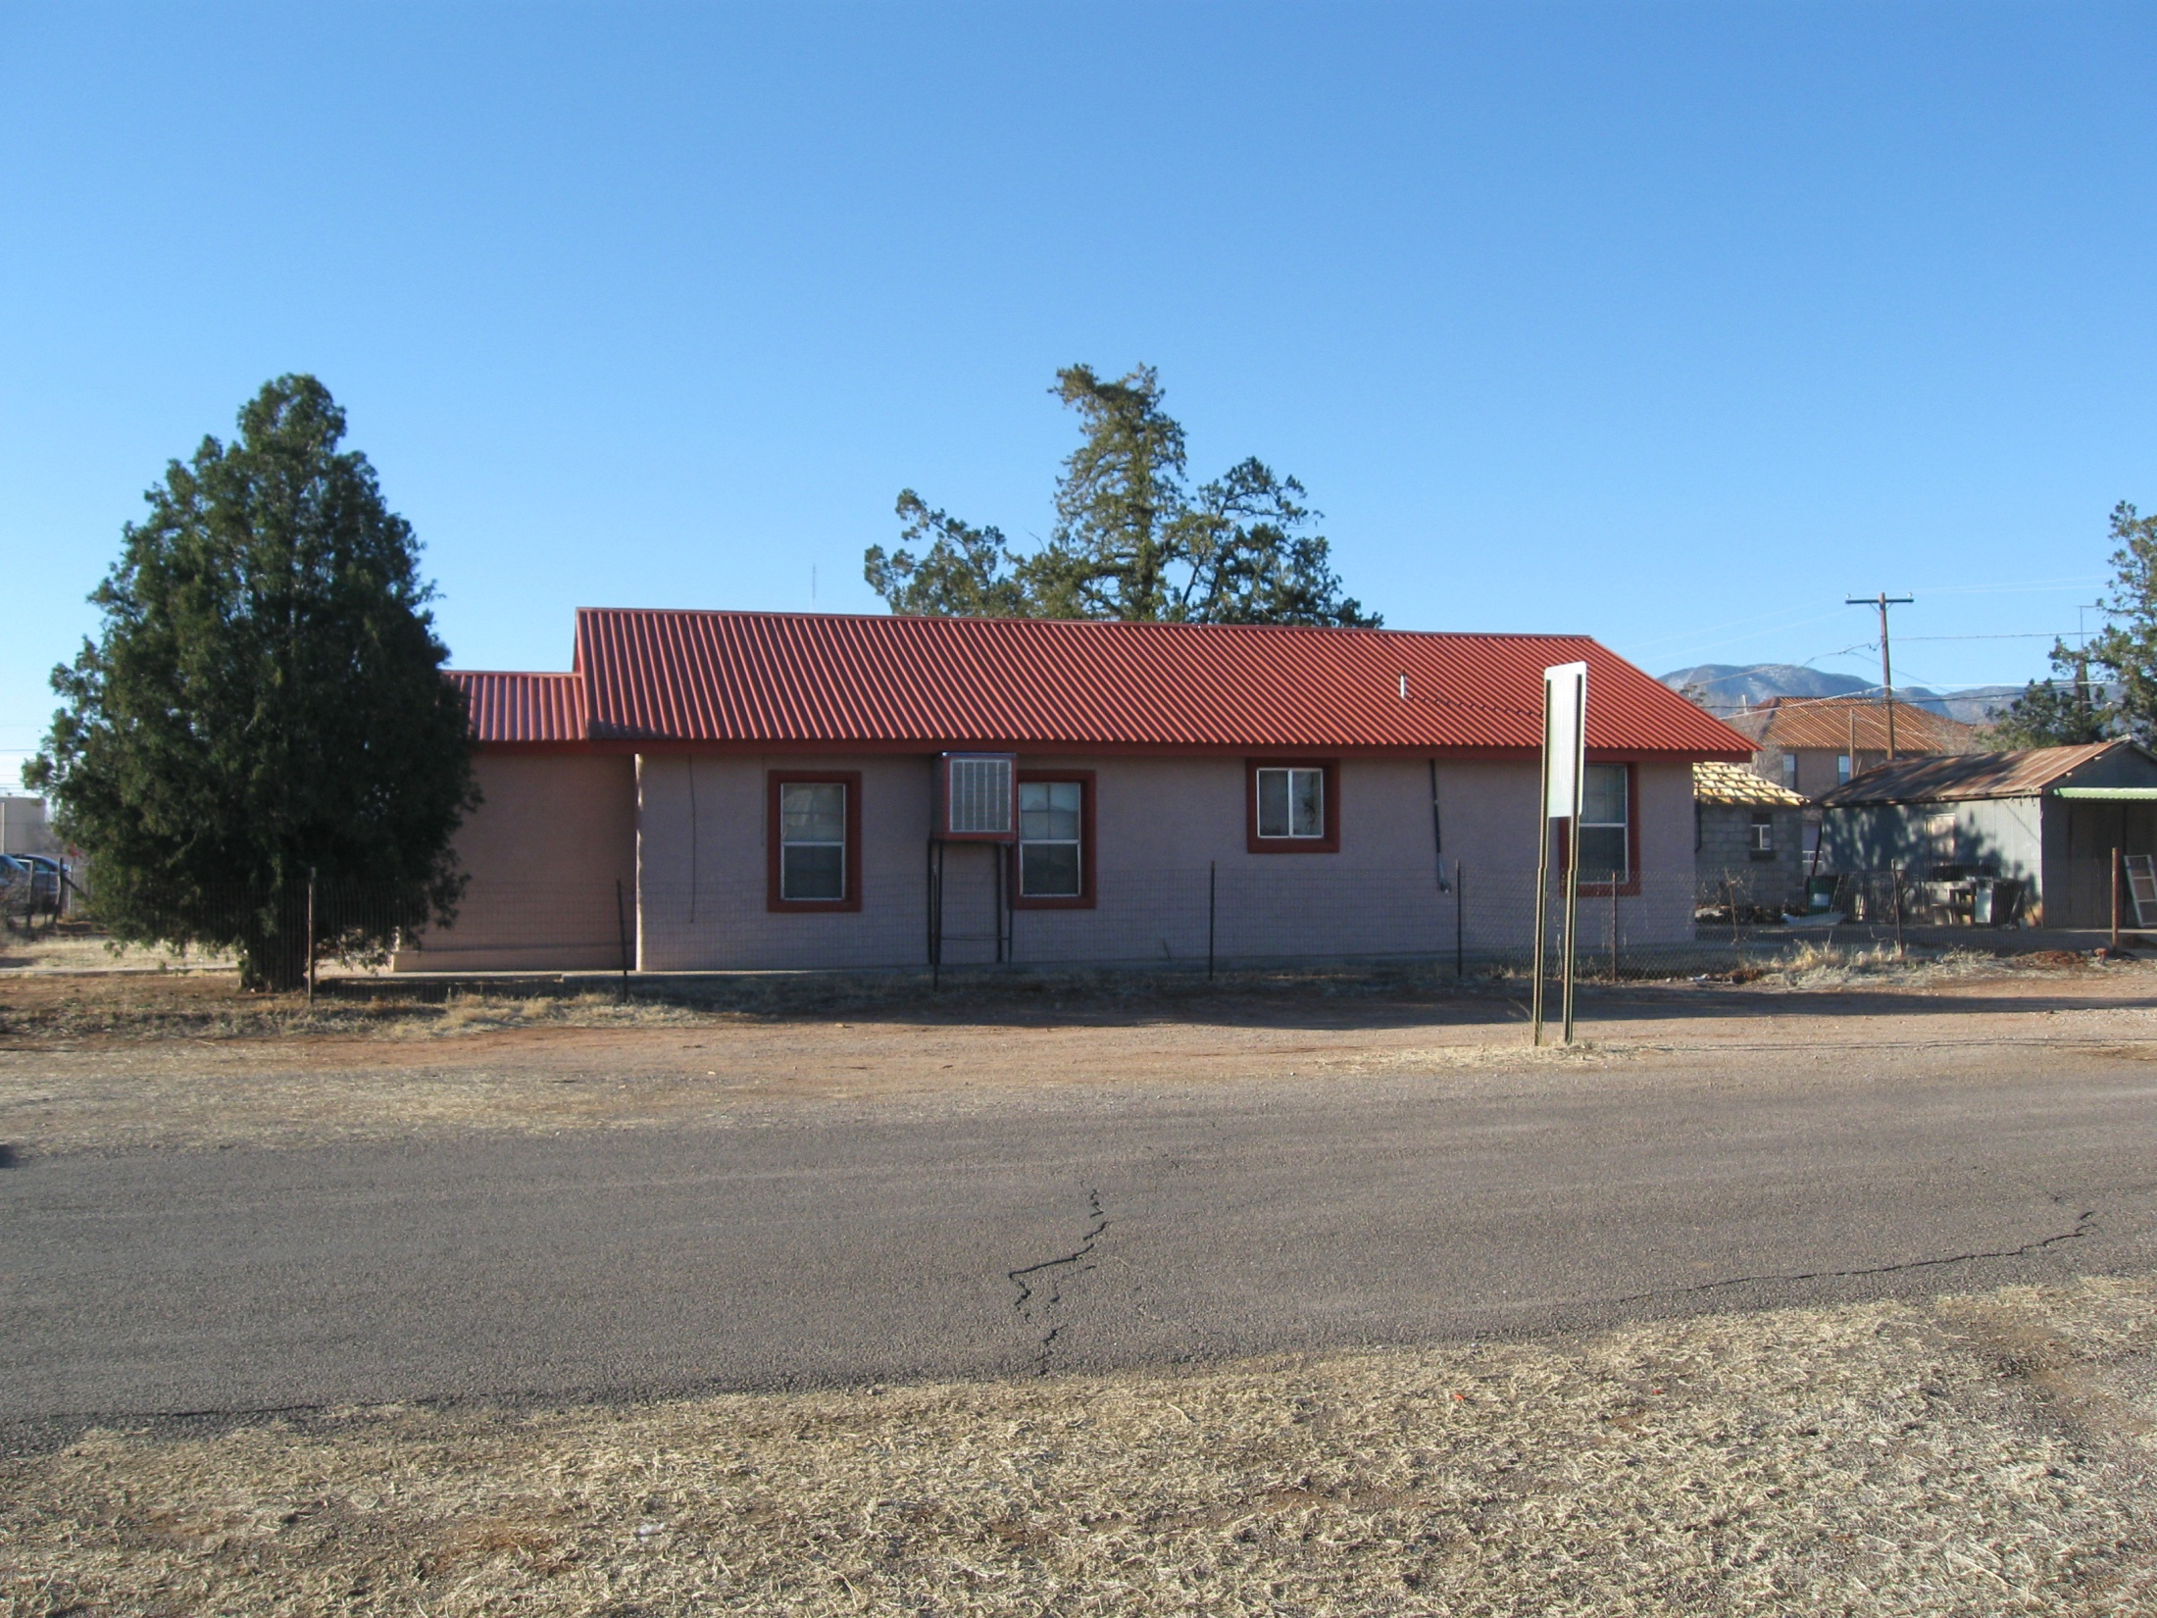
Site Photos
Looking East at farm fields on the site.
South view of the Yesca residence

Slide 8
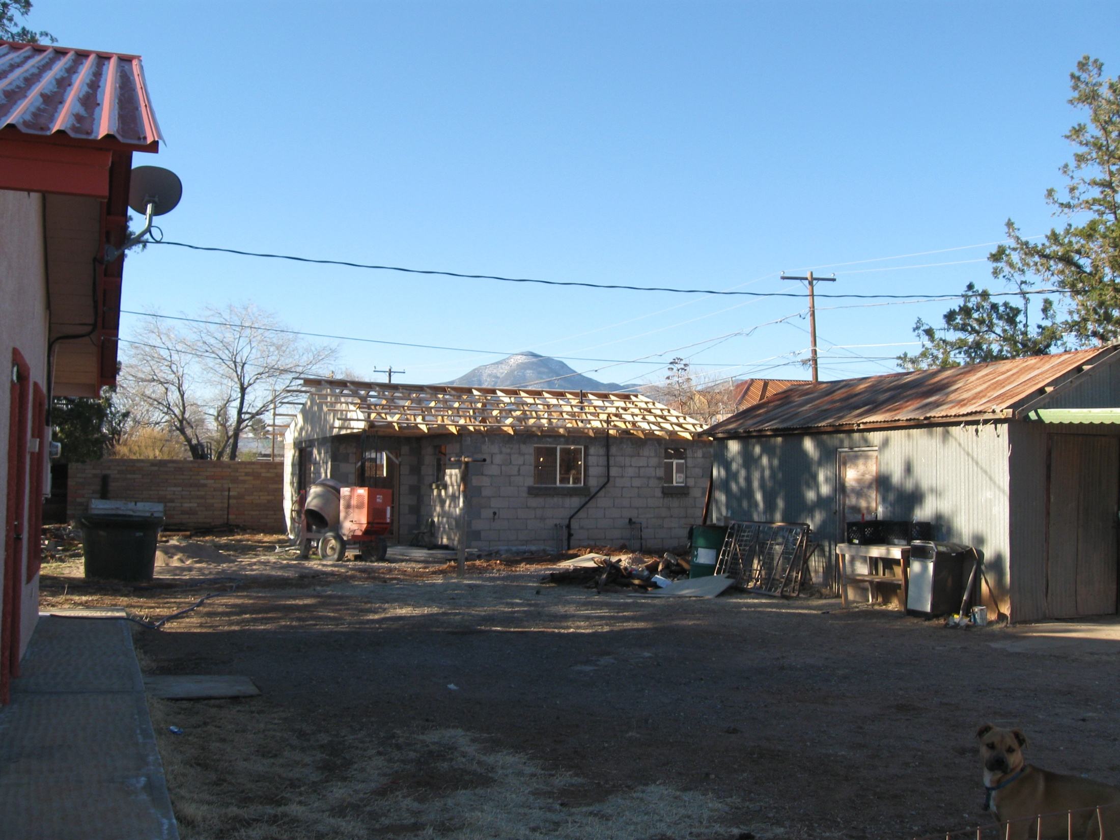
Site Photos
The partially-constructed second dwelling sits at the rear of the property
Future sweet potato fields and pistachio orchards.

Slide 9
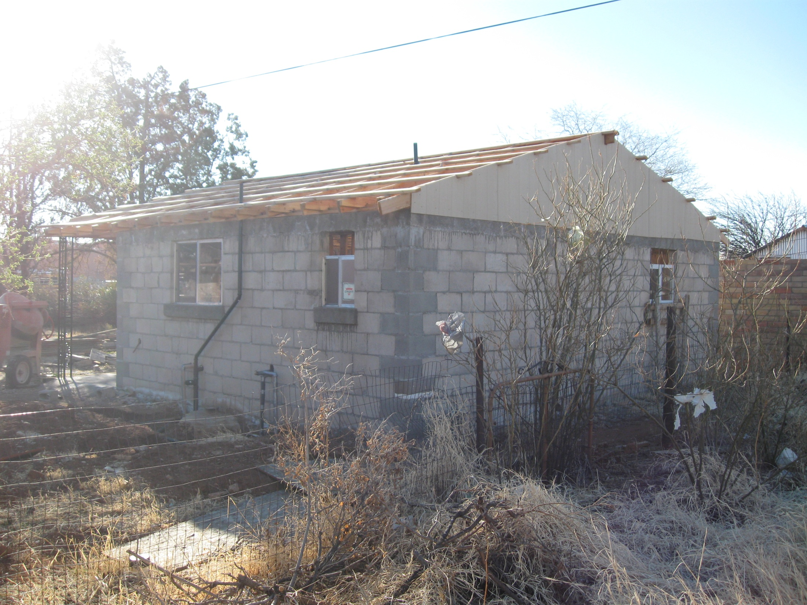
Site Photos
Fruit tree orchard adjacent to Allen Road.
Southeast view of the proposed second dwelling

Slide 10
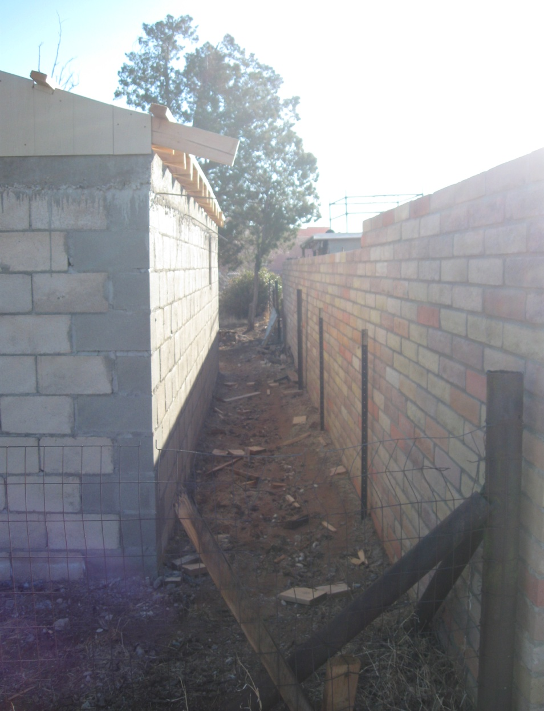
Site Photos
The original garage was demolished, and the second dwelling has been partially constructed on the existing pad.
The new structure would be non-conforming with the required 20-ft setback for MR-1 sites abutting a Residential Zoning District.
4’ 6”

Slide 11
Naco Community Plan
Property is within a “High-Density Residential” area within the Area Plan boundaries, defined as one dwelling per 3,100 to 9,000 square feet.
A rezoning request for MR-1 is therefore in conformance with the Naco Plan.

Slide 12
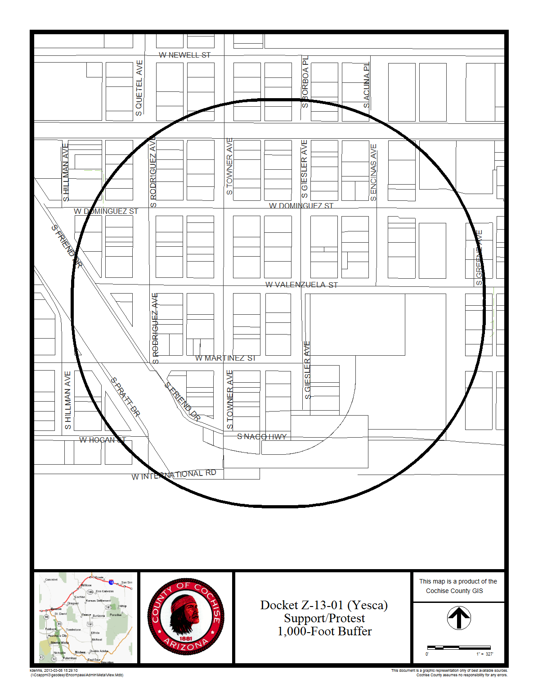
Support & Protest
Staff received letters of support from two area property owners & opposition from two property owners.

Slide 13
Factors in Favor
Allowing the request would be in keeping with the character of development in the area;
The Naco Community Plan policies prescribe a high density of residential development in this area, and the request would facilitate such a density;
The Applicant’s Citizen Review effort yielded eight positive responses from neighboring property owners; and
The subsequent County mailing resulted in two area property owners expressing support for the proposal.
The Planning & Zoning Commission voted 7-1 to forward recommendation of approval.

Slide 14
Factors Against
The request comes as a result of a Zoning Violation for building without a permit;
The rezoning, if approved, would result in increased setbacks, from the current TR-9 standard of 10-feet, to the MR-1 standard of 20-ft along abutting residential Districts. The proposed second dwelling, built on the existing concrete pad, will be non-conforming with the setback standards along the south property line; and
Two area property owners oppose the request.

Slide 15
Recommendation:
Conditional Approval
The Applicant shall provide the County with a signed Acceptance of Conditions and a Waiver of Claims form arising from ARS Section 12-1134 signed by the property owner of the subject property within thirty (30) days of Board of Supervisors approval of the rezoning; and
It is the Applicants' responsibility to obtain any additional permits, or meet any additional conditions, that may be applicable to the proposed use pursuant to other federal, state, or local laws or regulations.

