Slide 1

Broadband Local Planning Assistance through the
Digital Arizona Program for
Southeastern Arizona Counties
Cochise County
Board of Supervisors Work Session February 26, 2013
Notes:
Intro of who is in room and on conf call

Slide 2
Why Broadband?
Arizona rural residents and businesses do not have access to broadband services that urban areas possess
Lack of services has a direct and negative impact on their lives:
  Limits available jobs
  Limits educational opportunities
  Limits health care services
  Major safety factor for law enforcement
Negative impact on residents = negative impact on communities
Notes:
Negative impact on communities = negative impact on the Counties and our state

Slide 3
Quality of Life
2007 MIT Study
In Counties with broadband development, the Sales Per Capita grew almost twice as fast as counties without the service.
Employment increased over 5%
Larger impact in smaller, rural communities.

Slide 4
How Arizona Got Broadband
SB 1402 – Digital Arizona Highways Bill
Enables private sector providers to extend broadband services by expanding use of existing state roadway right-of-way uses.
End result: 2 highways for nearly the cost of one.
Notes:
Primary approach: deploy conduit along state highways and rural frontage roads to be leaded to providers at cost to facilitate availability of fiber internet middle-mike capacity to support provider’s investment in more and faster services for rural arizona.
Leverage public right of ways – canals, powerlines, railroads
Broadens definition of transportation to include the transportation of information.
1 conduit will be made available for ADOT smart highway use. All other conduits will be available for private sector provider use.
ADOT managed right of ways

Slide 5
Who Provides Funding?
Arizona Strategic Enterprise Technology (ASET) created the Digital Arizona Program for the State.
ASET is a division of the Arizona Department of Administration (ADOA)
Funding comes from Federal Stimulus grants with matching funds from Arizona
Notes:
Funding must come from sources other than existing ADOT funding or general fund

Slide 6
ASET’s Broadband Deployment Process
Outreach
Development Providers
Technical Assistance Providers
Informing
We inform COGs’ Regions/Communities
of the Broadband mission in AZ
(ASET must provide details/budget)
From the GAP Analysis we prepare
Infrastructure Concept Report
That will determine if Infrastructure is
  Satisfactory
  Unsatisfactory
Discussion
Listen to region/community
problems and document
Prepare Implementation Strategy
Working with:
Community Leaders/Businesses
Service Providers
ATII Technical Assistance Consultants
Prepare GAP Analysis
Gathered facts will produce
the problem(s) & our Tech-Assist.
Professionals will provide a
GAP Analysis
Notes:
Brad slide

Slide 7
How Much is Available?
Arizona received $6.3 million in Federal Broadband Funding Grants in 2010.
Future funding is expected to continue.
Notes:
Mission is to implement a sustainable, leveraged broadband plan for accelerating transformation of economic growth, education, healthcare and business in Arizona.

Slide 8

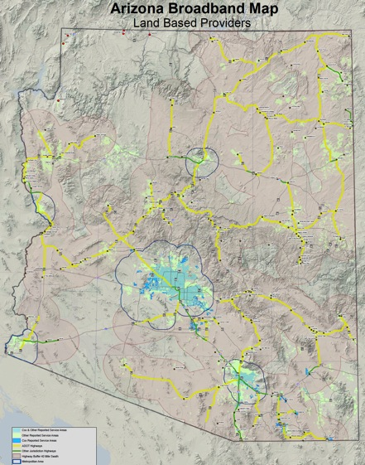
5 - 7 YEAR ESTIMATE
$25K to $50K per rural conduit trench mile
~2500 to 3000 rural trench miles
$20M to $50M per year
Whole State covered in 7 to 10 years
Program can then be “sunset” to maintenance only mode
Notes:
Brad – State Slide – what does 20m to 50M per year cover?

Slide 9
Why Partner?
3 Arizona COG’s have already agreed to receive planning and technical assistance under this program.
4 Southeastern Arizona Counties are collectively in need of grant funding:
  Cochise County
Graham County
Greenlee County
Santa Cruz County
The 4 Counties desire to enter into an Intergovernmental Agreement (IGA)

Slide 10
The 4 Counties desire the designation of Cochise County as Grant Recipient and Fiscal Agent for the Digital Arizona Program Grant for Southeastern Arizona.
Solution ?
The IGA would allow Cochise County to apply for and manage broadband grants

Slide 11
$30,000
25% match ($7,500)
Planning Grant
This grant would allow us to obtain the services of a consultant to develop the initial steps to create an effective broadband development plan for the 4 County region.
First step is to create a broadband committee of local stakeholders and interested parties.

Slide 12
$19,600
25% match ($4,900)
Technical Grant
This grant would focus on a gap analysis of broadband capacity needs in the 4 County region as determined by a consultant.

Slide 13
What about Match Funds?
The match can be met through in-kind assistance:
Grant Management and accounting
Staff time to travel to and attend meetings
Staff technical time
  The grant does not cover travel related costs of staff such as vehicle mileage or motels.
    These costs could be paid for by the Counties and used as local match
Notes:
Cash can always be used as match

Slide 14
What to Accomplish?
Discussion and Possible Recommendation regarding the IGA between the 4 Counties
Next Steps?
  Formal Approval of IGA between all Counties
  Select Consultant and Apply for Grant Funding
Notes:
Improve Quality of Life in 4 County Region

Slide 15
Questions?
Visit: DigitalArizona.gov
Thank you!

