Slide 1
Foreclosure Registry
Board of Supervisors Work Session
March 12, 2019
Cochise County
Community Development
Department of Planning, Zoning and Building Safety

Slide 2
What is a Foreclosure Registry?
Registration and maintenance program for properties in foreclosure or bank owned.

Slide 3
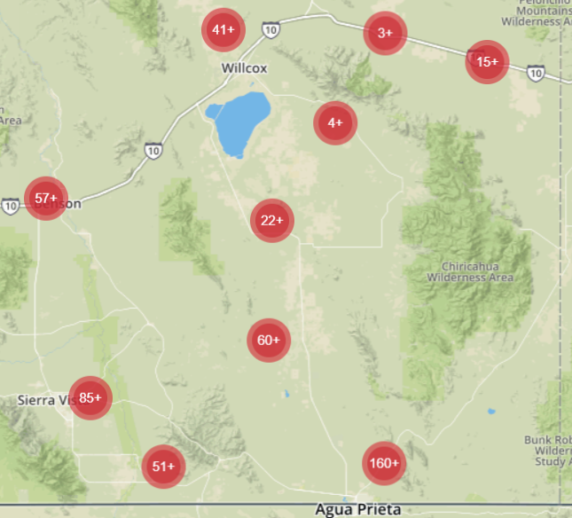
Foreclosed Homes in Cochise County
Estimate between 500 – 2000 properties, depending on the source.

Slide 4
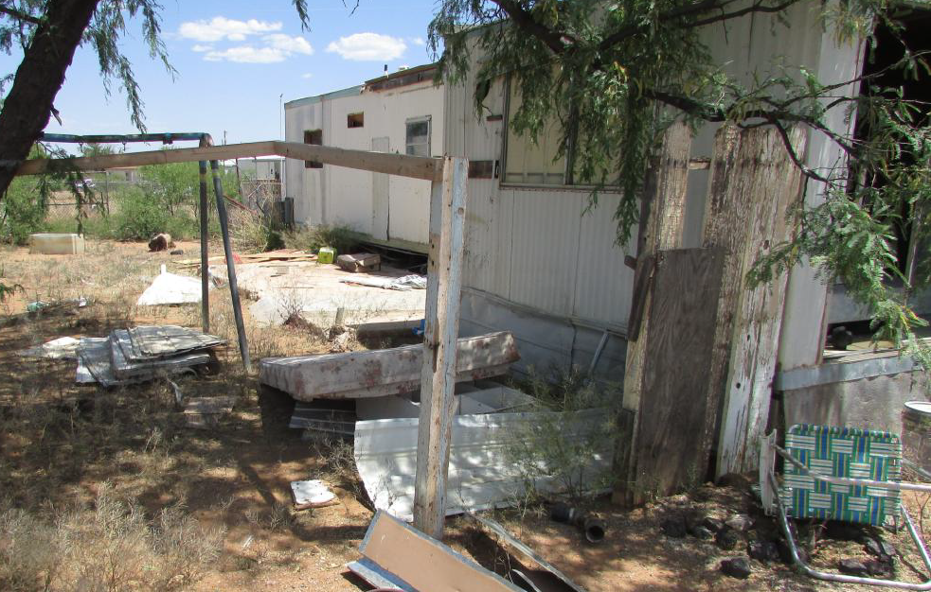
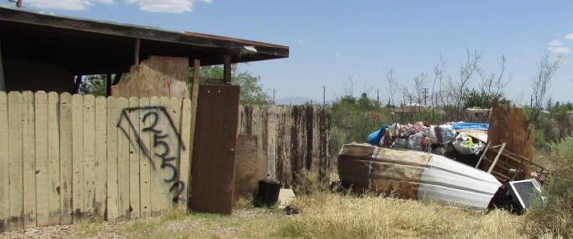
Huachuca City (Whetstone)

Slide 5
Why is a Foreclosure Registry Beneficial to the County
Foreclosed properties often lead to new violation cases.
It’s common to find damaged windows and/or doors and/or large amounts of trash and debris on the property after the home has been vacated.
Notifies the County that the property is vacant triggering active code enforcement.

Slide 6
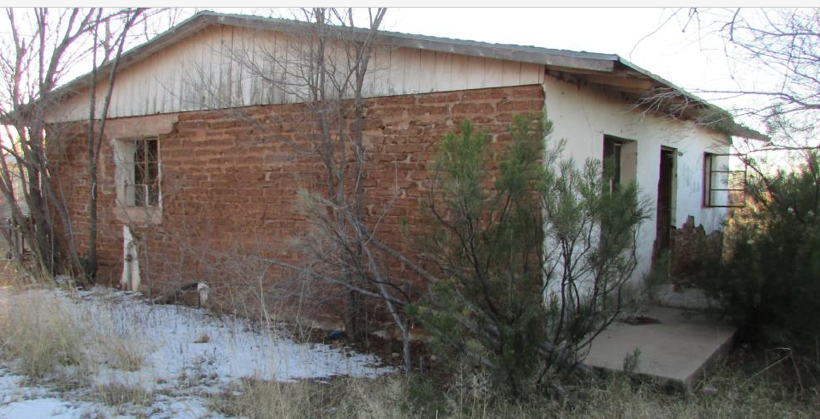
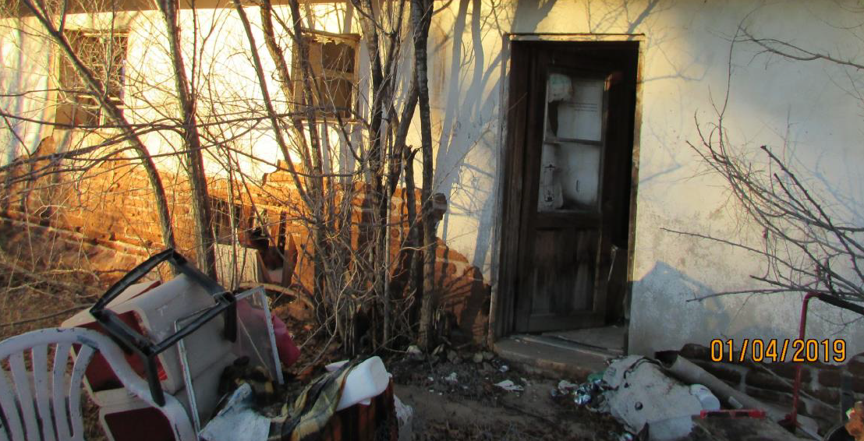
Bisbee

Slide 7
What will a Foreclosure Registry Accomplish
It protects the area from blight and nuisances resulting from foreclosed properties.
Provides a point of contact of the Bank’s Asset Manager.
Holds the Mortgagee accountable for securing and maintaining the property and keep it free of trash and waste.
Requires posting contact info in case of an emergency.
Requires the Bank to pay County liens on the property.

Slide 8
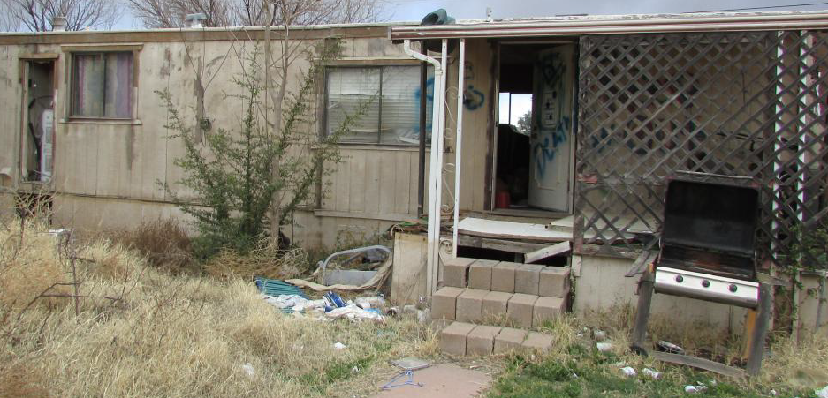
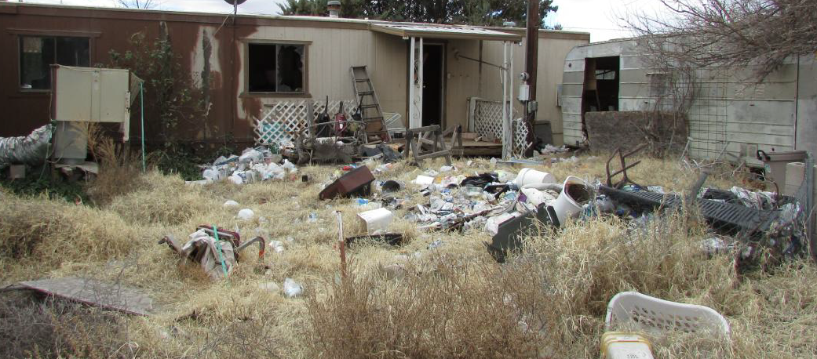
Hereford (Palominas)

Slide 9
How to Register and Deregister
Register and pay the fee online or fill out a form provided by the County.
Mortgage field service companies provide to banks a listing of communities with a Foreclosure Registry requiring registration.

Slide 10
Proposed Fees
Registration Application Fee of $150
Deregistration Fee $0
Any additional owed to the county such as taxes, fines, or leans

Slide 11

Questions
This Photo by Unknown Author is licensed under CC BY-NC-ND

