Slide 1
Docket V21-07 (Atsina)
Request for a Variance
Board of Adjustment, District 1
December 1, 2021

Slide 2
V21-07 (Atsina)
Request: Variance to Section 904.03 of the Zoning Regulations, requesting six foot setbacks where 20 foot is required
The subject property is located at 2955
Parcel Number is identified as 105-99-417
The site is approximately 1 acre
The Applicant is Mr. Neil Josephson

Slide 3
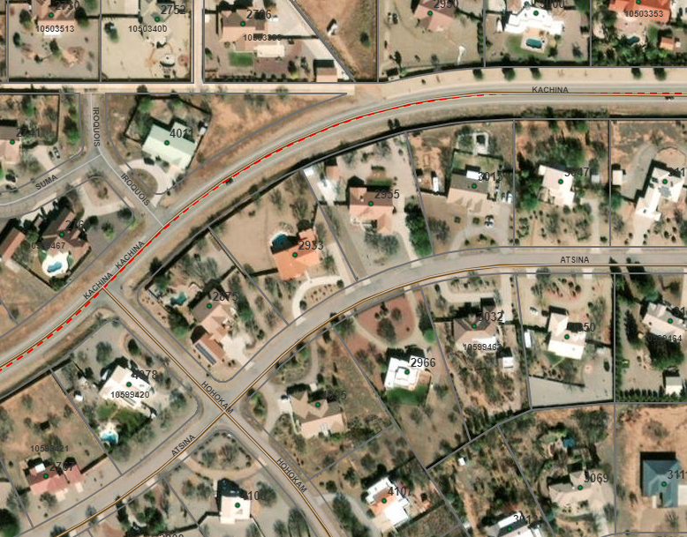
V21-07 (Atsina)
Location
PIQ

Slide 4
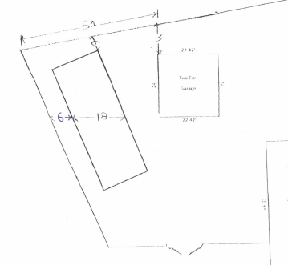
V21-07 (Atsina)
Kachina
N
Existing
Garage
Site Plan
Proposed Carport
Existing
Residence
Atsina

Slide 5
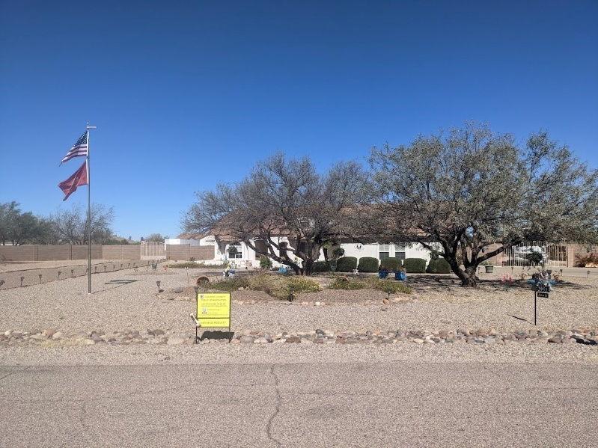
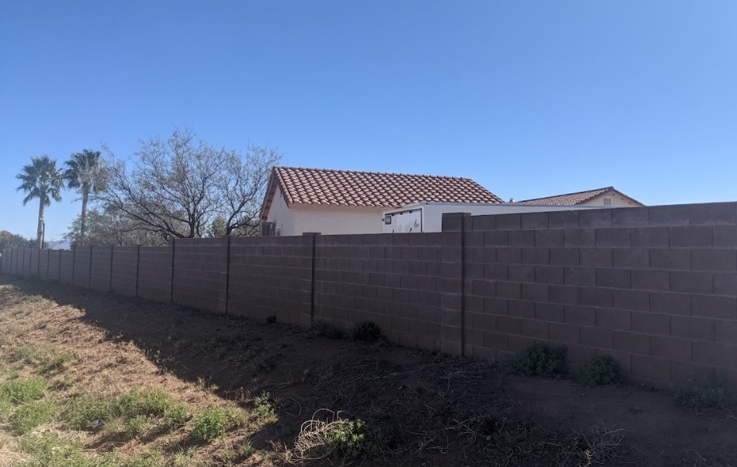
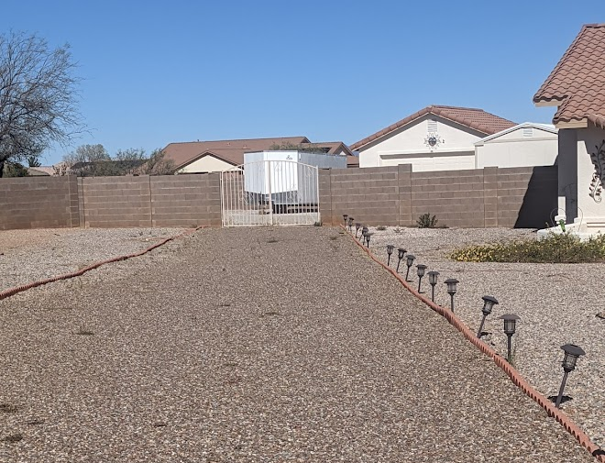
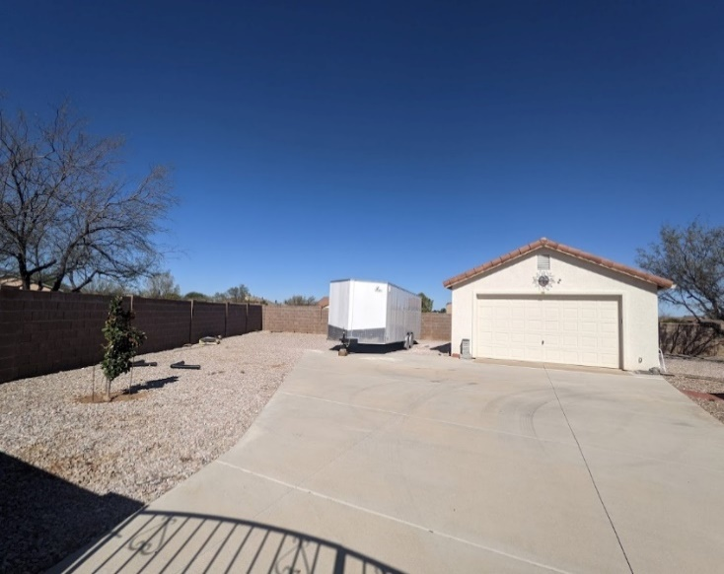
V21-07 (Atsina)
Site Photos

Slide 6
V21-07 (Atsina)
Surrounding Encroachments

Slide 7
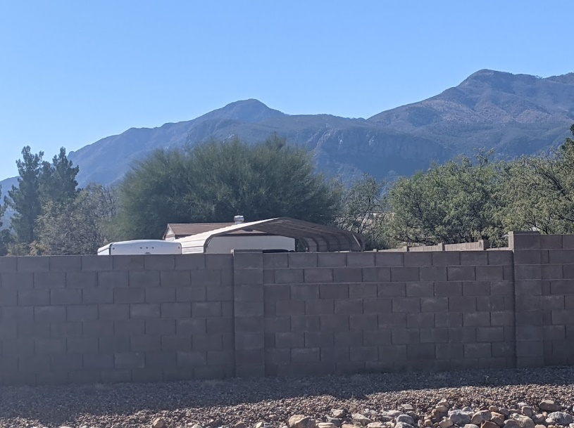
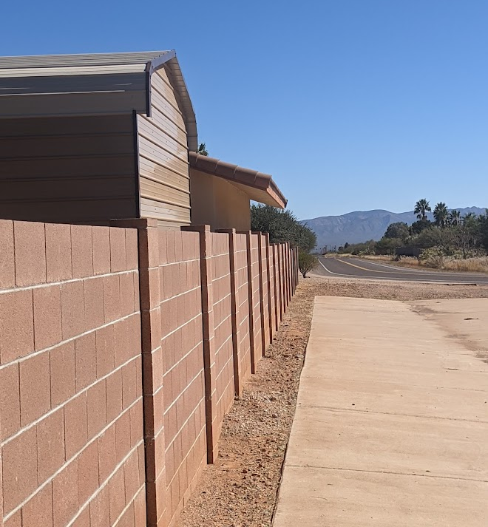
V21-07 (Atsina)
Surrounding Photos

Slide 8
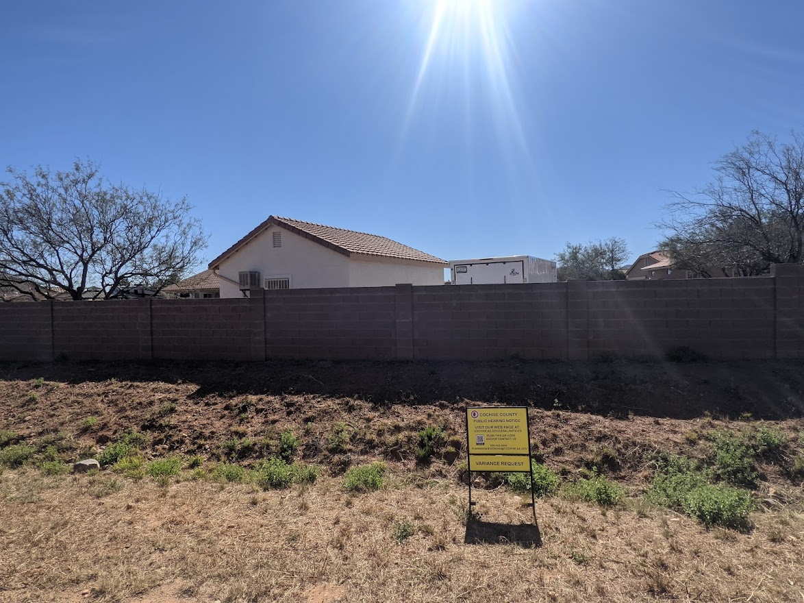
V21-07 (Atsina)
Public Input
One (1) response in support

Slide 9
Factors in Favor of Approval
V21-07 (Atsina)
The location of the residence, driveways and garage provides some difficulties in meeting the setback requirements;
The structure is consistent and compatible with the neighborhood;
Allowing the Variance does not compromise safety or quality-of-life for area residents;
County government has been engaged in an ongoing effort to make government operations, administration of Zoning and other regulations, and permitting requirements more “customer friendly.” Allowing the Variance would reinforce this effort without compromising safety or quality of life for area residents.
One letter in support was received
None identified
Factor Against Approval

Slide 10

V21-07 (Atsina)
Discussion

Slide 11
Recommendation:
Conditional Approval
V21-07 (Atsina)
Based on the Factors in Favor of Approval as Findings of Fact, Staff recommends approval of the Variance as requested and amended by staff.
Mr. Chairman, I move to approve Docket V21-07 (Atsina), on parcel 105-99-417, granting the Variance as requested by the Applicant and amended by Staff, the Factors in Favor of approval constituting the Findings of Fact.

