Slide 1
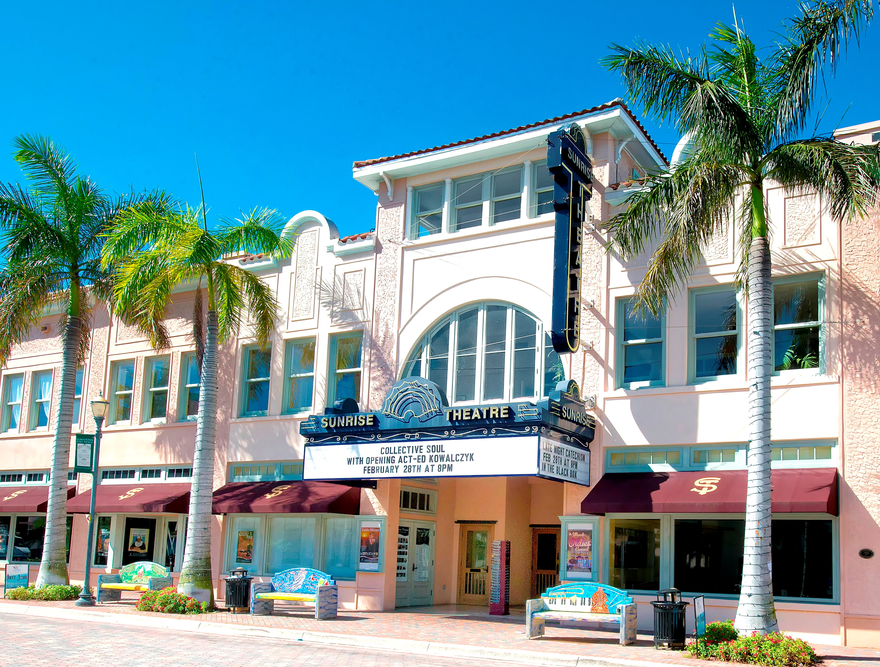
Sunrise Theatre
COMMUNITY INPUT MEETING
• June 27, 2018 •

Slide 2
CURRENT STATUS OF THE SUNRISE THEATRE

Slide 3
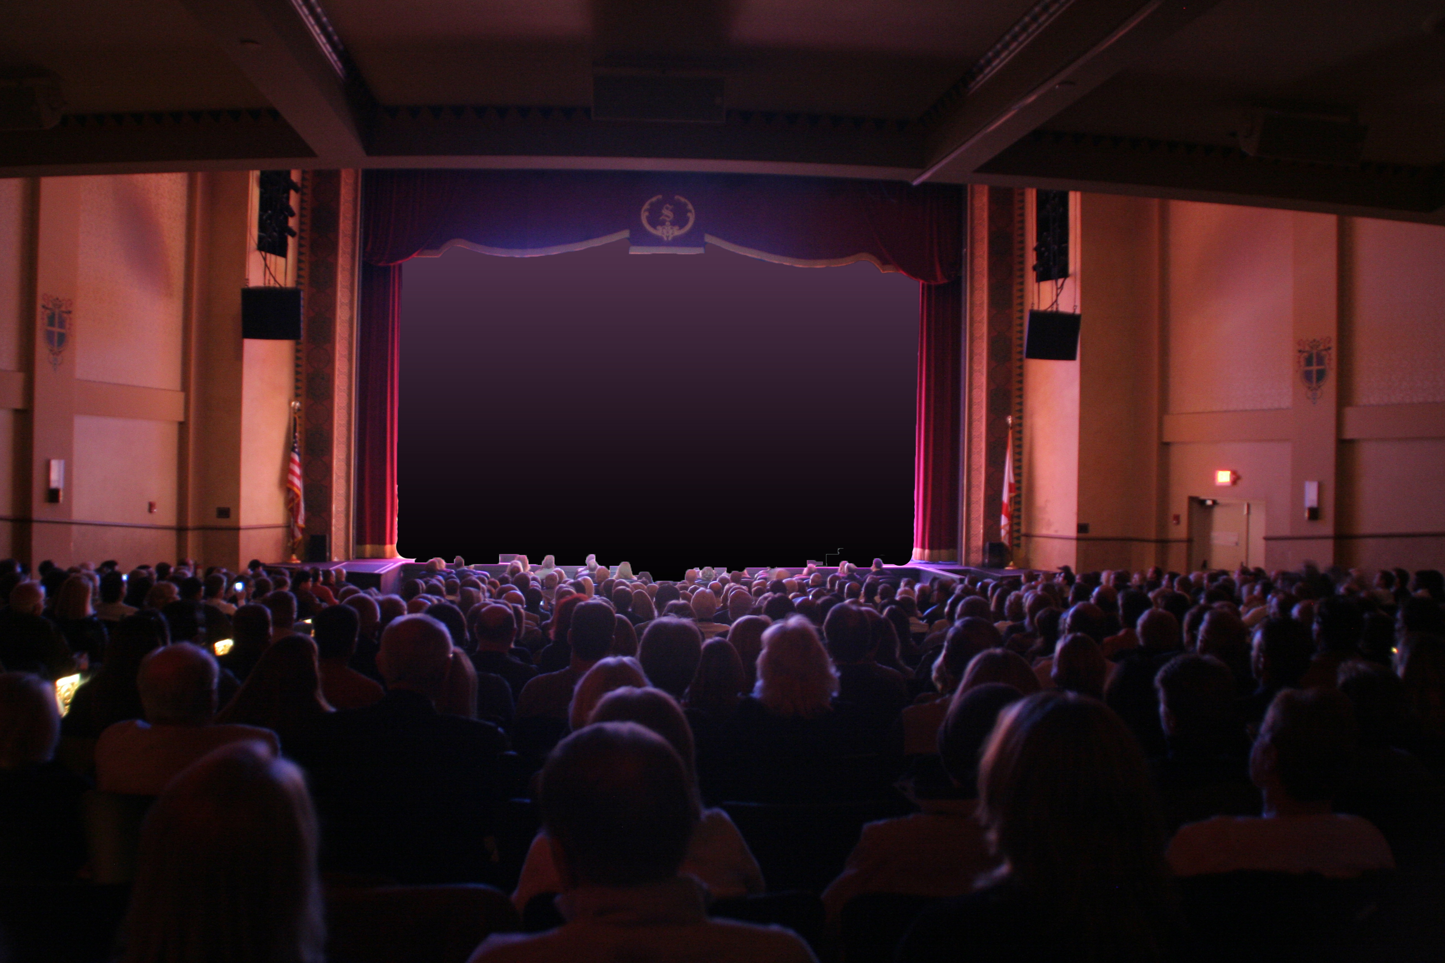
Survey Summary
LAUNCHED MAY 14, 2018
24 QUESTIONS
743 RESPONSES

Slide 4
HOME ZIP CODE

Slide 5
AGE

Slide 6
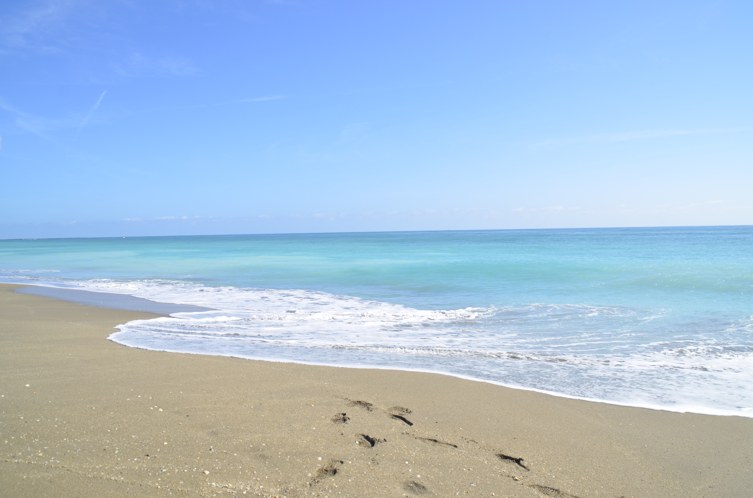
FULL TIME VS. SEASONAL RESIDENTS

Slide 7
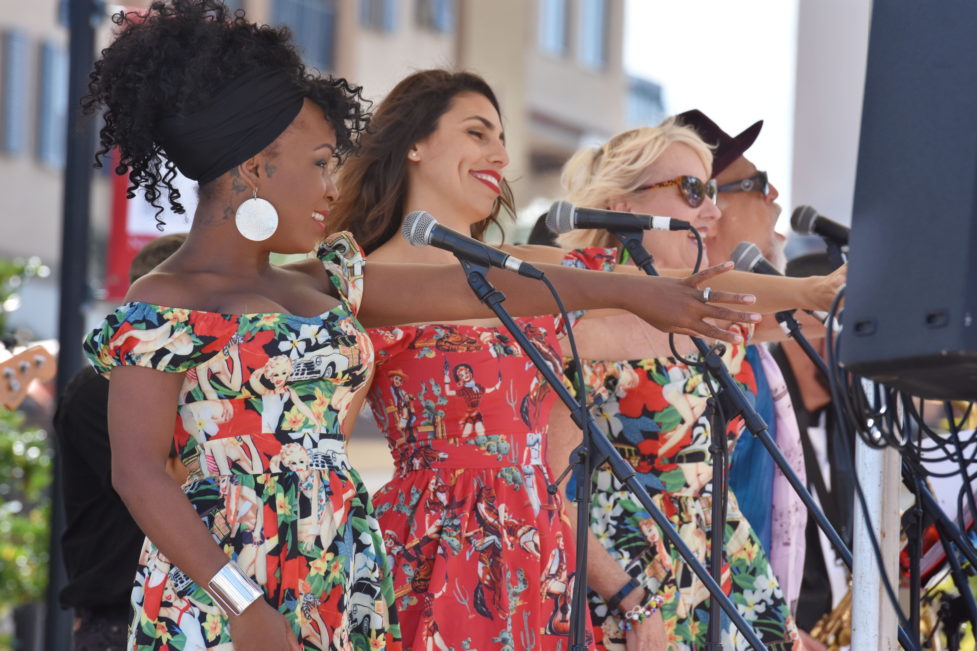
• GENERAL ENTERTAINMENT PREFERENCES •
35%
of respondents attend movies, live concerts, art-related events
1-2 TIMES PER MONTH.

Slide 8
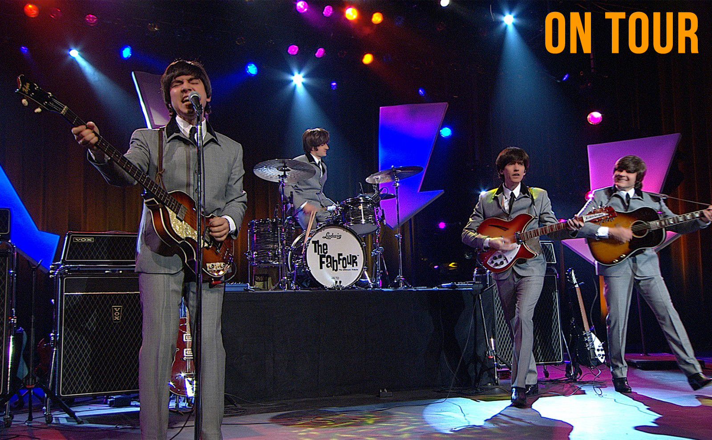
• GENERAL ENTERTAINMENT PREFERENCES •
91%
of respondents feel that the CONTENT OF THE SHOW is the most important factor when purchasing entertainment.

Slide 9
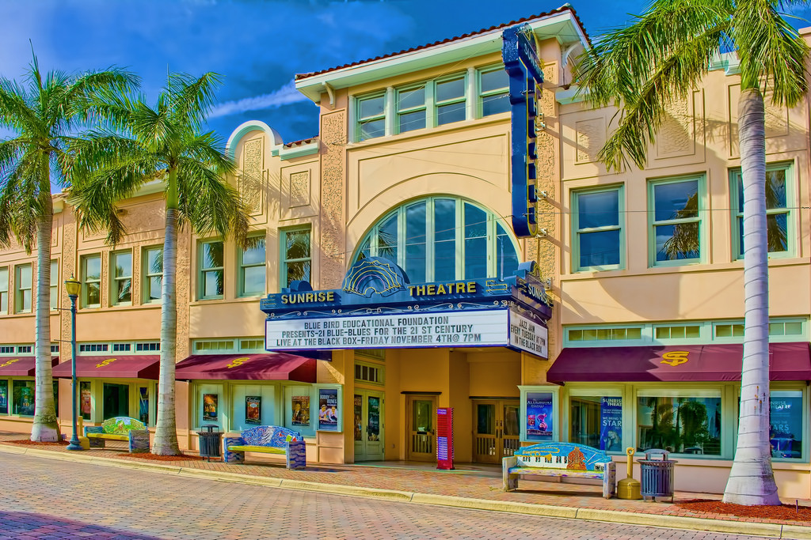
• SUNRISE EXPERIENCE •
96%
of respondents HAVE ATTENDED a show at the Sunrise Theatre.

Slide 10
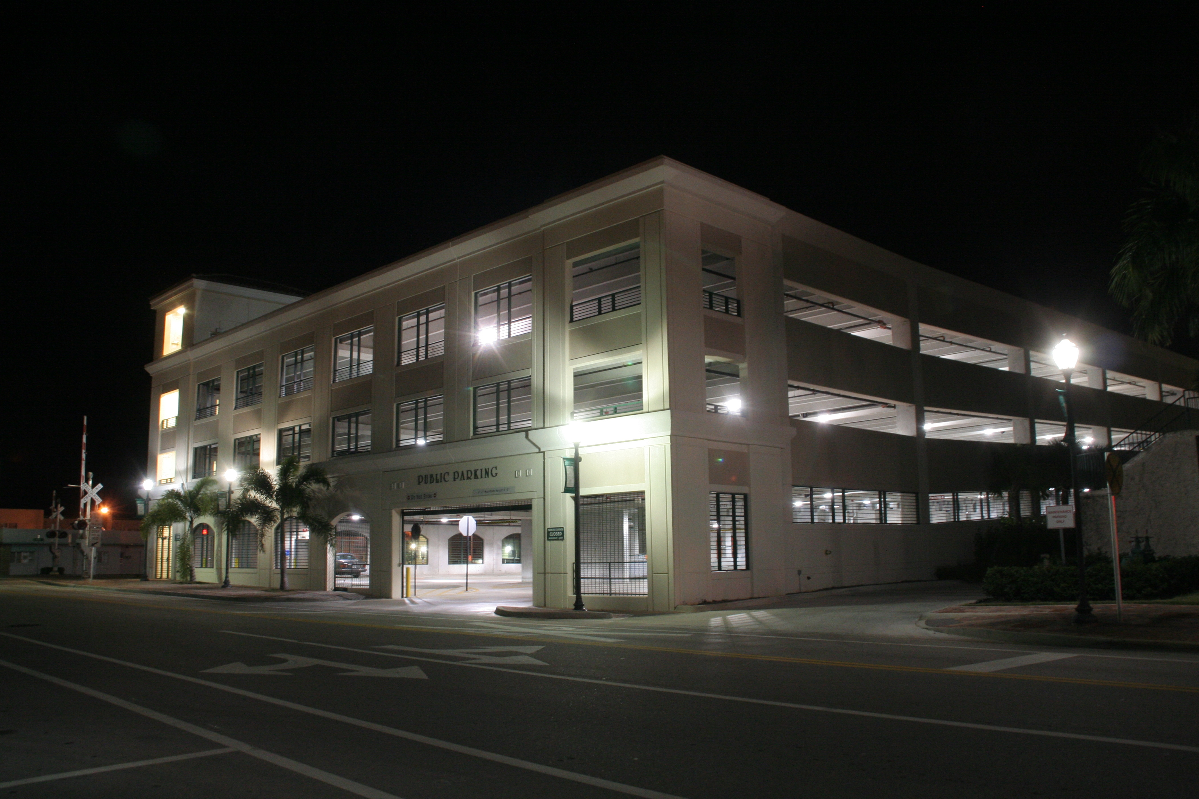
• SUNRISE EXPERIENCE •

Slide 11
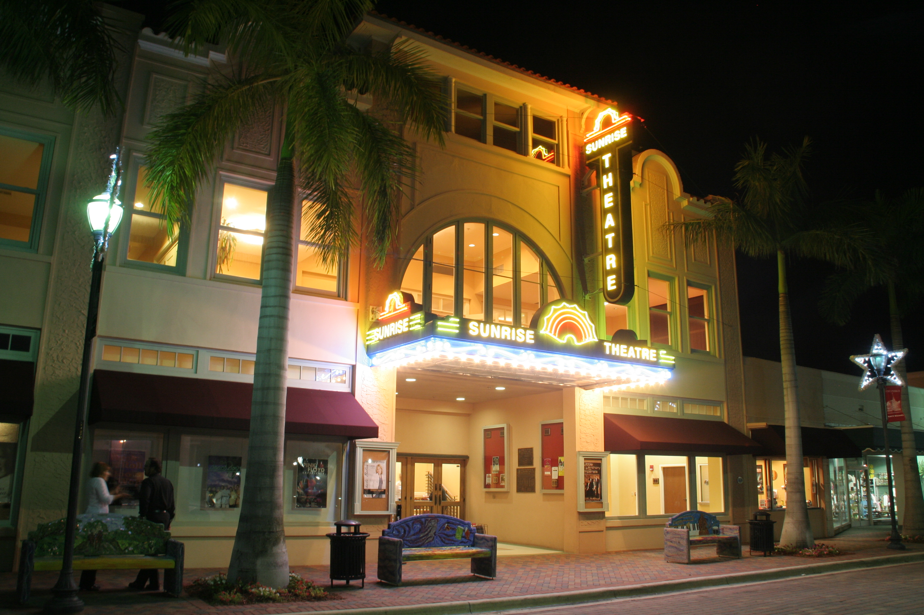
• TICKETS •
68%
of respondents rated the price of tickets at the Sunrise Theatre as COMPARABLE TO OTHER THEATERS

Slide 12
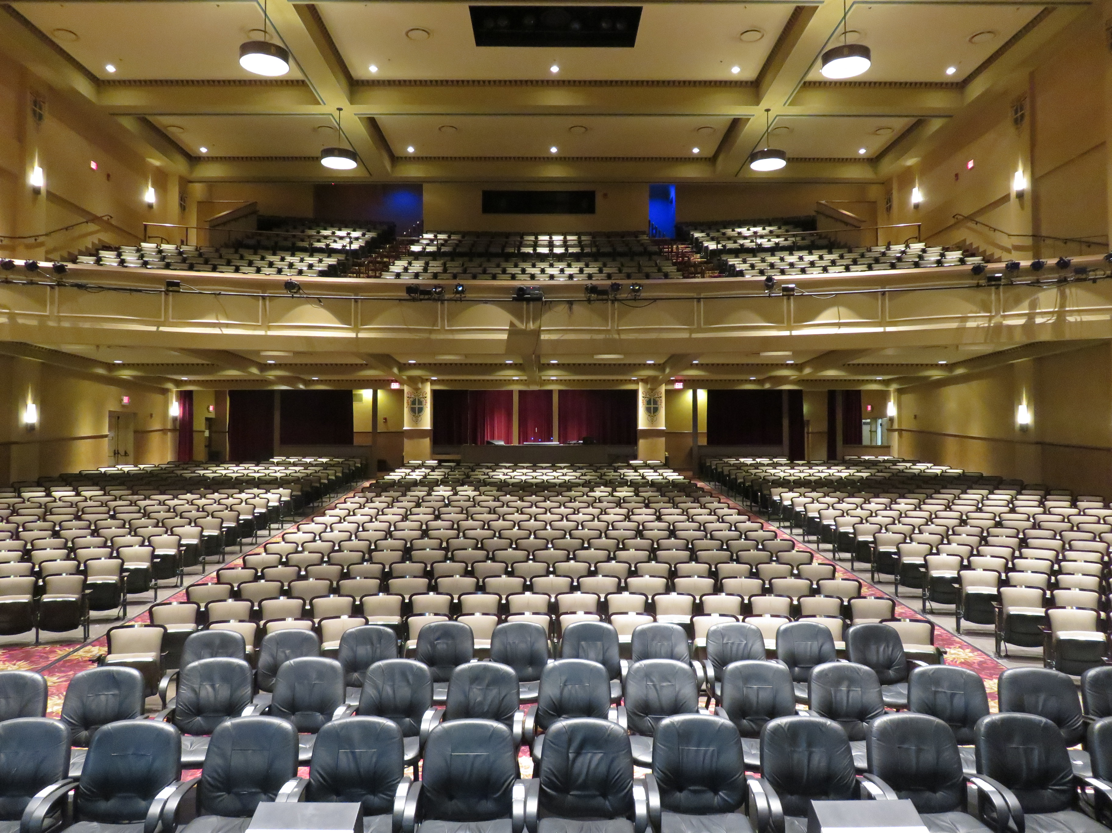
• TICKETS •
62%
of respondents purchase Sunrise Theatre tickets ONLINE

Slide 13
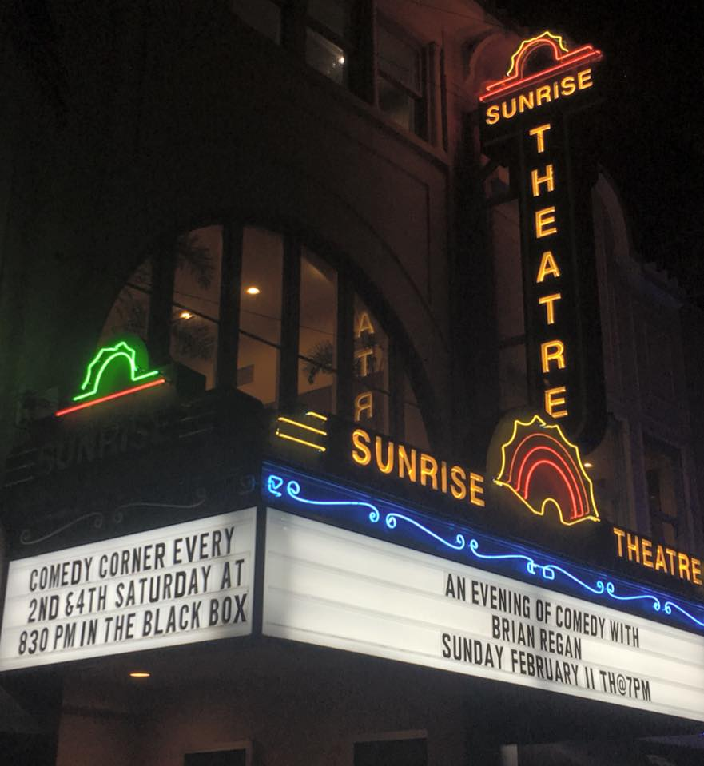
TOP 10 “MOST INTERESTED” EVENTS:
Theater: Professional
Concerts: Pop
Comedy/Variety/Open Mic
Concerts: Inde/Rock
Concerts: Country/Bluegrass
Concerts: Rhythm and Blues
Concerts: Jazz
Dance
Concerts: Classical Music
Movies: Recent Releases

Slide 14
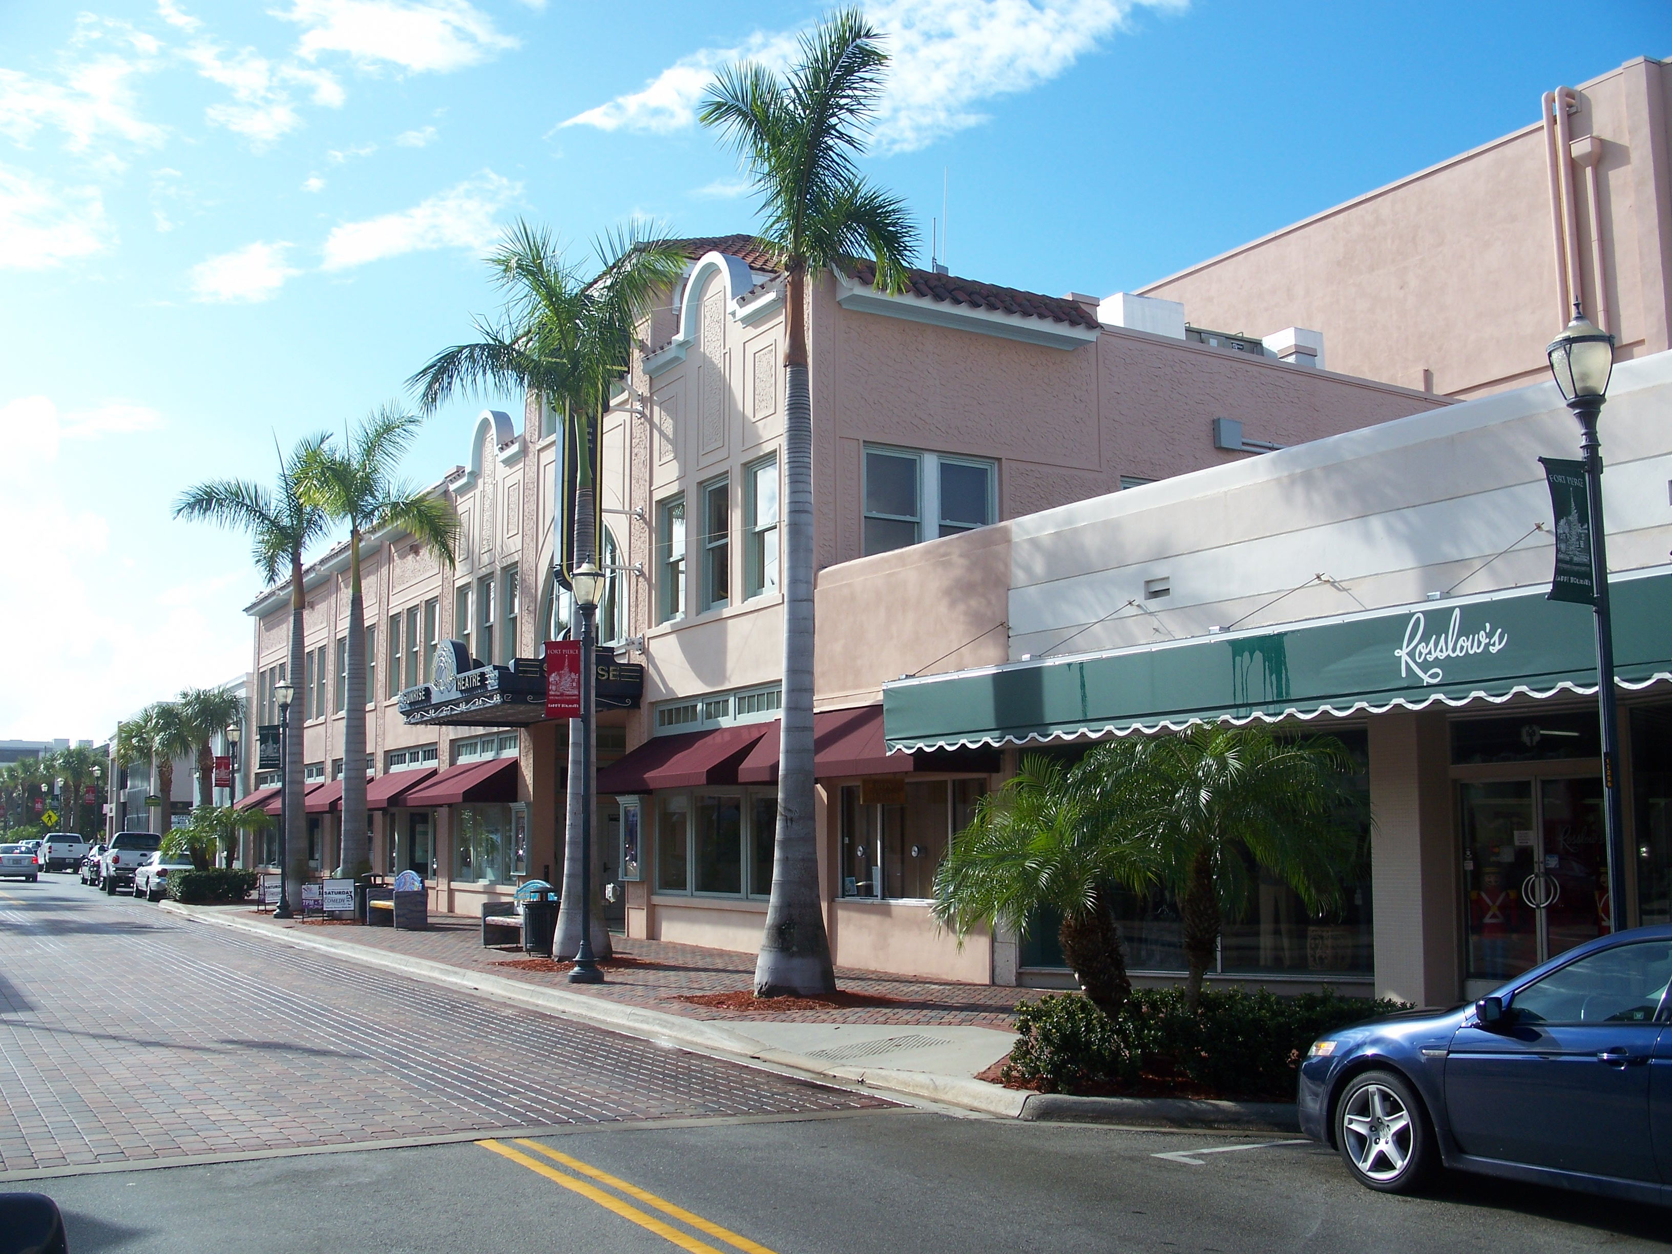
• WHAT MAKES THE SUNRISE GREAT •
LOCATION
CHARM
COMMUNITY IMPACT
ATMOSPHERE
BUILDING
COST
ACOUSTICS
SEATING
SHOWS
STAFF
HISTORY

Slide 15
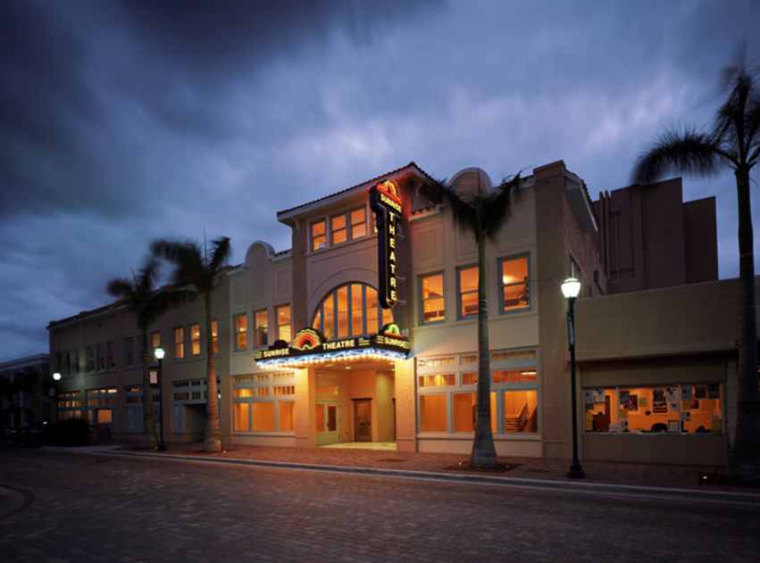
• HOW CAN THE SUNRISE IMPROVE? •
MORE BALLET
VARIETY OF SHOWS
MOVIES
YOUNGER / CURRENT SHOWS
ADVERTISING
SOUND
VALET PARKING
INTERIOR IMPROVEMENTS
MORE CONCERTS

Slide 16
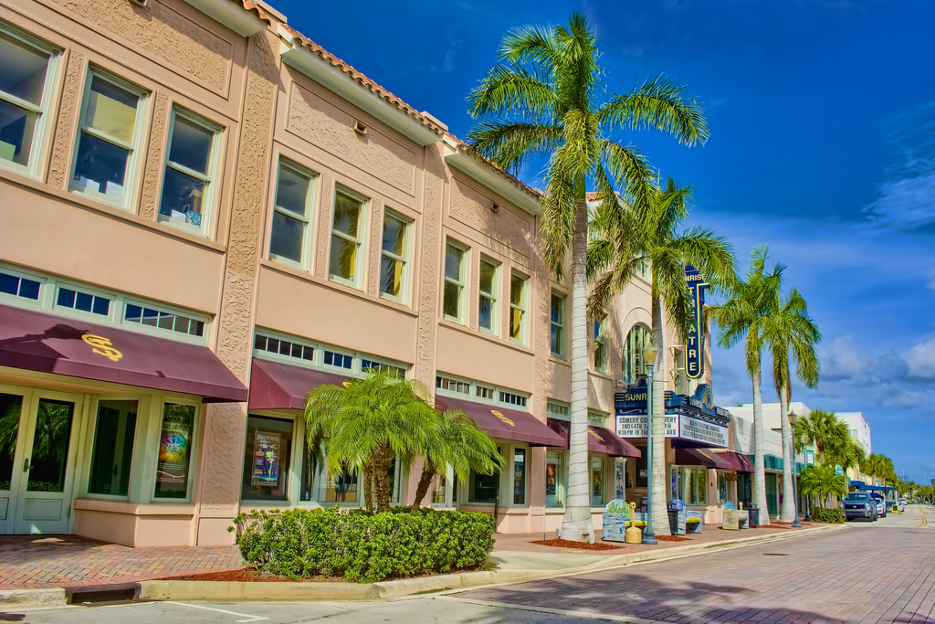
• HOW CAN THE BLACK BOX IMPROVE? •
SPOTLIGHT LOCAL ARTISTS
VARIETY OF EVENTS
INTERIOR UPDATES
MARKETING
BAR IMPROVEMENTS
QUALITY SHOWS
VENUE RENTAL

Slide 17
