Slide 1
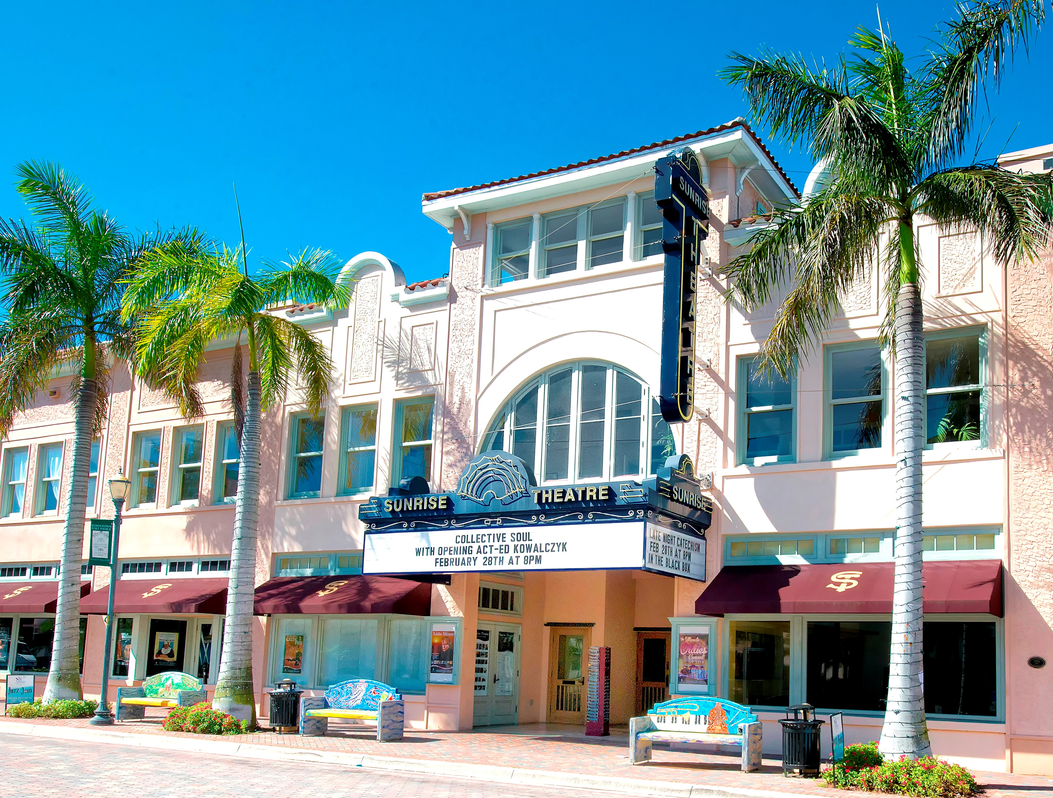
Sunrise Theatre
COMMUNITY INPUT MEETING
August 24, 2018

Slide 2
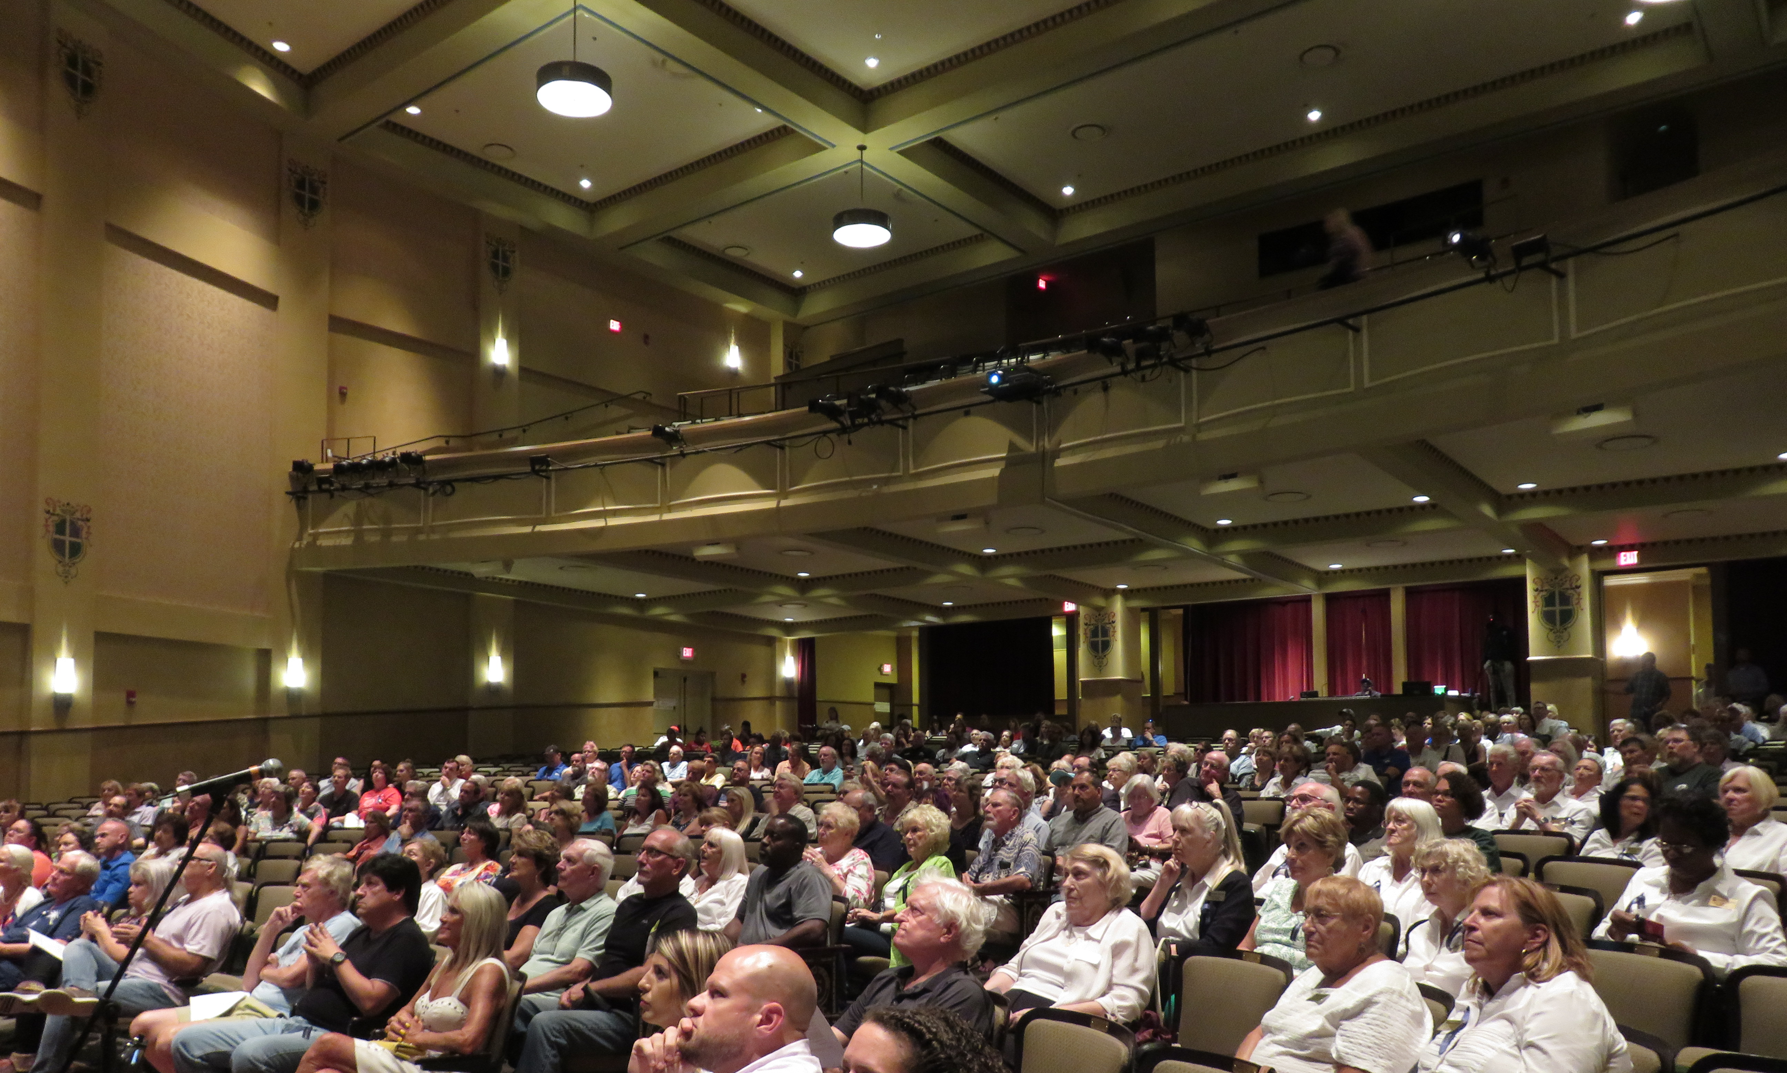
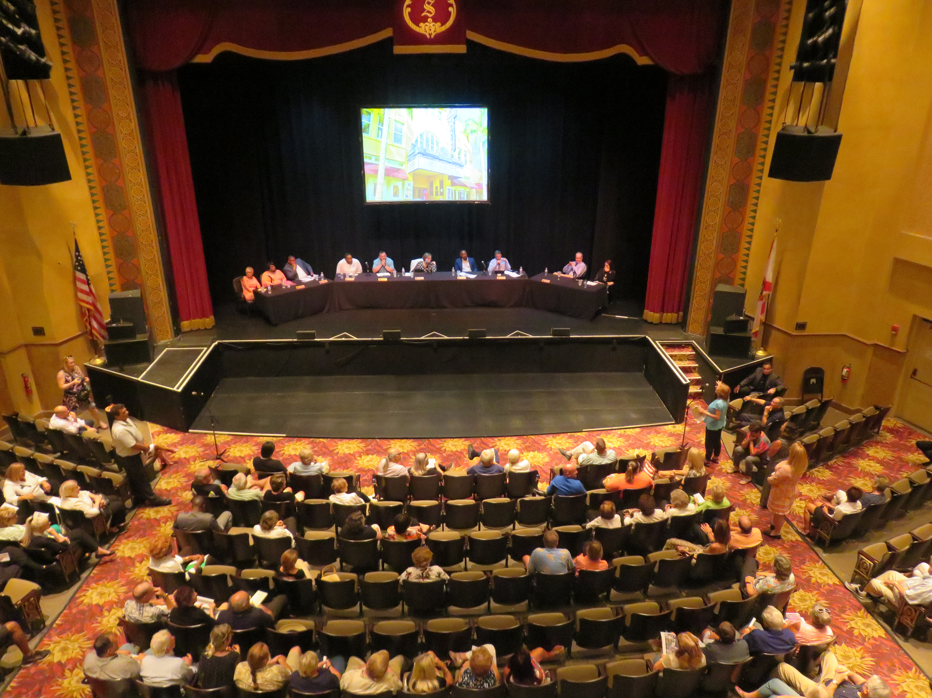
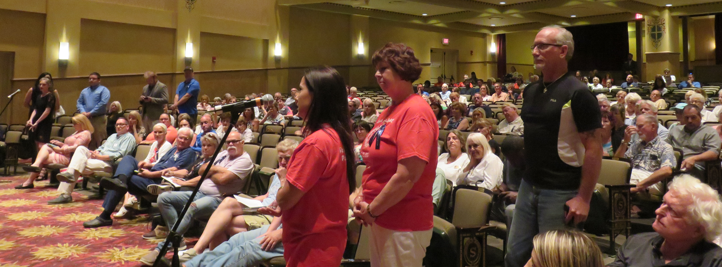
Community Input Summary

Slide 3
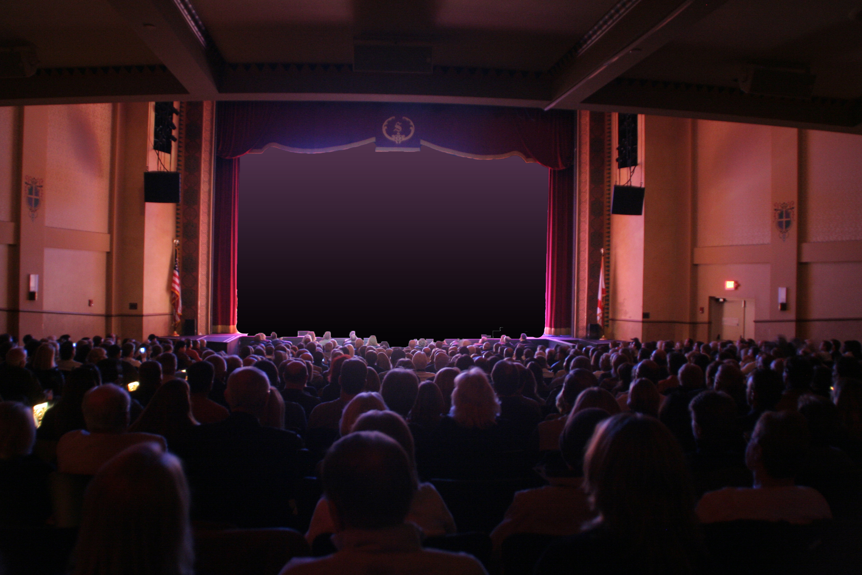
Survey Summary
Originally: 743 responses
Re-opened: 622 responses
Total of 1,365 surveys
Notes:
Originally received 743 responses
Reopened on June 28 received 622 additional responses
Total of 1,365 responses

Slide 4
HOME ZIP CODE

Slide 5
FULL TIME VS. SEASONAL RESIDENTS

Slide 6
AGE
Notes:
139 more surveys from respondents age 54 or younger.

Slide 7
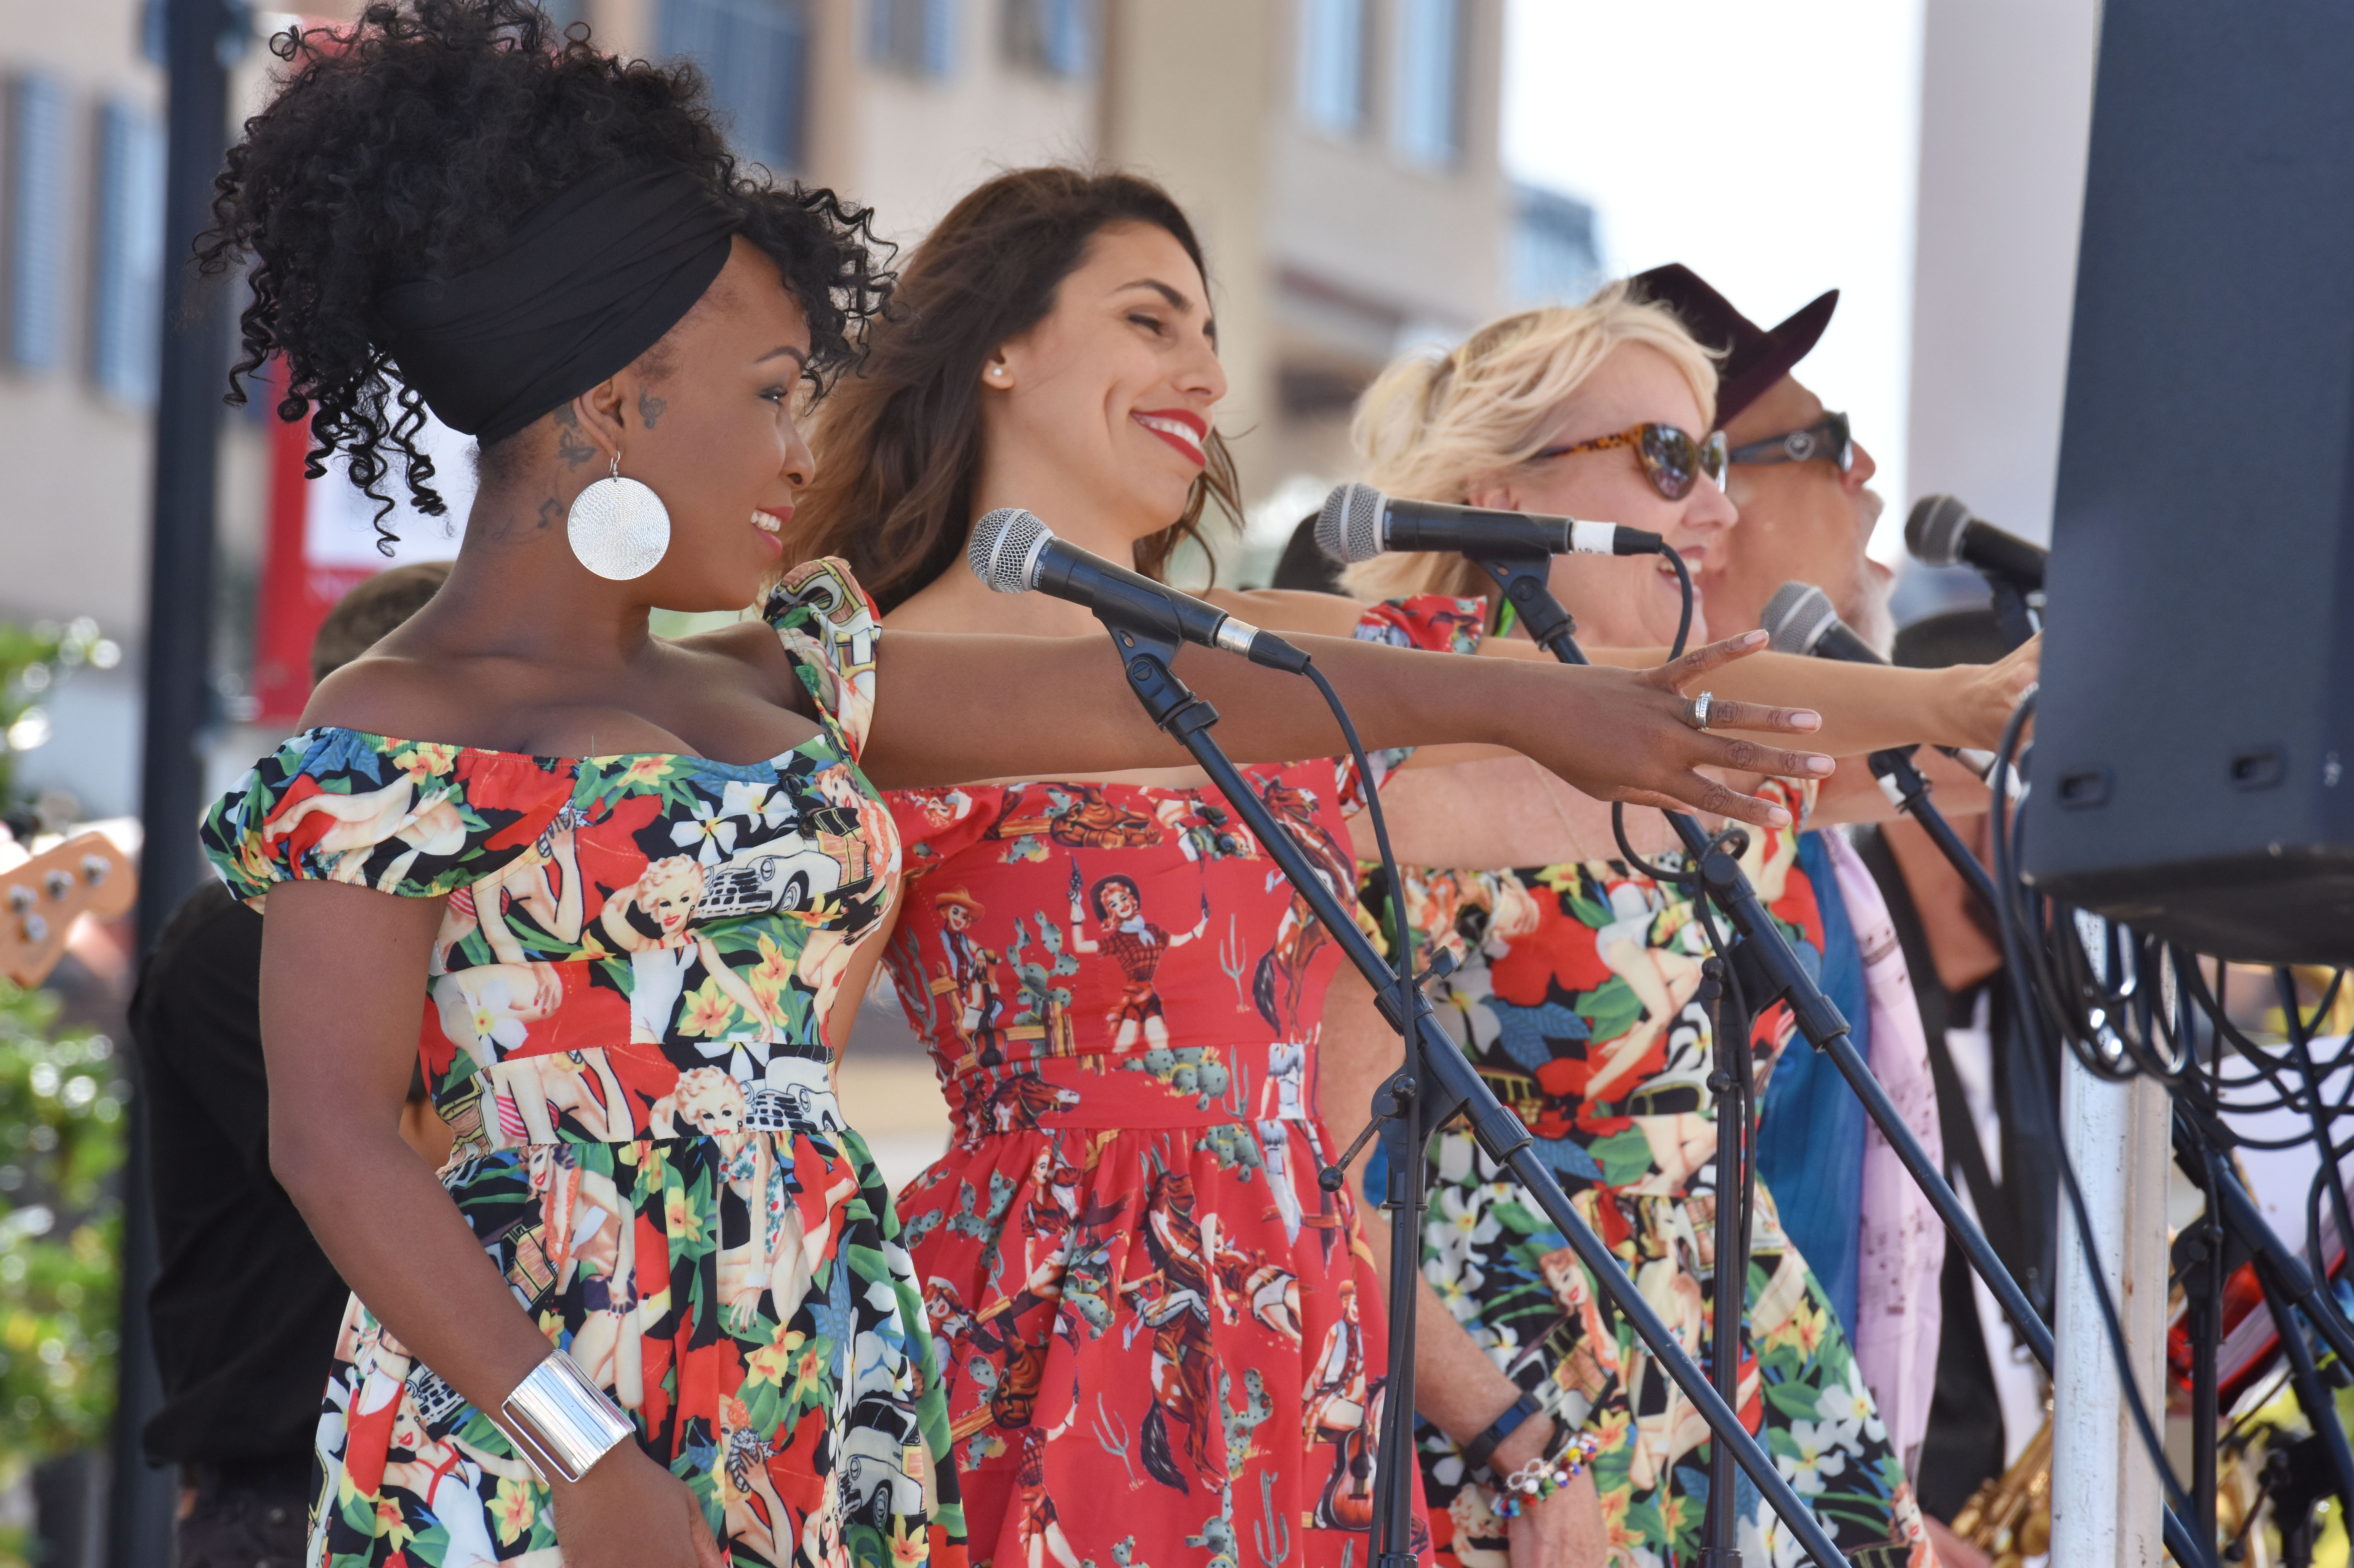
• GENERAL ENTERTAINMENT PREFERENCES •
35%
of respondents attend movies, live concerts, art-related events
1-2 TIMES PER MONTH.
Notes:
Number did not change.

Slide 8
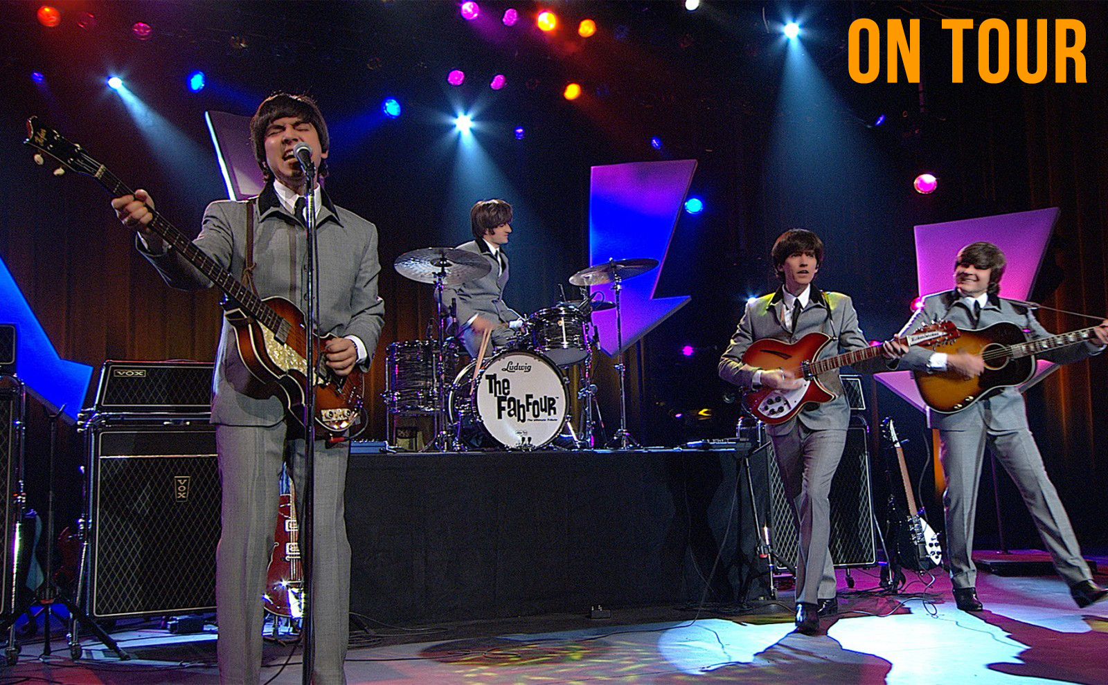
• GENERAL ENTERTAINMENT PREFERENCES •
93%
of respondents feel that the CONTENT OF THE SHOW is the most important factor when purchasing entertainment.
Notes:
Percentage increased from 91% to 93%.

Slide 9
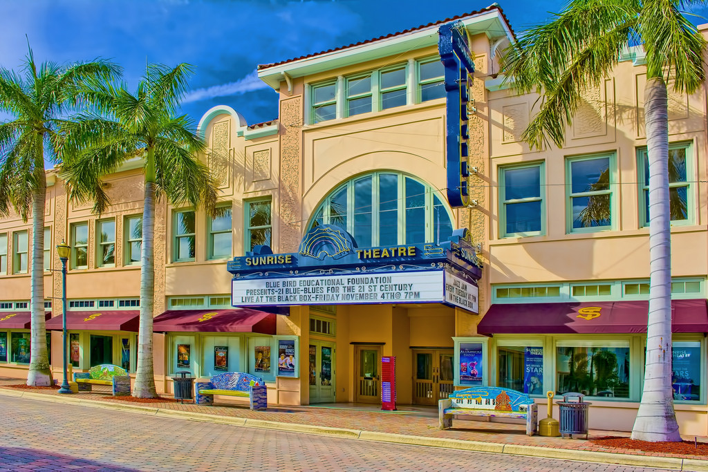
• SUNRISE EXPERIENCE •
96%
of respondents HAVE ATTENDED a show at the Sunrise Theatre.
Notes:
95.94%
Same

Slide 10
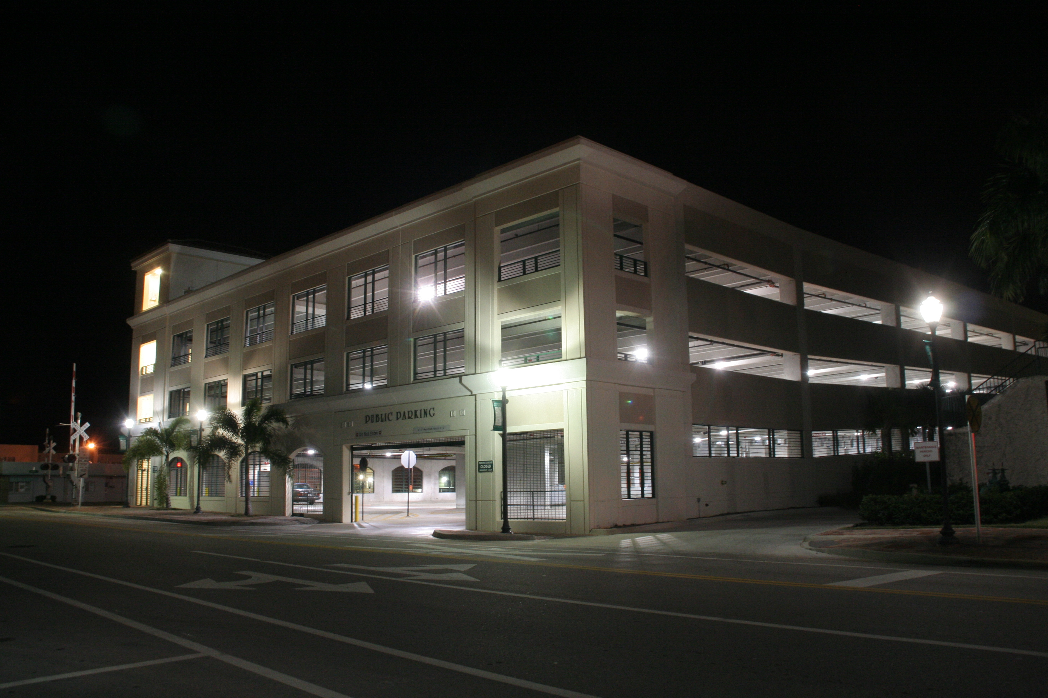
• SUNRISE EXPERIENCE •
Notes:
Consistent with first round of surveys

Slide 11
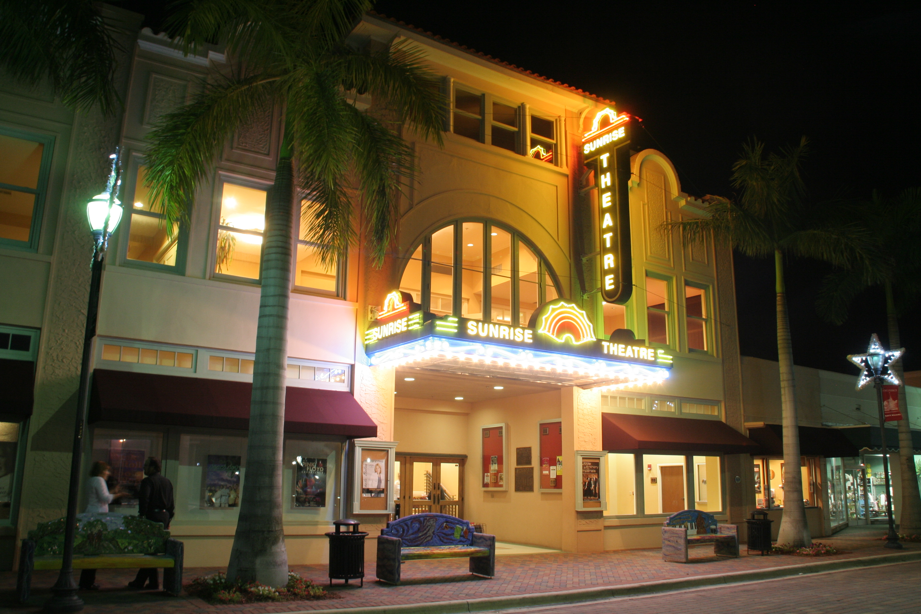
• TICKETS •
70%
of respondents rated the price of tickets at the Sunrise Theatre as COMPARABLE TO OTHER THEATERS
Notes:
Percentage increased from 68% to 70% (69.72)

Slide 12
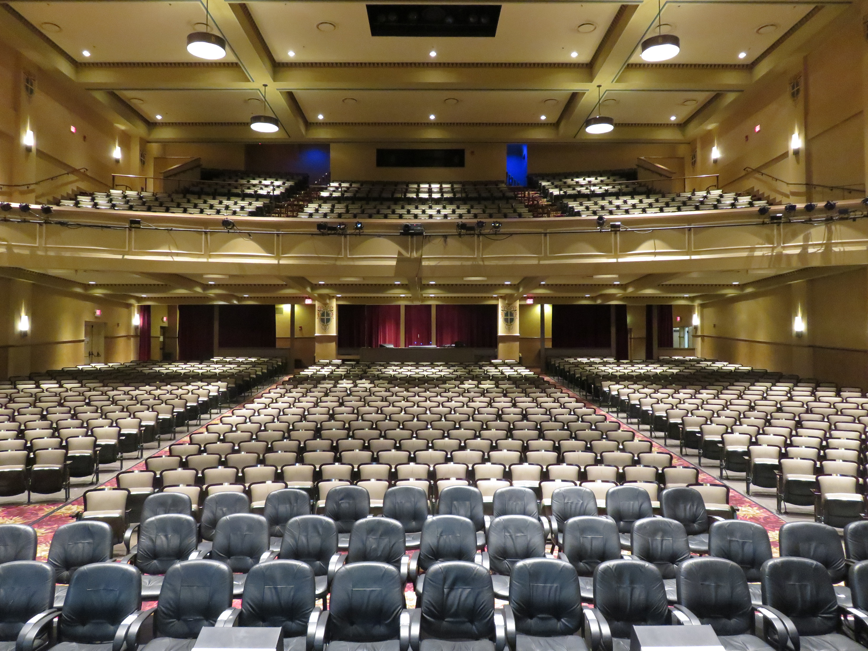
• TICKETS •
65%
of respondents purchase Sunrise Theatre tickets ONLINE
Notes:
Percentage increased from 62% to 65%

Slide 13
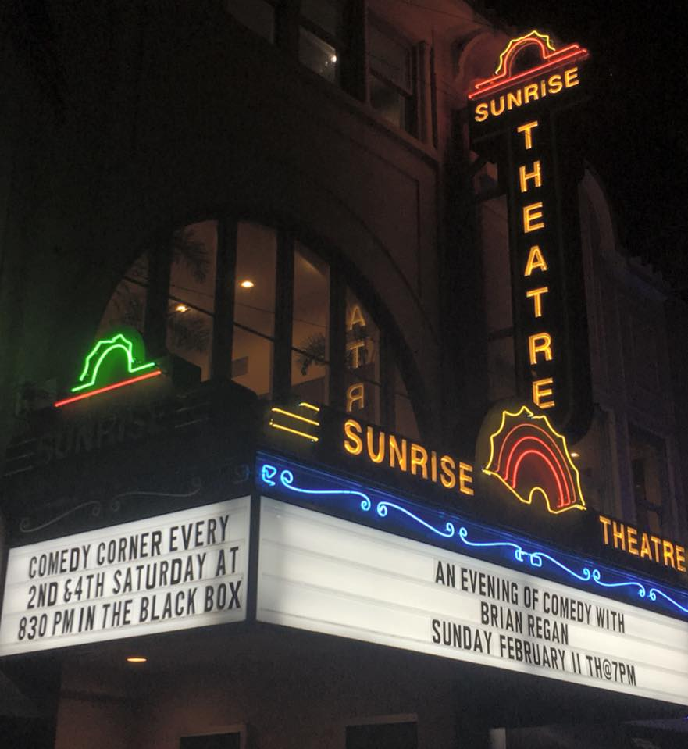
TOP 10 “MOST INTERESTED” EVENTS:
Theater: Professional
Concerts: Pop
Concerts: Indie/Rock
Comedy/Variety/Open Mic
Concerts: Country/Bluegrass
Concerts: Rhythm and Blues
Concerts: Jazz
Dance
Concerts: Classical Music
Movies: Recent Releases
Notes:
Previous Top 10:
Theater: Professional
Concerts: Pop
Comedy/Variety/Open Mic
Concerts: Indie/Rock
Concerts: Country/Bluegrass
Concerts: Rhythm and Blues
Concerts: Jazz
Concerts: Classical Music
Movies: Recent Releases
Theater: Community

Slide 14
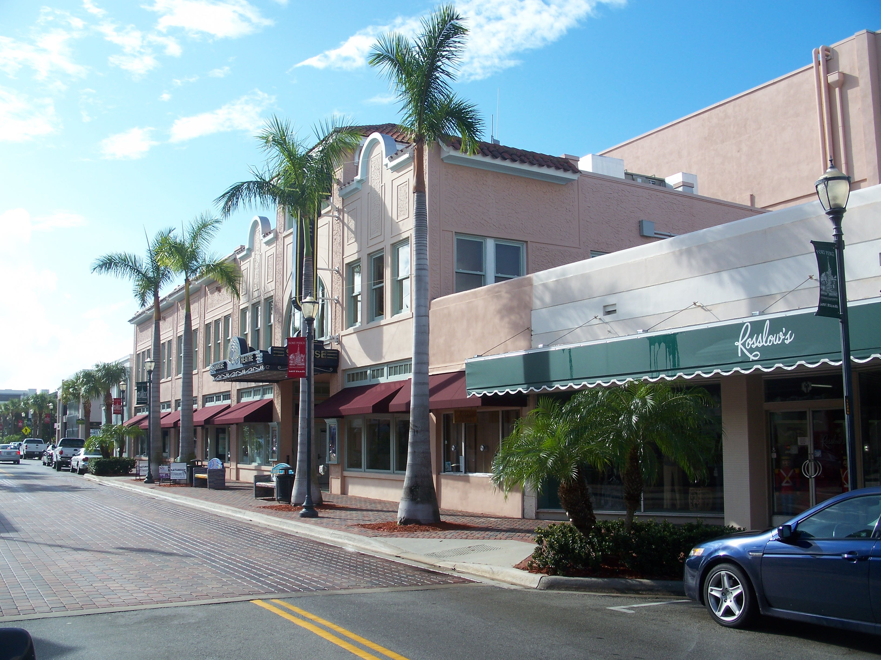
• WHAT MAKES THE SUNRISE GREAT •
LOCATION
CHARM
ATMOSPHERE
COMMUNITY IMPACT
BUILDING
COST
ACOUSTICS
SEATING
SHOWS
STAFF
HISTORY
SIZE

Slide 15
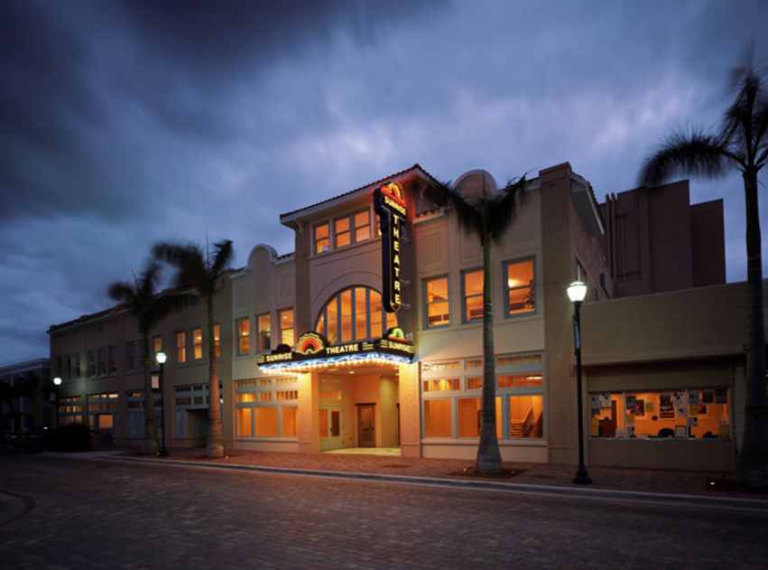
• HOW CAN THE SUNRISE IMPROVE? •
VARIETY OF SHOWS
MOVIES
ADVERTISING
YOUNGER / CURRENT SHOWS
TICKET PRICES
SOUND
INTERIOR IMPROVEMENTS
VALET PARKING
MORE CONCERTS
OFF-SEASON SHOWS

Slide 16
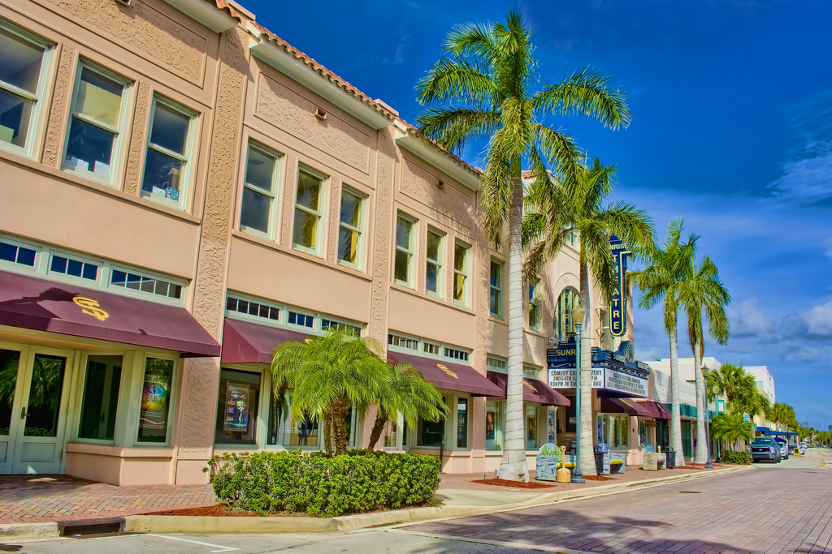
• HOW CAN THE BLACK BOX IMPROVE? •
INTERIOR UPDATES
VARIETY OF EVENTS
SPOTLIGHT LOCAL ARTISTS
QUALITY SHOWS
MARKETING
BAR IMPROVEMENTS
VENUE RENTAL

Slide 17
Sunrise Theatre Update

Slide 18
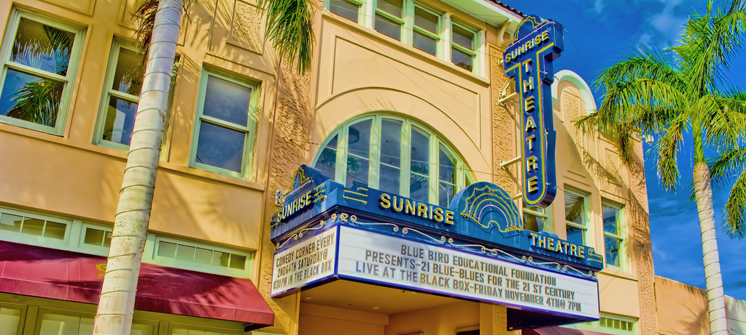
Financial Analysis

Slide 19
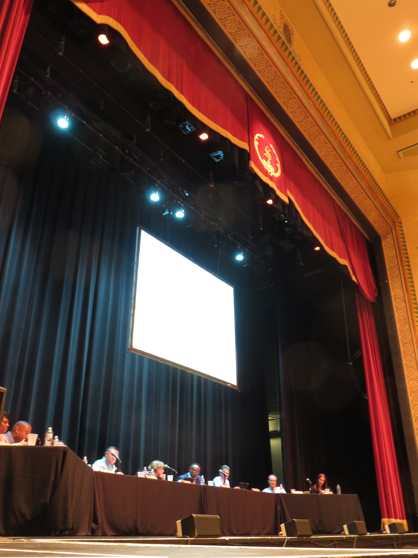
Commission Discussion

