Slide 1




www.cachidalgo.org
Presentation Created By
By Pat Blum and Tracy Gerdes

Slide 2
Our Mission….
To reduce the emotional trauma to child abuse victims by facilitating a multidisciplinary team approach, which supports the prevention of child abuse through community education and promotes the effective prosecution of those who perpetrate crimes against children.

Slide 3
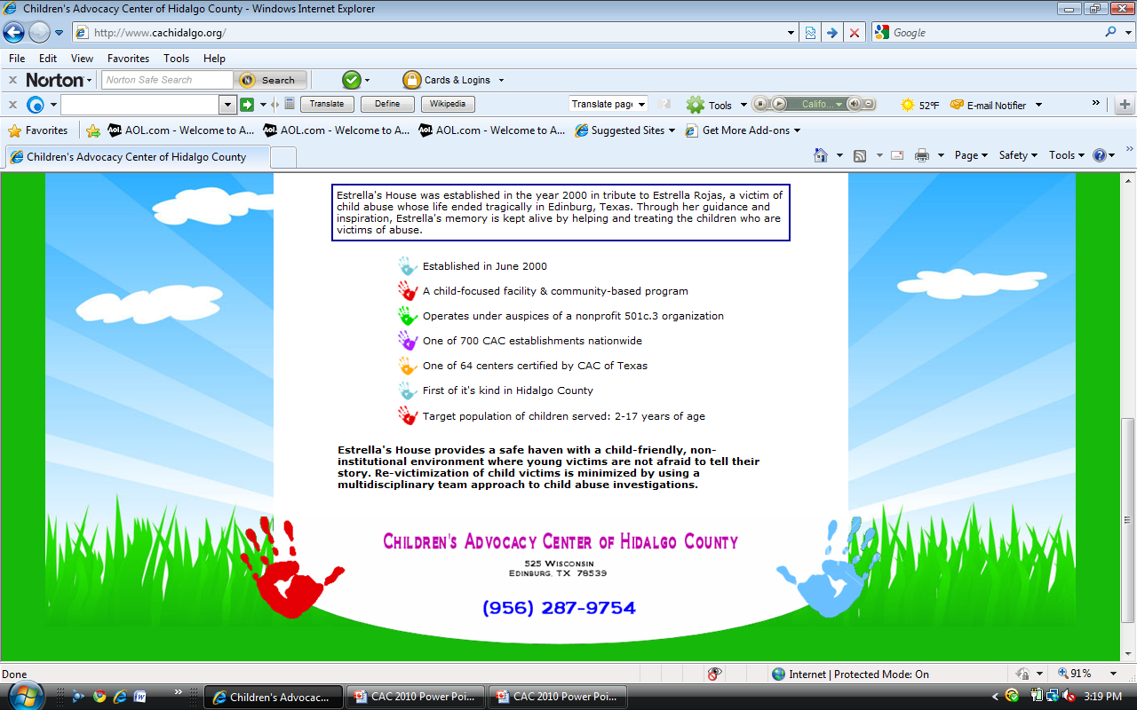
Established in June 2000
A child-focused facility & community-based program
Non-profit 501c.3 organization
One of 500 Children’s Advocacy Centers nationwide
One of 67 centers in Texas and the first in Hidalgo Co
Serves children 2 – 17 years of age

Slide 4
Estrella’s House was named as a tribute to Estrella Rojas, a victim of child abuse. In 2000, Estrella’s life ended tragically, in Edinburg, Texas, at the hands of her mother’s boyfriend. Estrella’s House was established to keep her memory alive by helping and treating children who are victims of abuse.

Slide 5

What is CHILD ABUSE?
Sexual Abuse
Neglect
Physical Abuse
Emotional Abuse

Slide 6
The Statistics are Shocking!

Slide 7

4 children die in the U.S. every day as a result of child abuse

Slide 8
The numbers are much greater than you think
Sexually abused before the age of 18:
1 in 4 girls
1 in 6 boys
Solicited sexually while on the internet:
1 in 5 children

Slide 9
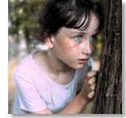
It occurs at all ages, probably younger than you think
The median age for reported abuse is 9 years old.

Slide 10
Total Victims Served

Slide 13
MARITAL STATUS OF VICTIMS’ FAMILIES

Slide 14
Family Income Level

Slide 15

Unknown Perpetrator 1%
Known Perpetrator 99%
ALLEGED PERPETRATORS

Slide 16
ALLEGED PERPETRATOR GENDER

Slide 17
ALLEGED PERPETRATOR AGE

Slide 18
Children are not immune anywhere
Step grandfather | 8
Stepbrother | 8
Grandmother's Paramour | 8
Adoptive/Foster Father | 8
Sister | 8
Teacher | 7
Unknown | 7
Brother-in-law | 6
Grandmother | 4
Aunt | 3
Step Uncle | 3
Therapist | 2
Co-Worker | 1
Step Mother | 1
Coach | 1
Teacher Assistant | 1
Bus Driver | 1
Father | 157
Unrelated Known | 144
Stepfather | 104
Uncle | 90
Mother's Paramour | 76
Cousin | 73
Mother | 48
Grandfather | 47
Brother | 40
Boyfriend | 38
Neighbor | 33
Friend | 26

Slide 19
VICTIMS SERVED BY CITY
CITY | TOTAL | CITY | TOTAL | CITY | TOTAL
Mission | 169 | Palmview | 8 | La Joya | 2
Edinburg | 148 | Zapata | 8 | Los Ebanos | 2
McAllen | 142 | Elsa | 7 | Palmhurst | 2
Pharr | 81 | Harlingen | 7 | Raymondville | 2
Weslaco | 78 | La Villa | 6 | San Carlos | 2
San Juan | 53 | Laredo | 5 | El Salvador | 1
Alamo | 52 | Hebbronville | 3 | San Benito | 1
Donna | 51 | Monte Alto | 3 | Falfurrias | 1
Mercedes | 49 | La Grulla | 3 | Alto Bonito | 1
Rio Grande City | 48 | Los Fresnos | 3 | San Ignacio | 1
Alton | 22 | Progresso | 3 | Hargill | 1
Edcouch | 16 | Garciasville | 2 | Santa Maria | 1
Roma | 14 | La Blanca | 2 | Las Lomas | 1
Hidalgo | 11 | La Casita | 2 | Taft | 1
Penitas | 11 | La Feria | 2 | Las Vegas | 1
Sullivan City | 10 | La Gloria | 2

Slide 20
REFERRALS
AGENCY | TOTAL | AGENCY | TOTAL
CPS | 398 | Alton PD | 7
Hidalgo Co Sheriff Office | 167 | Zapata Co Sheriff Office | 7
Edinburg PD | 64 | Donna ISD PD | 4
McAllen PD | 62 | Palmview PD | 4
Pharr PD | 62 | Sullivan City PD | 4
Starr Co Sheriff Office | 34 | Progreso PD | 5
Weslaco PD | 33 | Edcouch PD | 1
Mission PD | 32 | Edinburg ISD PD | 1
San Juan PD | 25 | FBI | 1
Mercedes PD | 22 | Jim Hogg Co Sheriff Office | 1
Alamo PD | 17 | Judge Reyna | 1
Rio Grande City PD | 13 | La Joya ISD PD | 1
Child Care Licensing | 10 | La Villa PD | 1
Elsa PD | 9 | McAllen ISD PD | 1
Donna PD | 8 | Cameron Co. Constable | 1
Hidalgo PD | 8 | Brooks Co. SO | 1
ICE | 8 | RGC ISD PD | 1
Penitas PD | 8 | Roma PD | 1
Residential CCL | 8 | Texas Rangers | 1
Therapy Walk Ins | 8 | Texas Youth Commission | 1

Slide 21

How Children’s Advocacy Center, Estrella’s House Protects & Provides for Children in Hidalgo & Starr Counties
We can’t change what happened
but we CAN
change what
happens next.

Slide 22
How Children Are Referred
CPS or Law Enforcement schedules an appointment for an interview and/or a sexual assault exam at Children’s Advocacy Center Estrella’s House

Slide 23
Estrella’s House Provides
safe haven with a child-friendly, non-institutional environment where young victims are not afraid to tell their story
Minimizes re-victimization of child victims by using a multidisciplinary team approach with child abuse investigations

Slide 24
Services Provided
Comfortable setting for child victims and non-offending family members
Coordinated team investigation
Child forensic video recorded interviews
On-site sexual assault examinations
Immediate crisis intervention
Individual Counseling

Slide 25
Services Provided
Multi-disciplinary case staffing and review
Accompaniment to hospital, court when necessary
Texas Crime Victim’s Compensation services
Social service referrals

Slide 26
Services Provided
Criminal justice support and advocacy
Contact with and support for the child and family during legal proceedings
Keep other team members informed and advised of family developments
Prevention education and community outreach activities

Slide 27
Multidisciplinary Team
Prosecutors
Law enforcement
Child Protective Service
Sexual Assault Nurse Examiner
Mental health professionals
Victim advocates
Children’s Advocacy Center at Estrella’s House staff

Slide 28
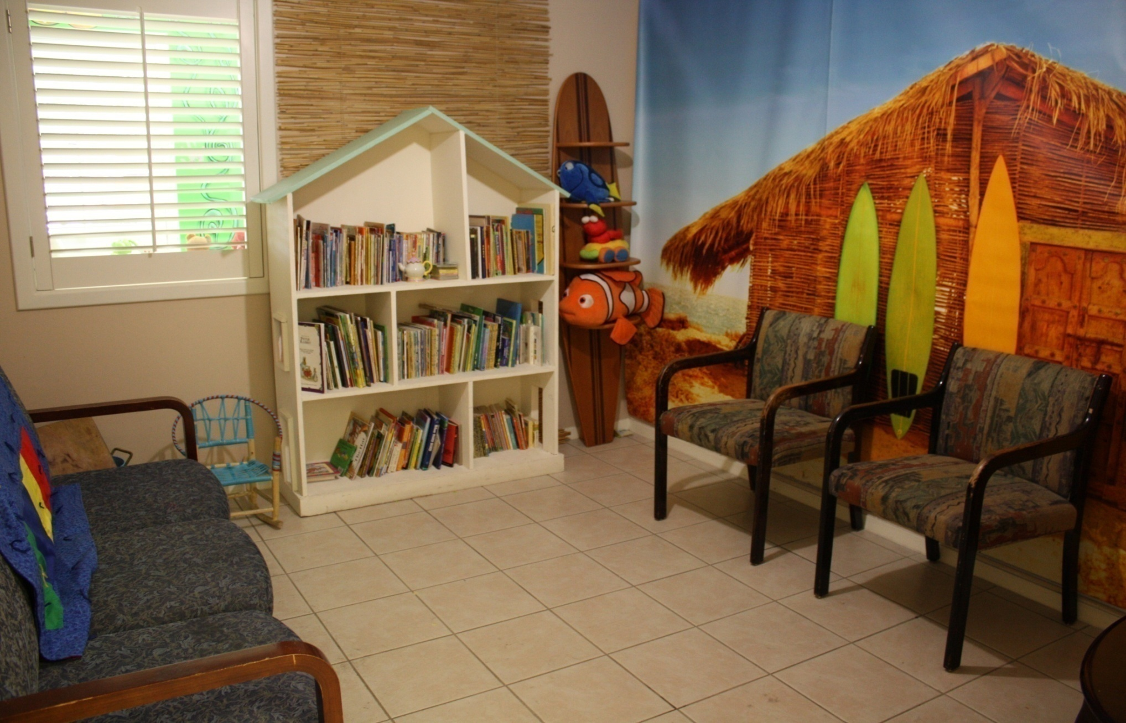
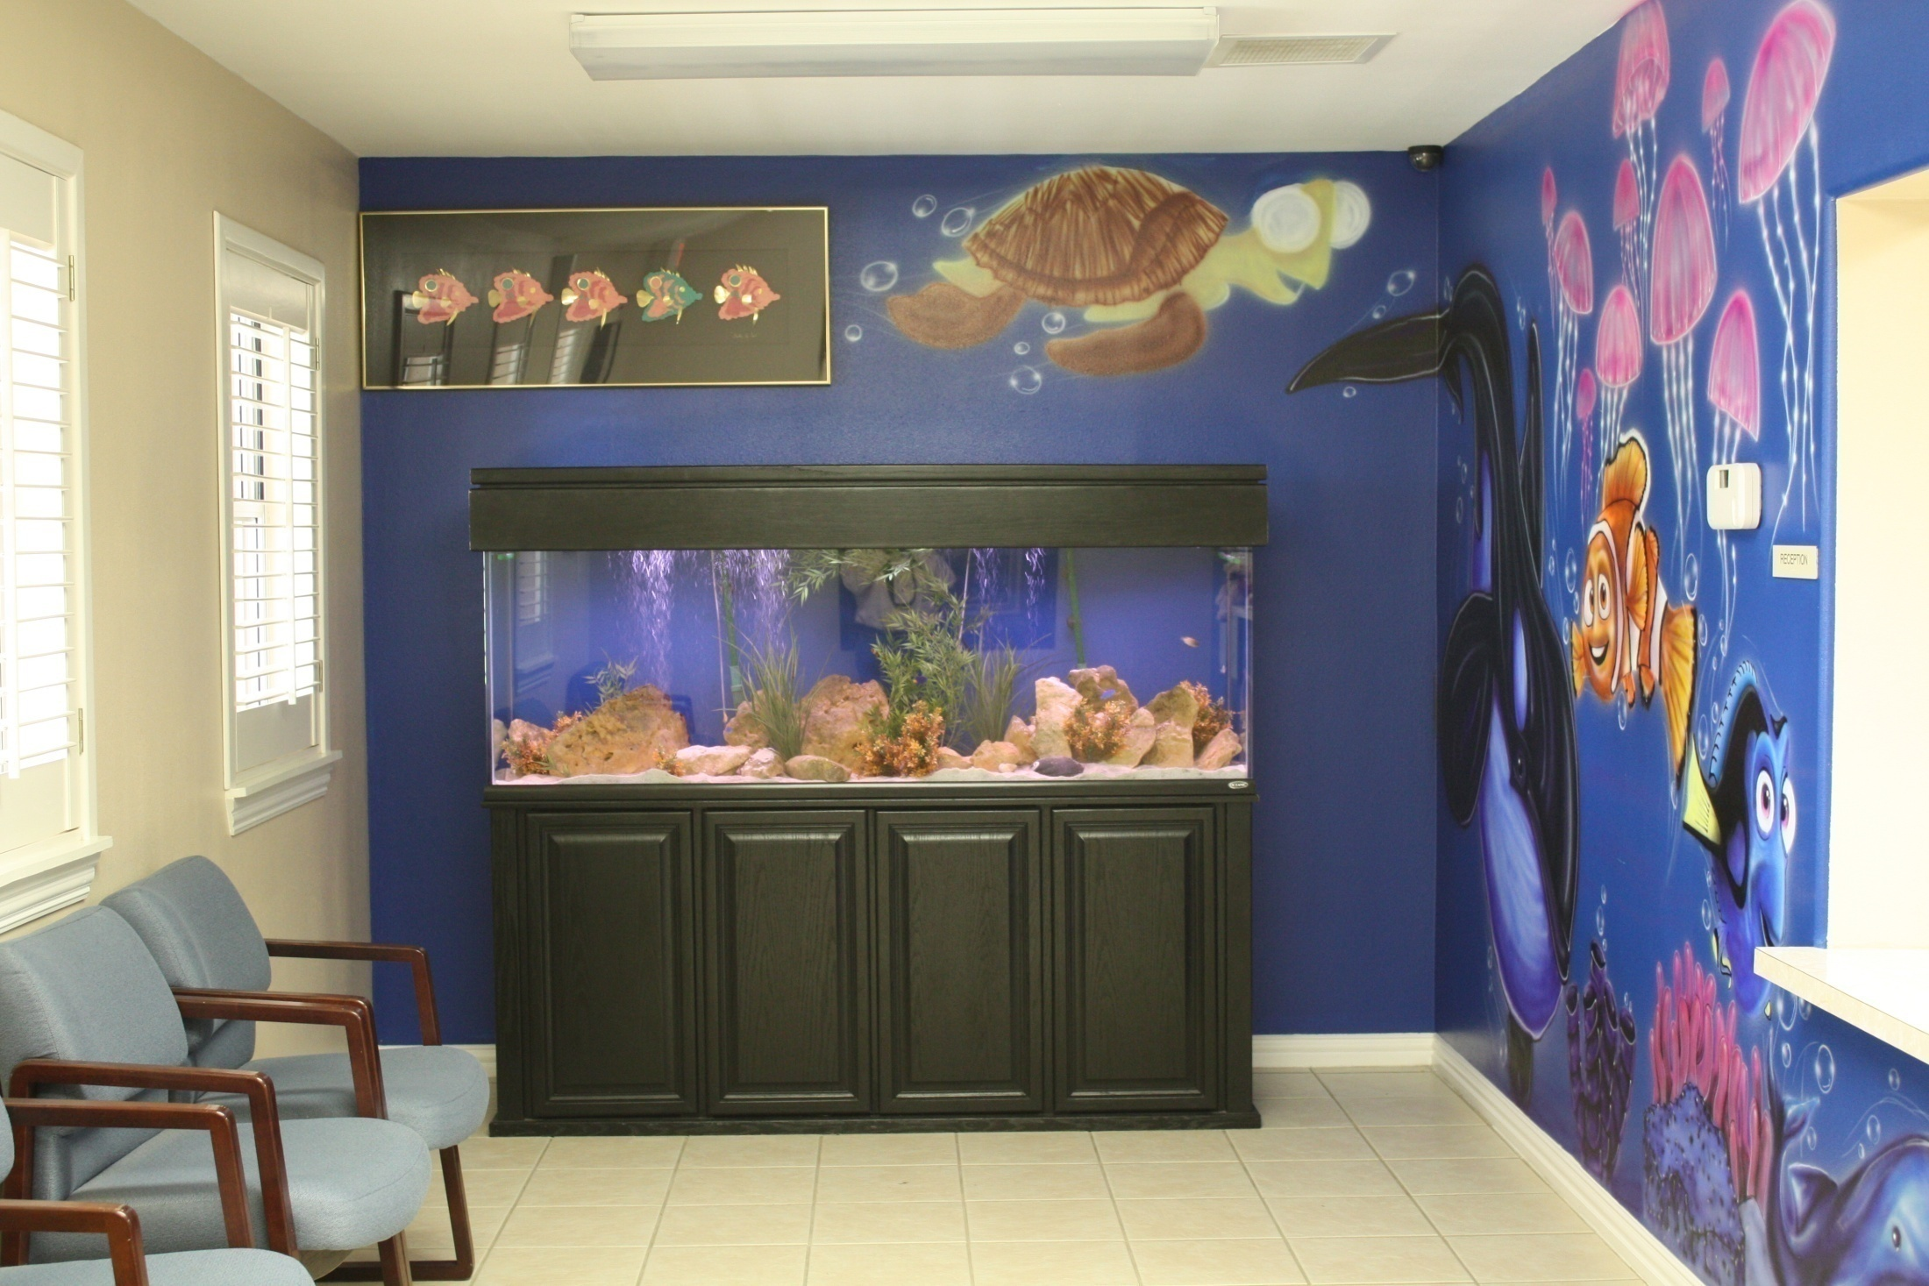
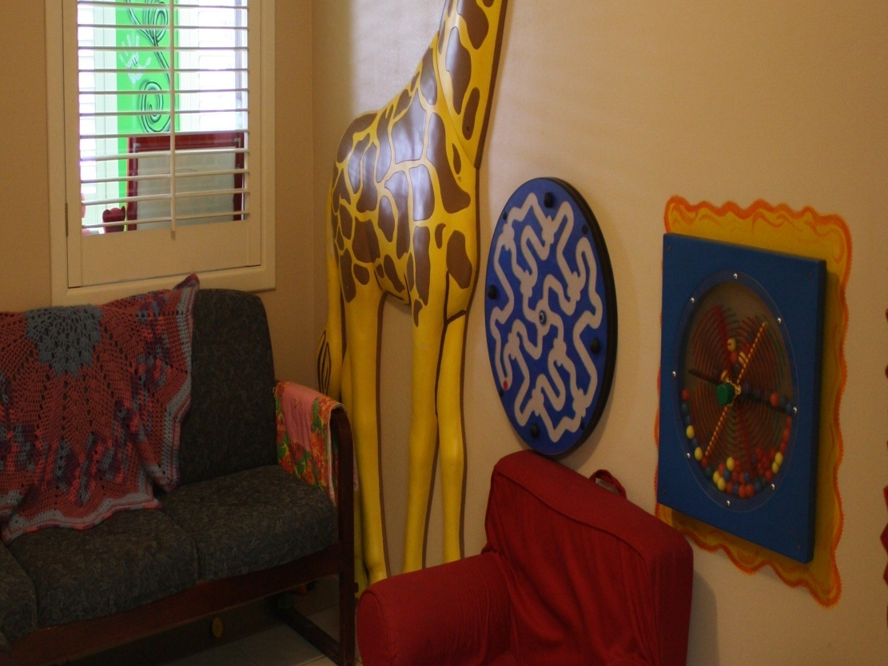
WAITING ROOMS

Slide 29
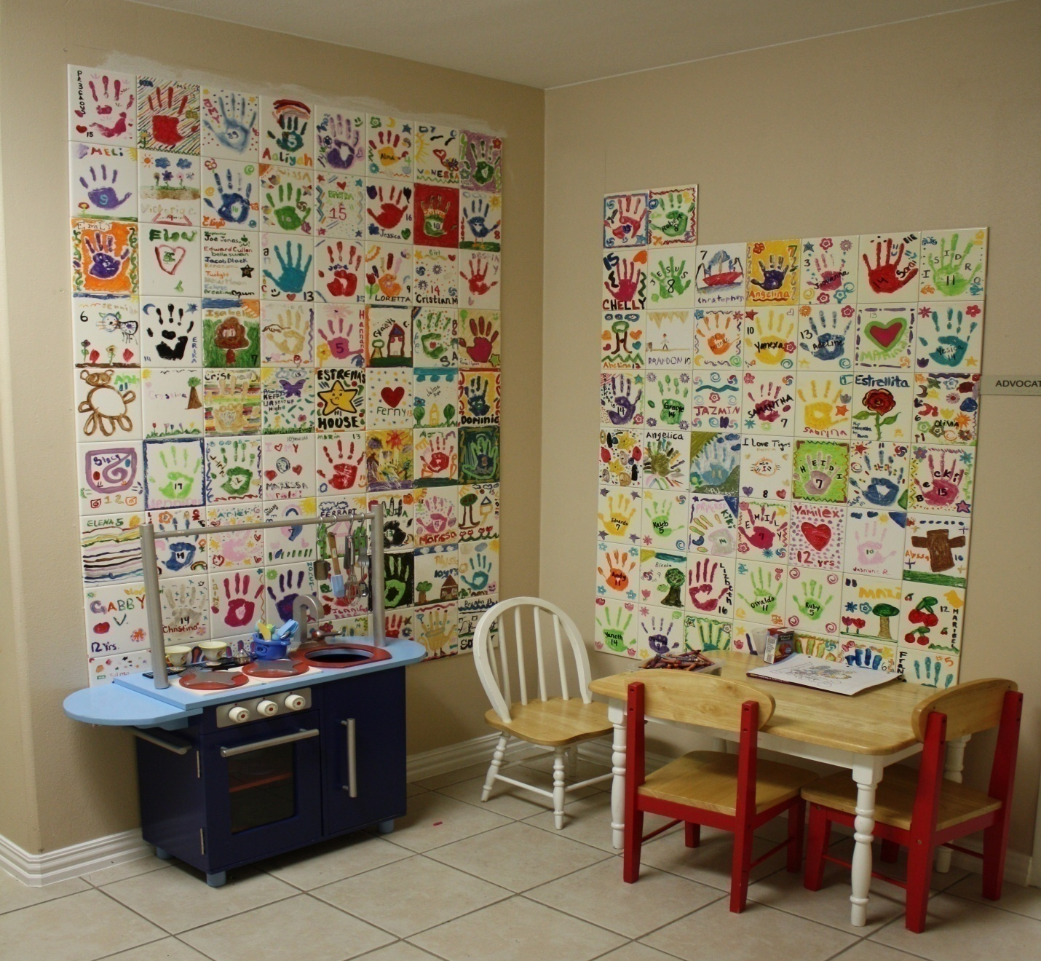
Victims’ Handprints

Slide 30
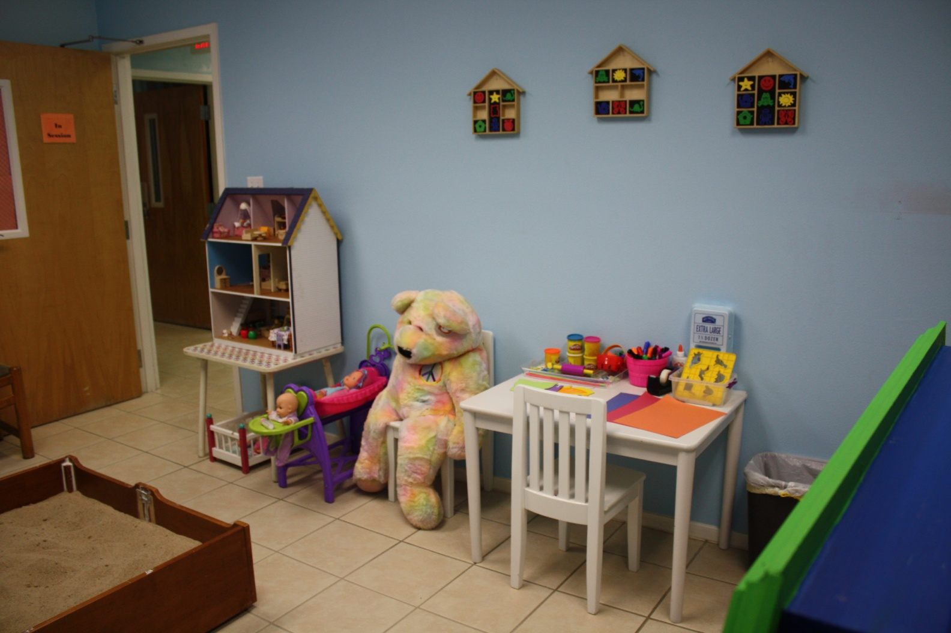
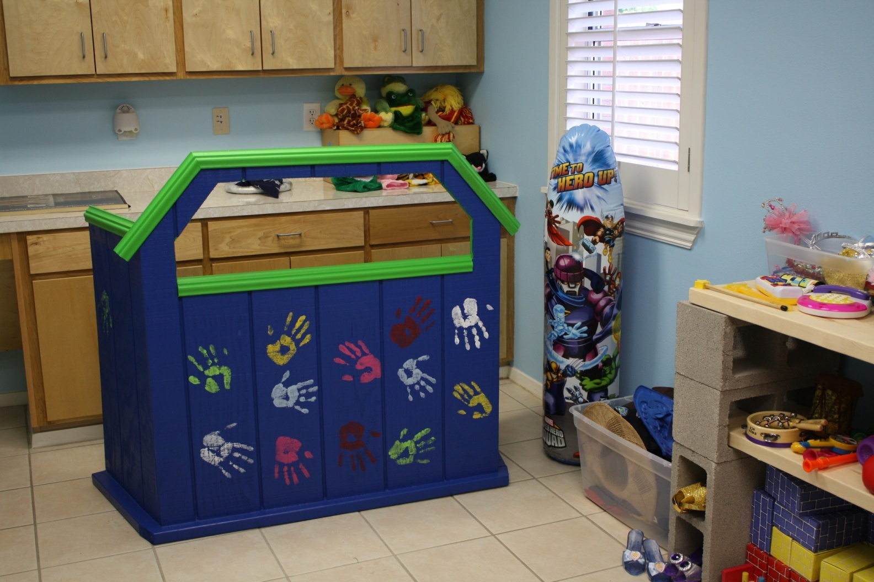
Therapy Rooms

Slide 31
Services provided by
Estrella’s House in 2010
Forensic Interviews to 970 children
Sexual Assault Exams to 240 children
Therapy Services to 235 children
Assistance to 1293 non-offending family members
Crime Victim’s Compensation info to 293 children
Clothing and/or Backpacks to 209 children
Educational Literature Distributed

Slide 32
Funding
Annual Budget $1.2M
Federal and State Grants
United Way
Governor’s Office
McAllen, Mission, Pharr CDBG
Urban County Program of Hidalgo County
Children’s Advocacy Centers of Texas
Attorney General’s Office
Donations
Fund-raising

Slide 33

Saturday, February 18, 2012
7:00 pm – 11:00 pm
Valencia Event Center
3012 S Jackson Rd McAllen
Wine, Food, Fun and Music featuring Renaissance Rockers and Del Castillo
www.cachidalgo.org Facebook

