Slide 1


Strategic Plan Update 2014
HCRMA Board of Directors
Dennis Burleson, Chairman
Josue Reyes, Vice-Chairman
Ricardo Perez, Secretary/Treasurer
Michael Cano, Director
R. David Guerra, Director
Forrest Runnels, Director
Alonzo Cantu, Director
HCRMA Staff
Pilar Rodriguez, P.E., Executive Director
Flor E. Koll, Program Administrator
Program Management Consultant
DANNENBAUM ENGINEERING CORP

Slide 2
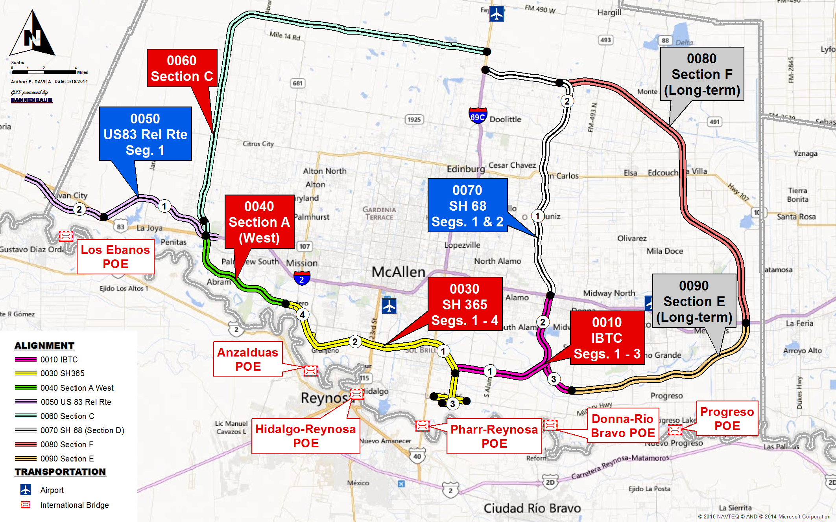
Strategic Plan Update 2014

Slide 3
Short Term Strategic Plan Summary

Slide 4
TxDOT AFA Summary
Note: If additional TxDOT funds are available beyond an AFA for the IBTC, then a modified Short Term Strategy may include additional AFA funds to cover the remaining SH 365 Segment 4 development.

