Slide 1


2019 Community Survey City of Schertz, Texas
Presented by
August 2019

Slide 2
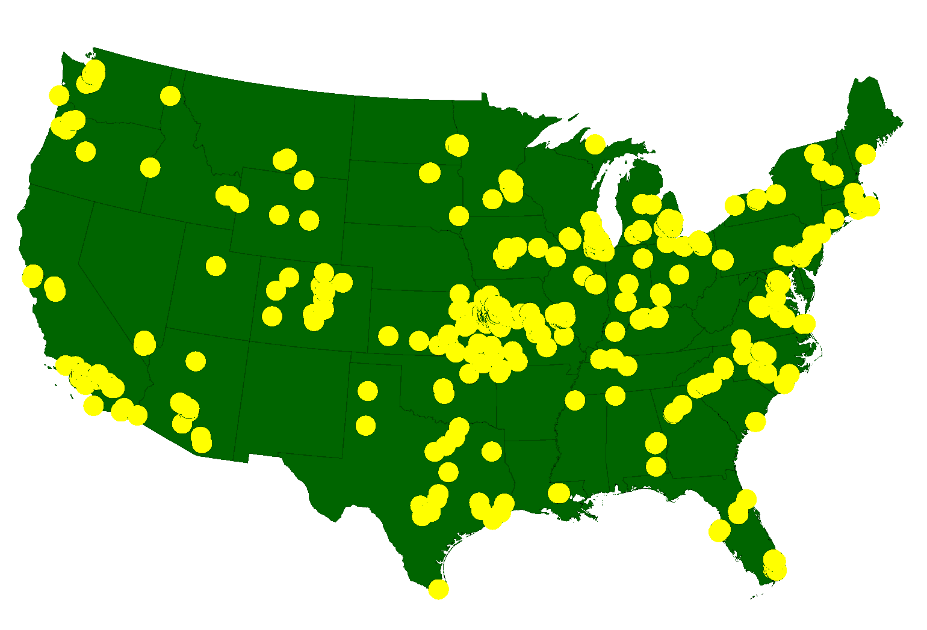
ETC Institute
A National Leader in Market Research for Local Governmental Organizations …helping City and county governments gather and use survey data to enhance organizational performance for more than 35 years
More than 2,200,000 Persons Surveyed Since 2009
for more than 900 cities in 49 States

Slide 3
Agenda
Purpose and Methodology
Bottom Line Upfront
Major Findings
2
Summary
Questions

Slide 4
Purpose
To objectively assess satisfaction among residents with the delivery of City services
To help determine priorities for the community
To measure trends from previous survey
To compare the City’s performance with other communities regionally and nationally
4

Slide 5
Methodology
Survey Description
seven-page survey; included many of the same questions that were asked on 2016 survey
2nd Community Survey conducted for the City
Method of Administration
by mail, online, & phone to a random sample of City residents
each survey took approximately 15-20 minutes to complete
Sample size:
409 completed surveys
demographics of survey respondents accurately reflects the actual population of the City
Confidence level: 95%
Margin of error: +/- 4.8% overall

Slide 6
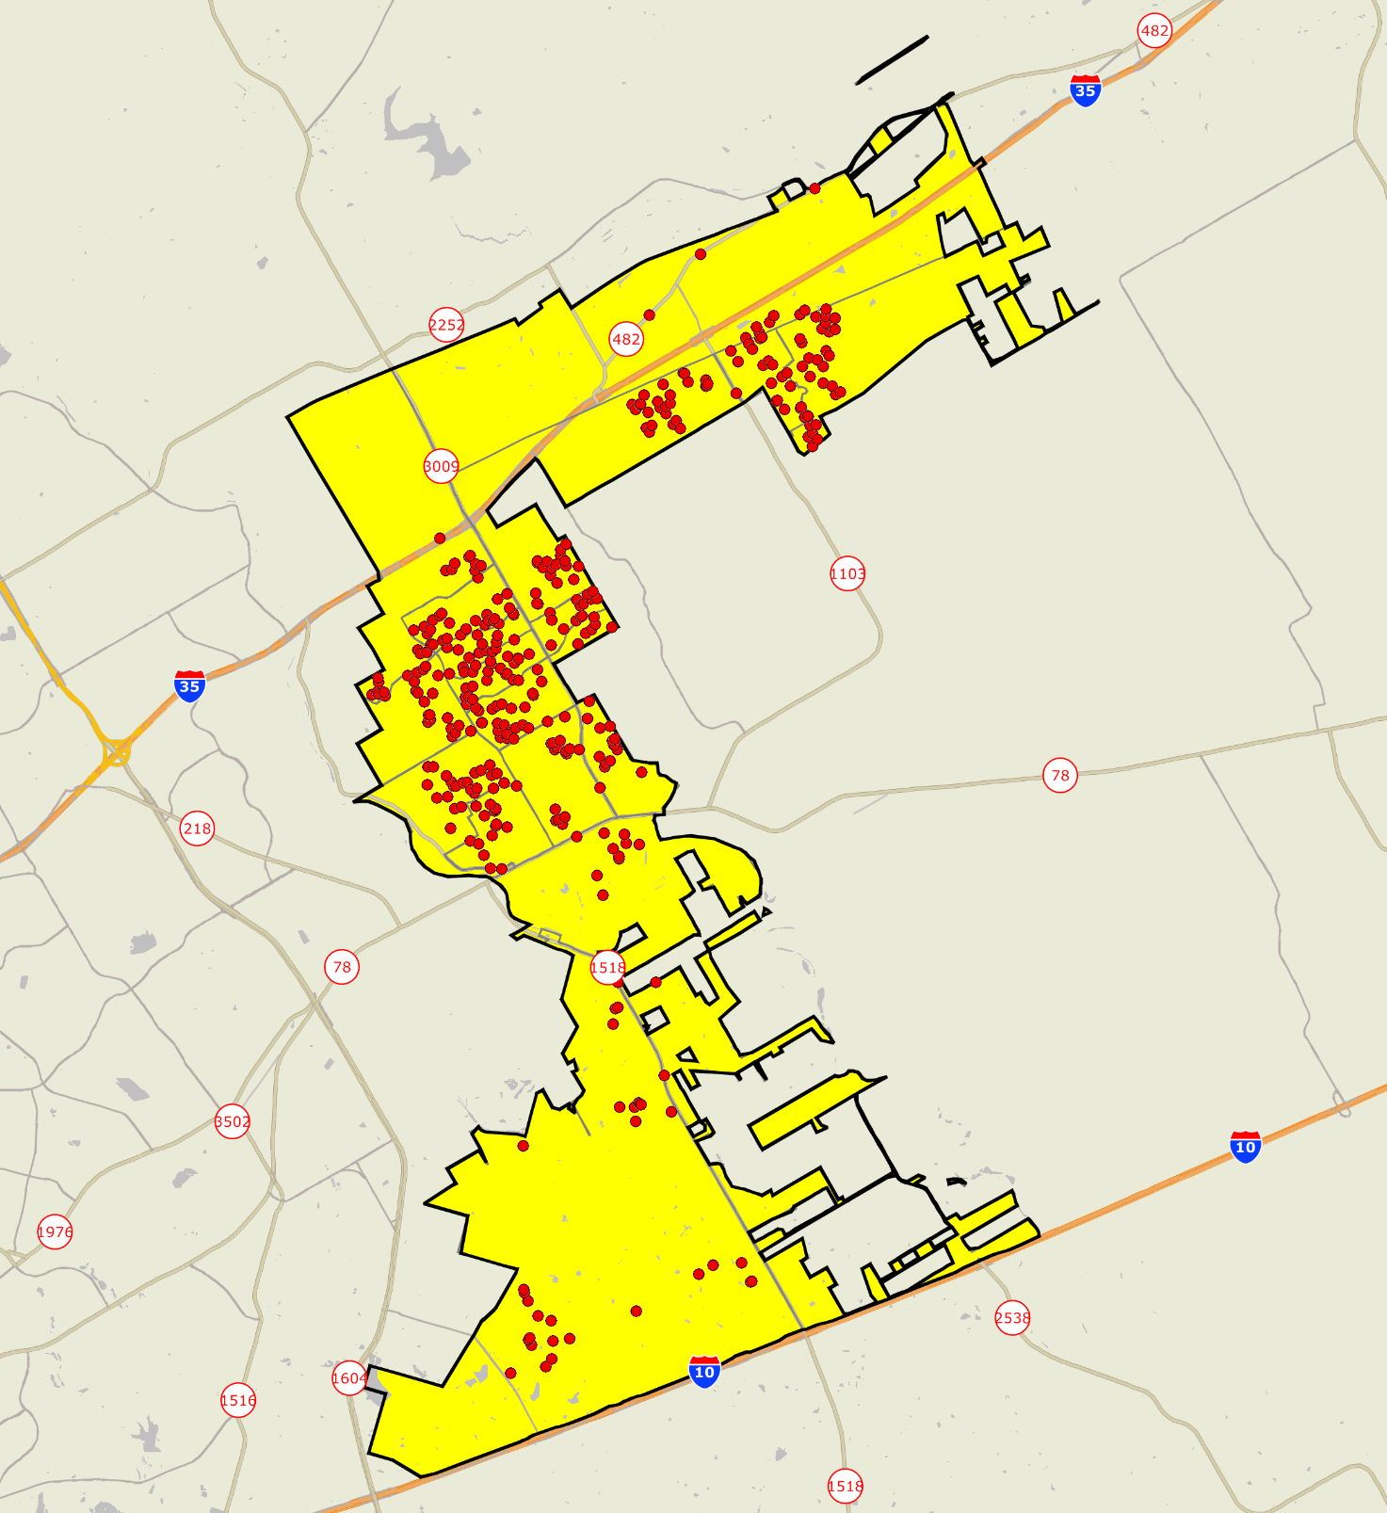

Location of Survey Respondents
Good representation throughout the City

Slide 7
Bottom Line Up Front
Residents Have a Very Positive Perception of the City
86% are satisfied with the overall quality of life in the City; only 2% are dissatisfied
The City Is Moving in the Right Direction
Satisfaction with City Services is Much Higher in Schertz Than Other Communities
Schertz rated above the U.S. Average in 43 of 50 areas, and above the Texas Average in 42 of 50 areas
Satisfaction with the Overall Quality of City Services rated 36% above the U.S. Average, and 38% above the Texas Average
Satisfaction with Customer Service from City Employees rated 33% above the U.S. Average and 36% above the Texas Average
Top Community Priorities:
Traffic
Road Repair/Maintenance/Expansion
Planning for Rapid Growth
Enforcing Codes and Ordinances

Slide 8
Major Finding #1
Residents Have a Very Positive Perception of the City

Slide 9
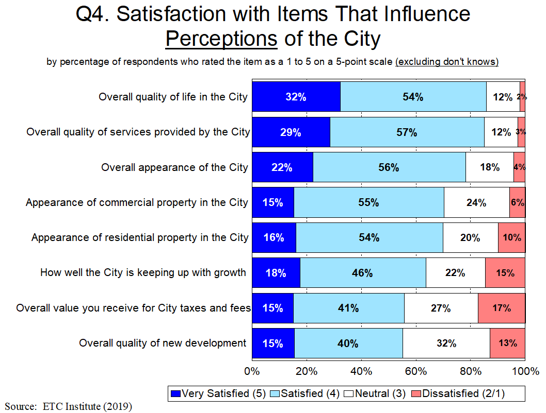
86% of Residents Are Satisfied with the Overall Quality of Services Provided by the City,
Compared to Only 3% Who Are Dissatisfied

Slide 10
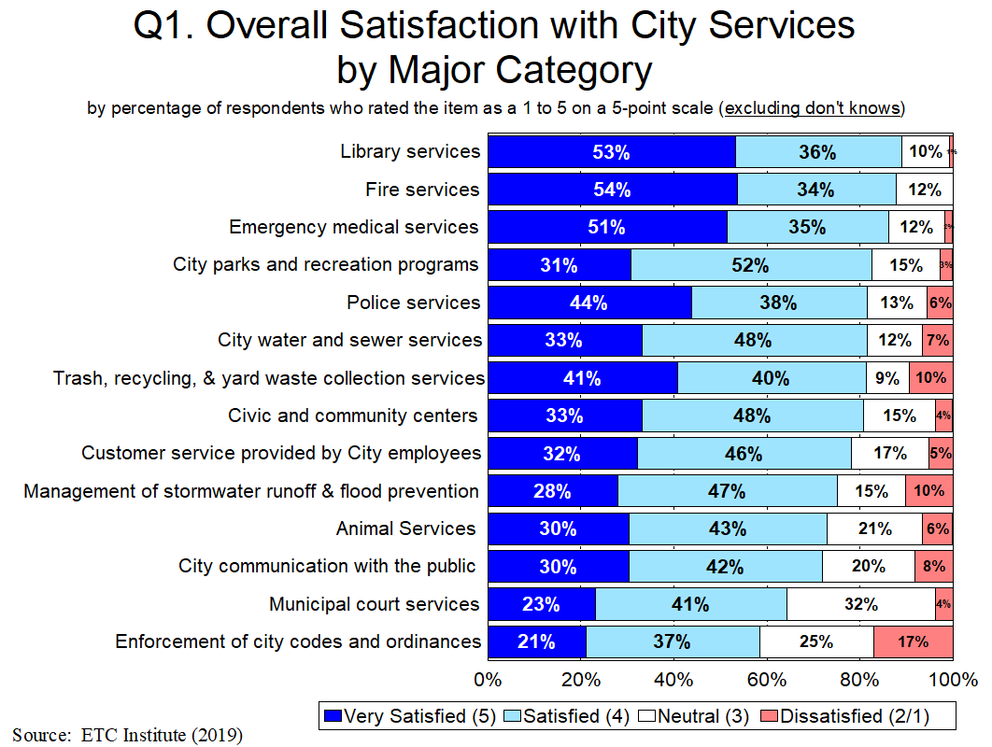
Less Than 20% Are Dissatisfied with All Major Categories of City Services

Slide 11
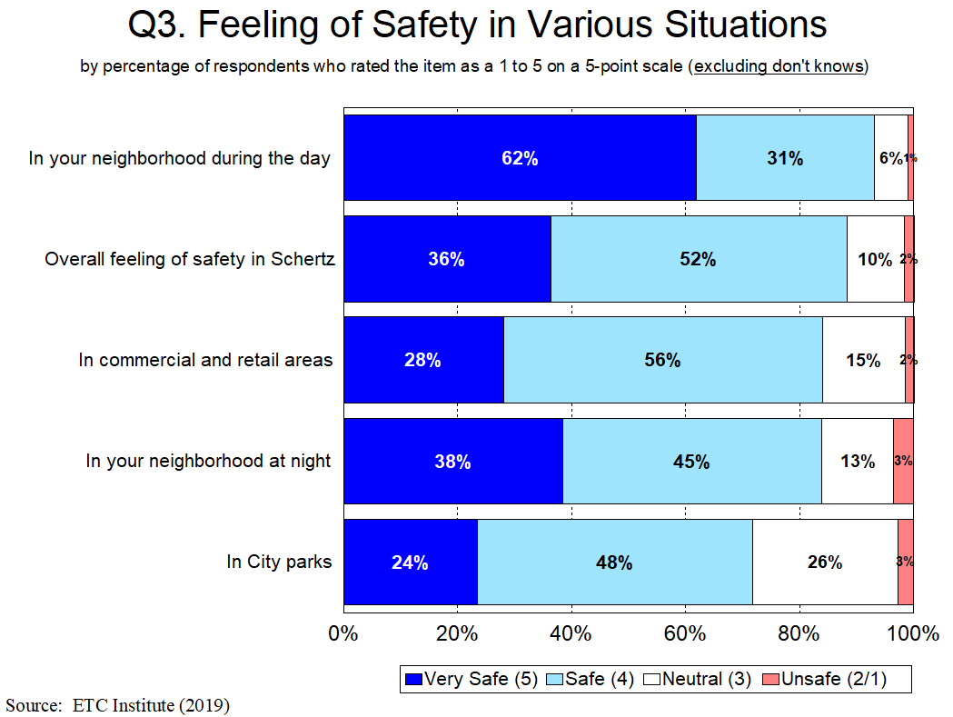
Residents Feel Safe in the City

Slide 12
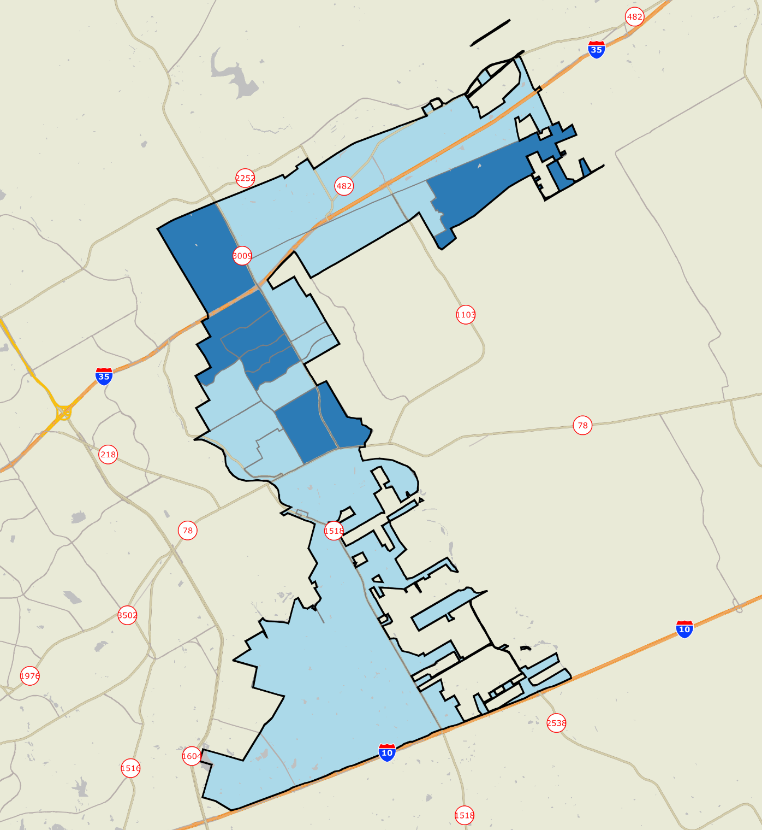


Overall Quality of Services Provided by the City of Schertz
All Areas Are in Blue, Indicating That Residents in All Parts of the City Are Satisfied with the Overall Quality of City Services
Legend
Mean rating on a 5-point scale
1.0-1.8 Very Dissatisfied
1.8-2.6 Dissatisfied
2.6-3.4 Neutral
3.4-4.2 Satisfied
4.2-5.0 Very Satisfied
No Response
ETC INSTITUTE

Slide 13
Major Finding #2
Satisfaction with City Services Is Much Higher in Schertz Than Other Communities

Slide 14
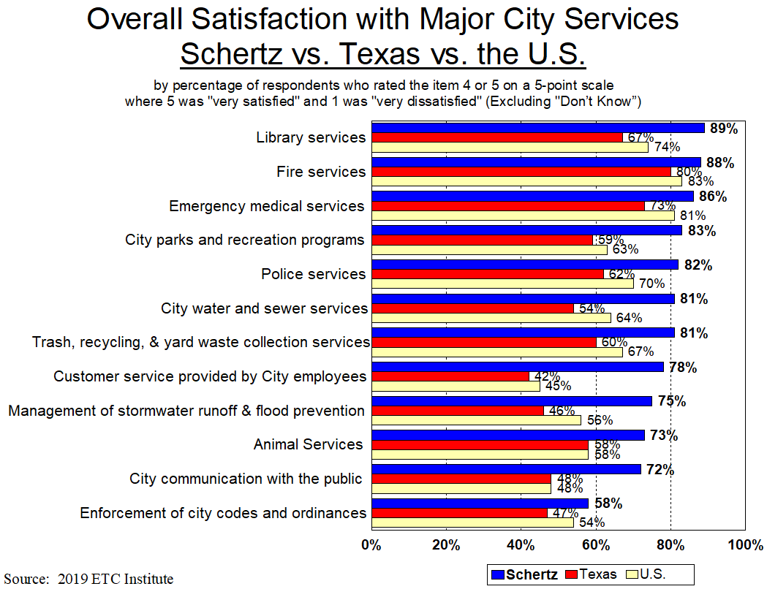
14
Significantly Higher: Significantly Lower:

Slide 15
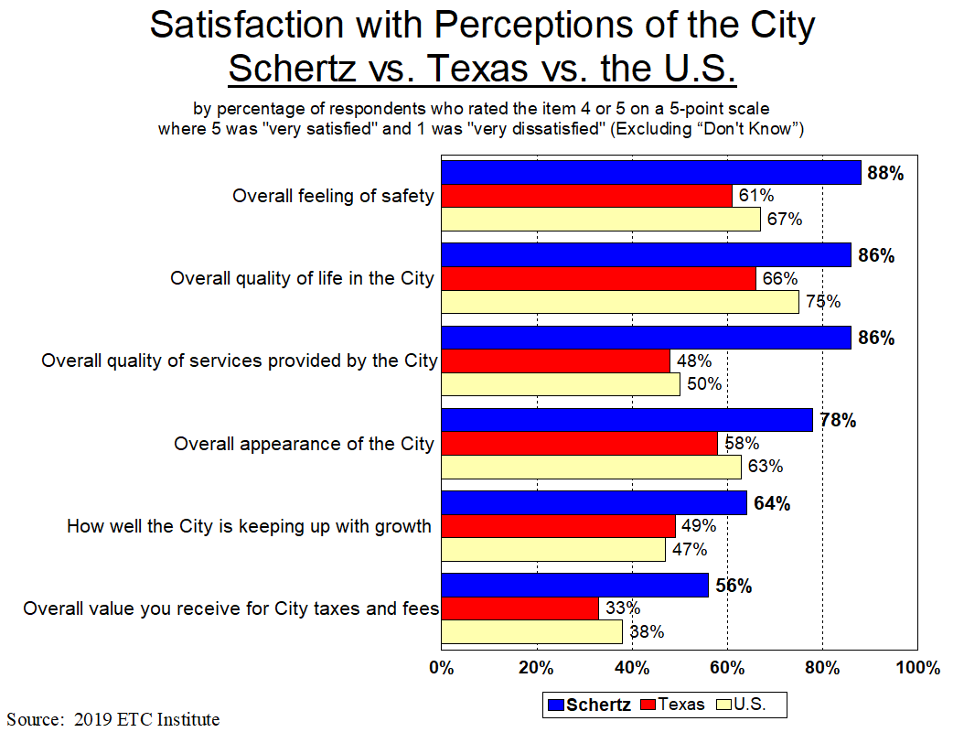
15
Significantly Higher: Significantly Lower:

Slide 16
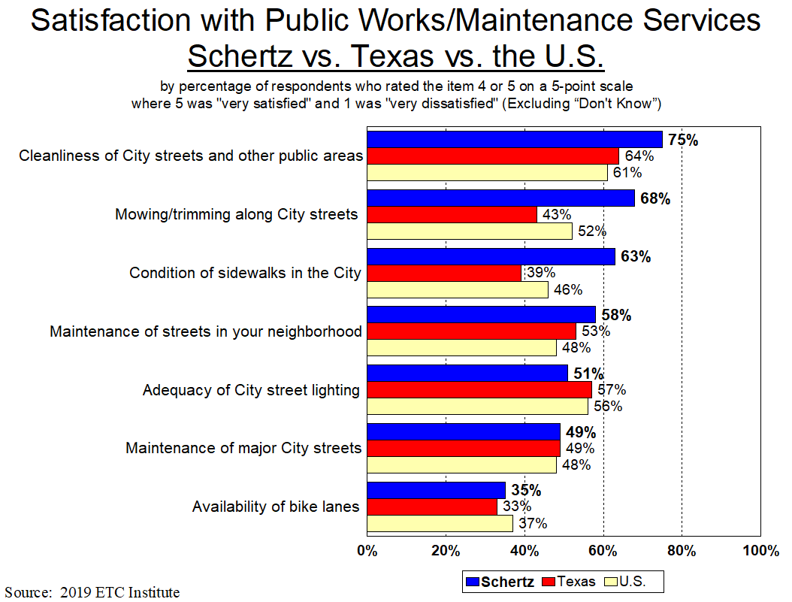
16
Significantly Higher: Significantly Lower:

Slide 17
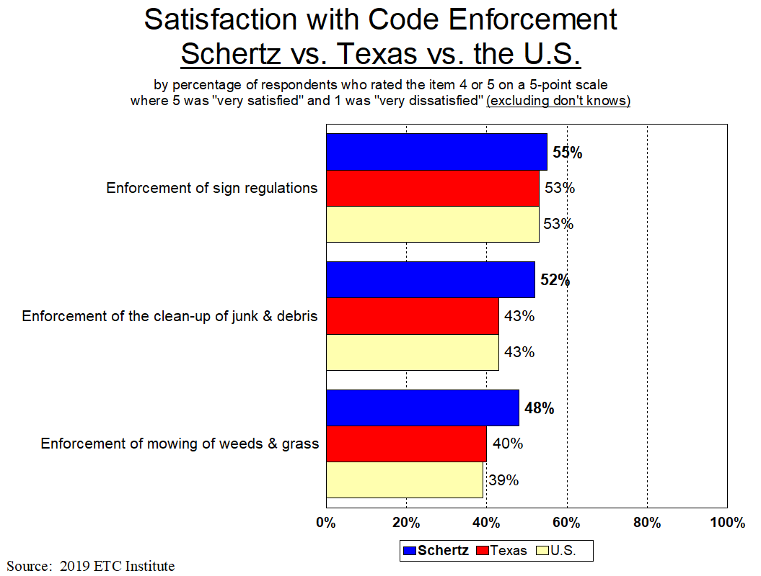
17
Significantly Higher: Significantly Lower:

Slide 18
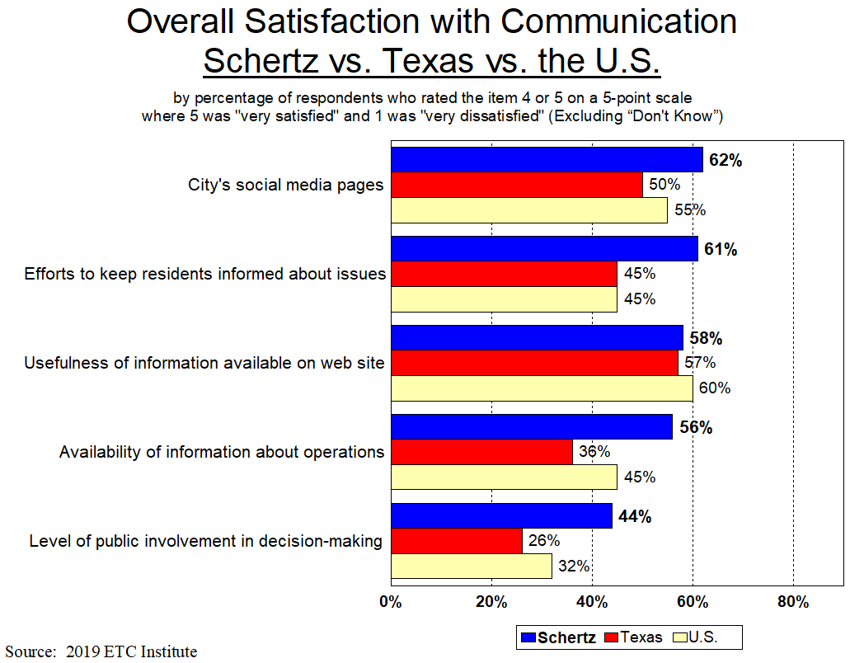
18
Significantly Higher: Significantly Lower:

Slide 19
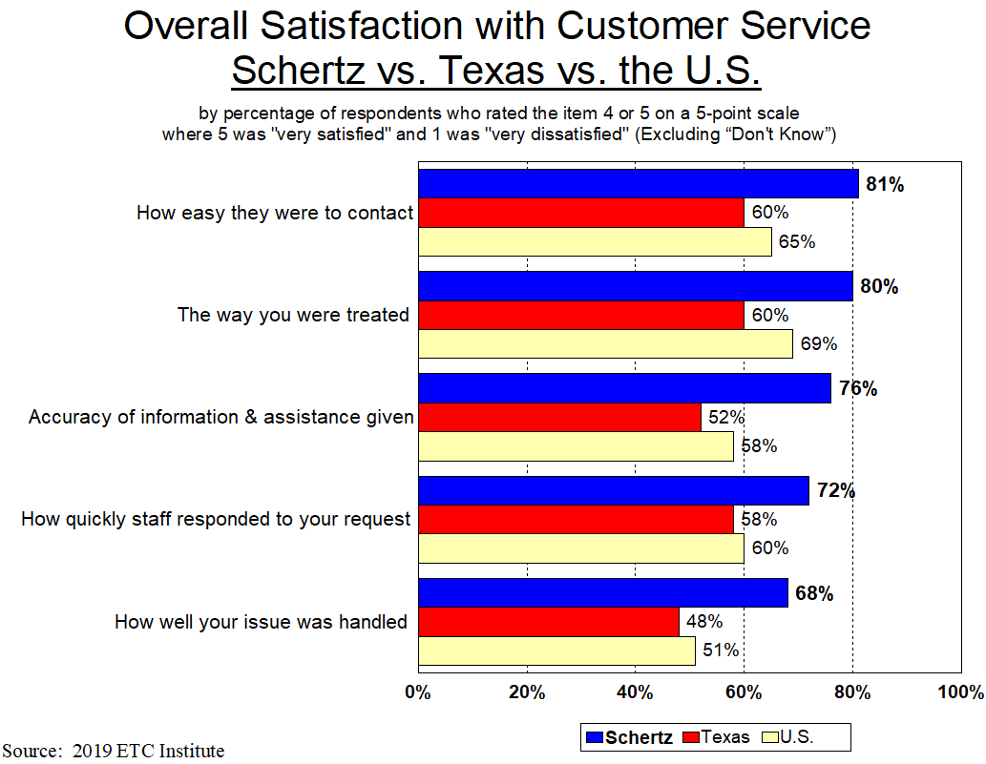
19
Significantly Higher: Significantly Lower:

Slide 20
Major Finding #3
The City Is Moving in the Right Direction

Slide 21
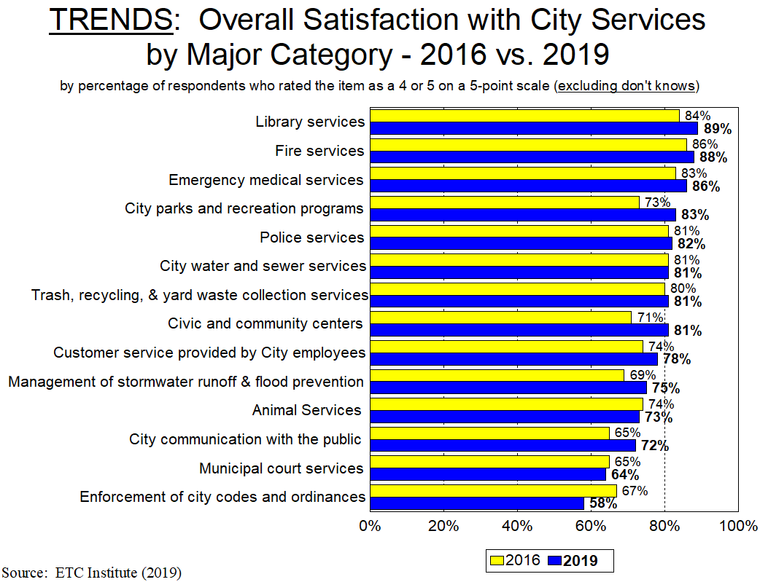
21
Significant Increases From 2016: Significant Decreases From 2016:

Slide 22
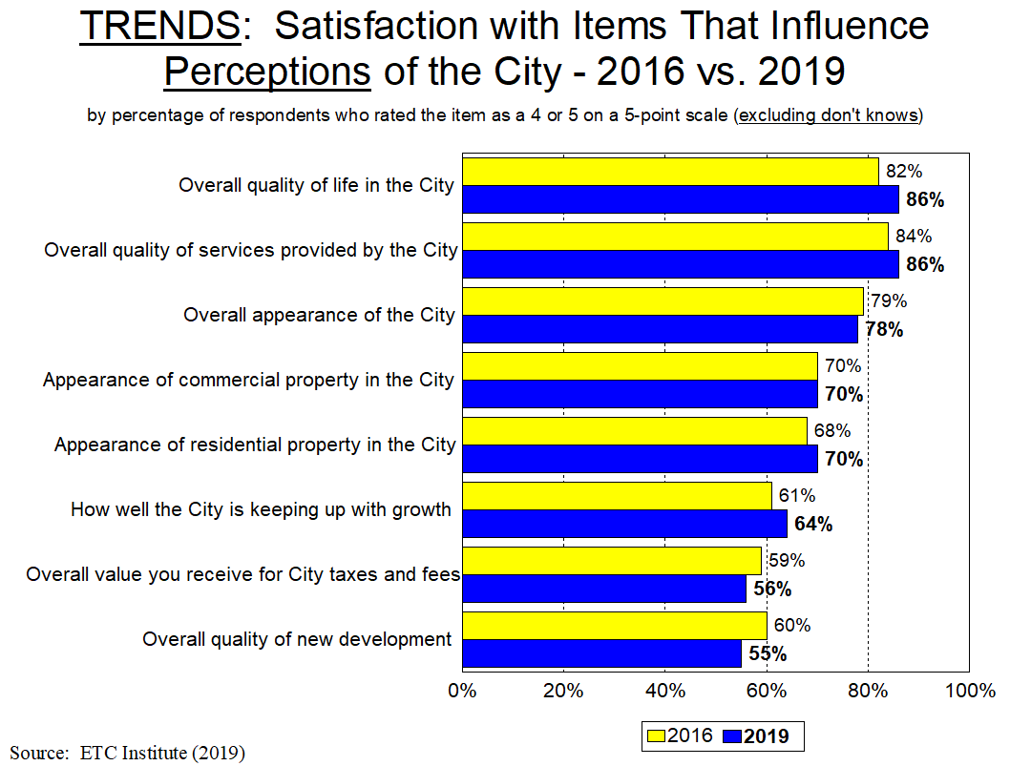
22
Significant Increases From 2016: Significant Decreases From 2016:

Slide 23
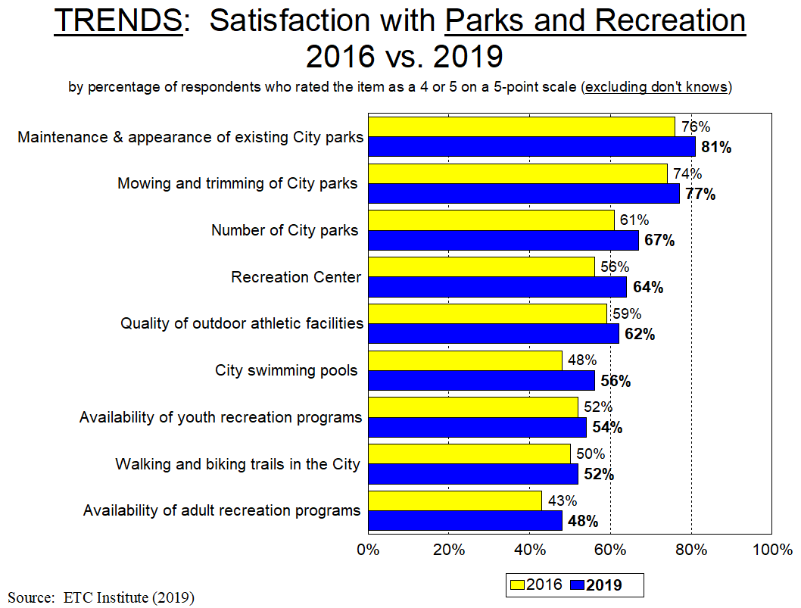
23
Significant Increases From 2016: Significant Decreases From 2016:

Slide 24
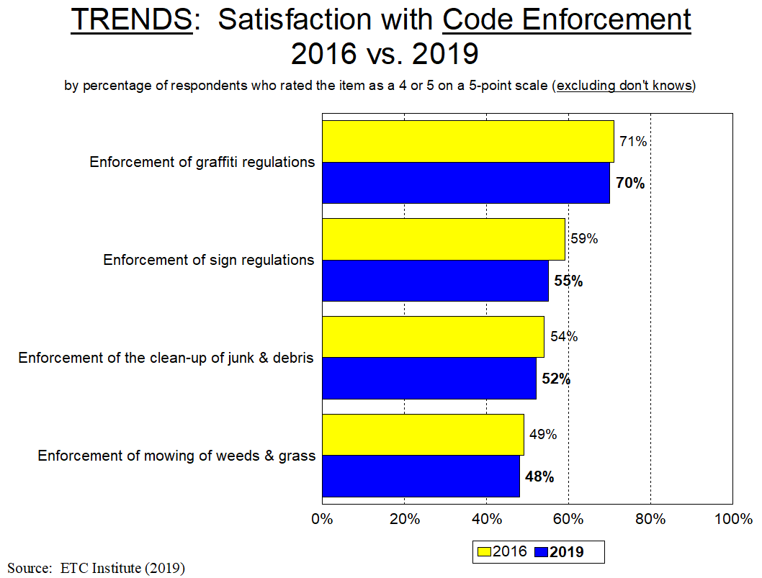
24
Significant Increases From 2016: Significant Decreases From 2016:

Slide 25
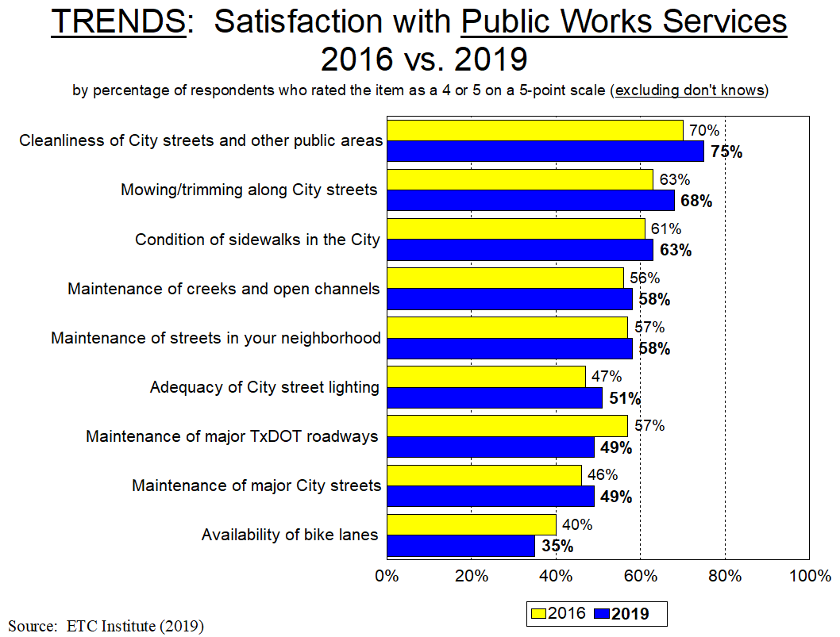
25
Significant Increases From 2016: Significant Decreases From 2016:

Slide 26
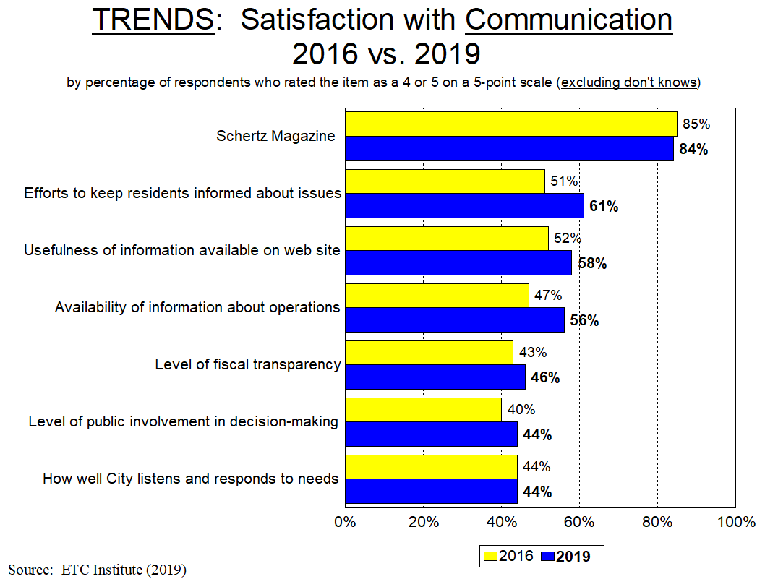
26
Significant Increases From 2016: Significant Decreases From 2016:

Slide 27
Major Finding #4
Top Community Priorities

Slide 28
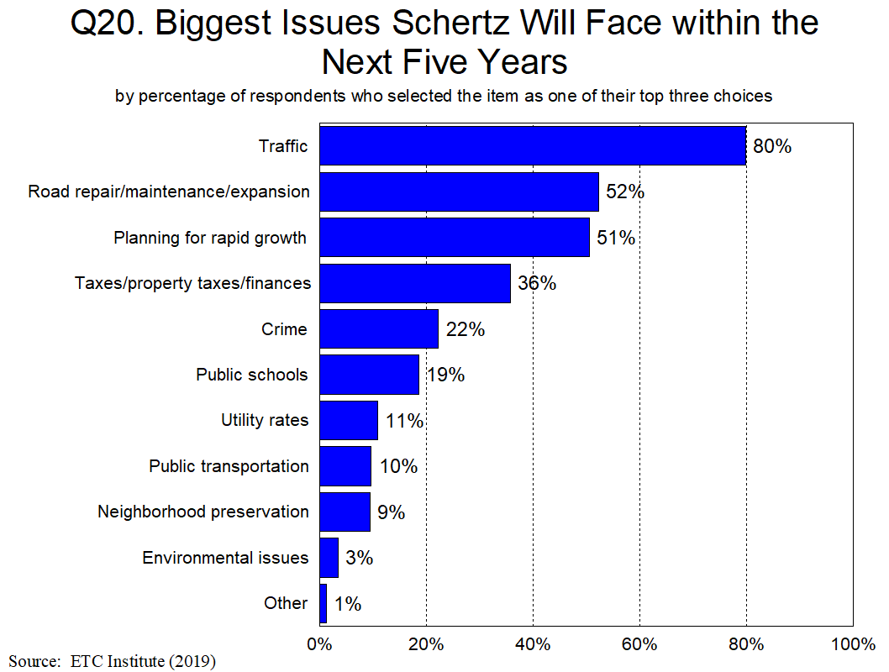
Biggest Issues Facing the City Over the Next Five Years: 1) Traffic, 2) Road Repair/Maintenance/Expansion, 3) Planning for Rapid Growth

Slide 29
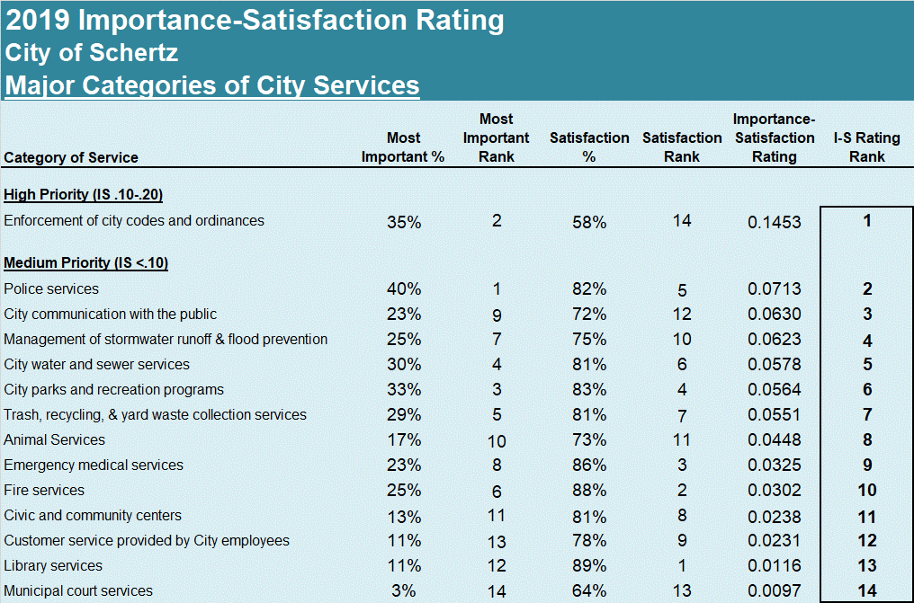
Overall Priorities:
29

Slide 30
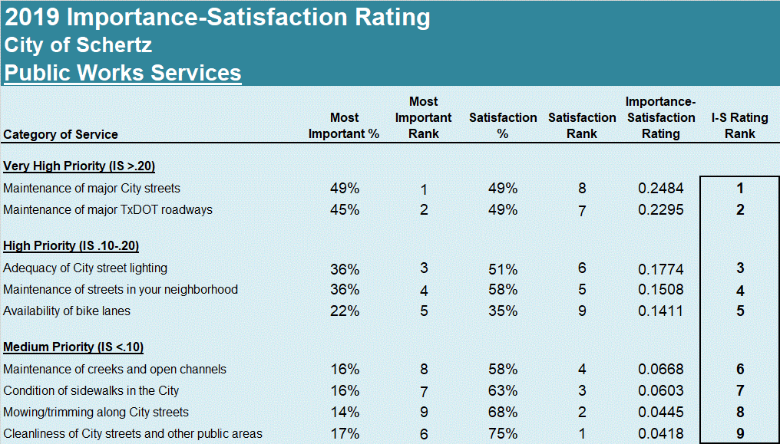
Public Works Priorities:
30

Slide 31
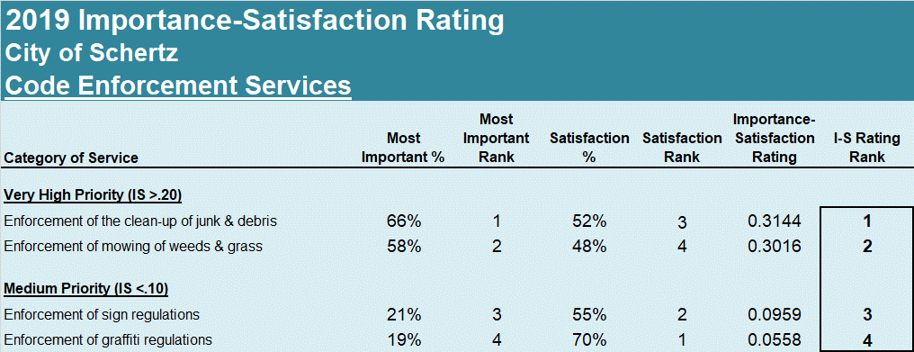
Code Enforcement Priorities:
31

Slide 32
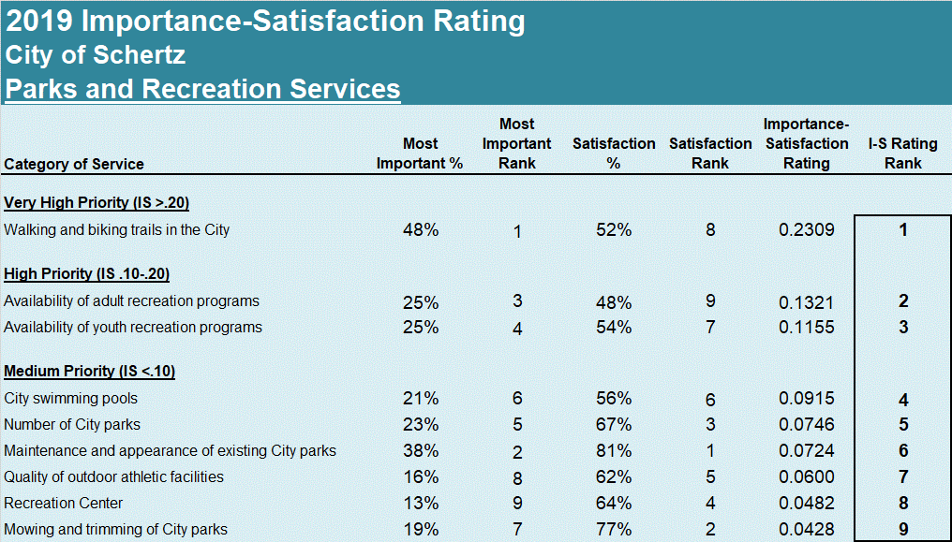
Parks and Recreation Priorities:
32

Slide 33
Other Findings

Slide 34
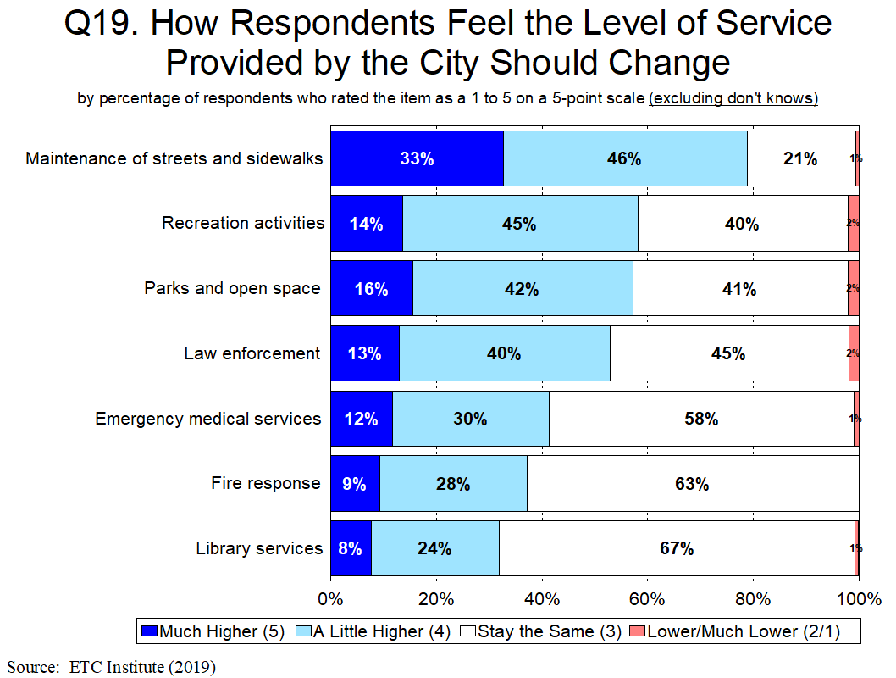

Slide 35
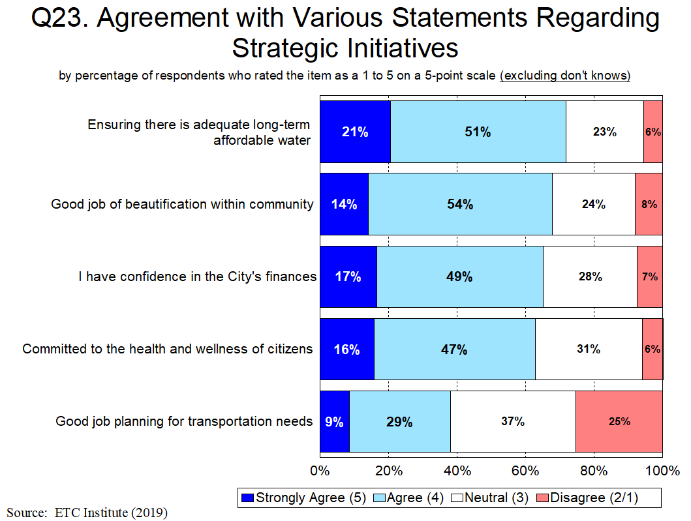

Slide 36
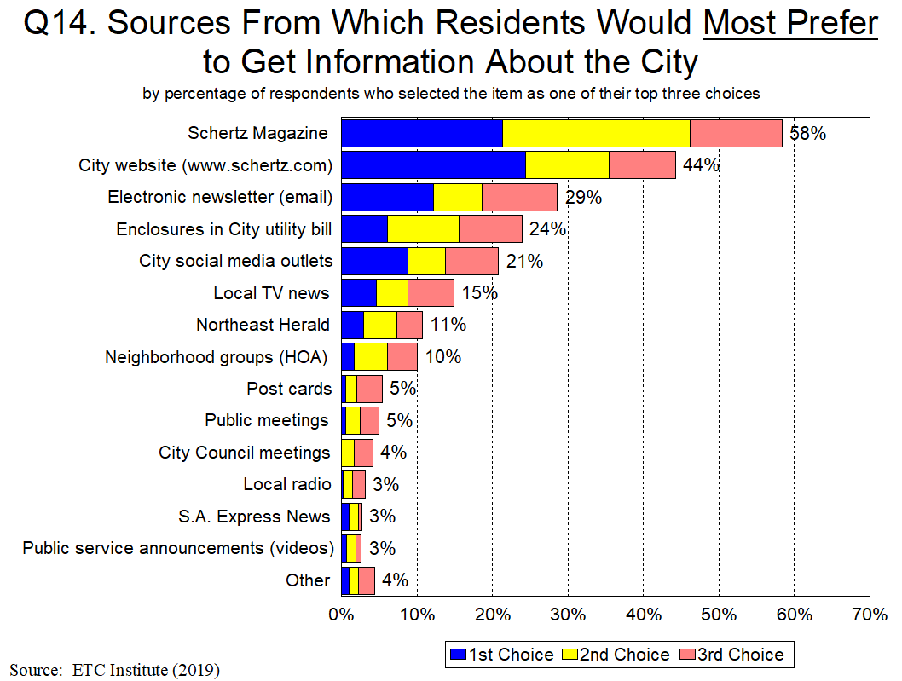

Slide 37
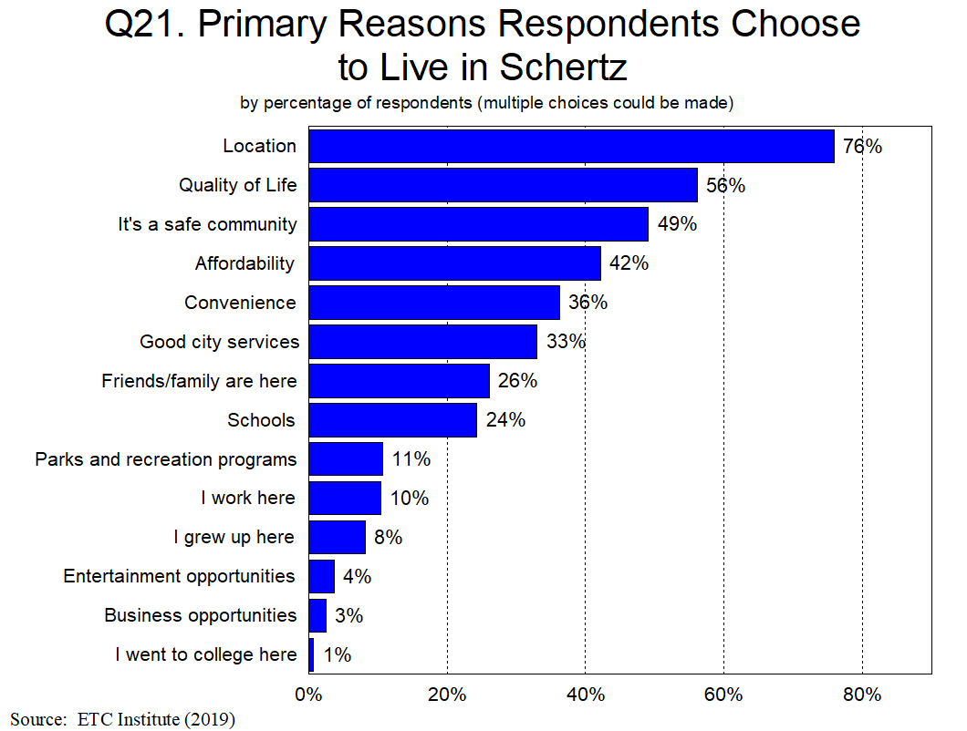

Slide 38
Summary

Slide 39
Summary
Residents Have a Very Positive Perception of the City
86% are satisfied with the overall quality of life in the City; only 2% are dissatisfied
The City Is Moving in the Right Direction
Satisfaction with City Services is Much Higher in Schertz Than Other Communities
Schertz rated above the U.S. Average in 43 of 50 areas, and above the Texas Average in 42 of 50 areas
Satisfaction with the Overall Quality of City Services rated 36% above the U.S. Average, and 38% above the Texas Average
Satisfaction with Customer Service from City Employees rated 33% above the U.S. Average and 36% above the Texas Average
Top Community Priorities:
Traffic
Road Repair/Maintenance/Expansion
Planning for Rapid Growth
Enforcing Codes and Ordinances

Slide 40
Questions?
THANK YOU!!

